Slide 1
Learn to Progam in C# 4.0
Using .NET Framework 4.0

Slide 2
Agenda – Day 1
.NET Framework Overview
Introducing Visual Studio 2008 / 2010
Core C# Programming Concepts

Slide 3
.NET Framework 3.0
Introducing the Building Blocks of the .NET Platform (the CLR, BCL)
An Overview of .NET Assemblies
Exploring an Assembly Using ildasm.exe
Understanding the Common Language Runtime

Slide 4
.NET Framework 3.0 Contd..
Understanding the Common Type System
Understanding the Common Language Specification
The Assembly/Namespace/Type Distinction
Deploying the .NET Runtime
The Role of the .NET Framework SDK

Slide 5
An Overview of .NET Assemblies
Win32 Execution Model
.NET Execution Model
Anatomy
Managed Code
Managed Module
Metadata
MSIL
Assembly

Slide 6
.NET Assemblies
C# Source Code File(s)
Basic Source Code File(s)
C++ Source Code File(s)
Fortran Source Code File(s)
C# Compiler
Basic Compiler
C++ Compiler
Fortran Compiler
Managed Assembly (IL and Metadata)
Managed Assembly (IL and Metadata)
Managed Assembly (IL and Metadata)
Managed Assembly (IL and Metadata)

Slide 7
Intermediate Language
All .NET compilers produce IL code
IL is CPU-independent machine language
IL is higher-level than most CPU machine languages
Developers can write in IL assembler (ILAsm.exe)

Slide 8
Hello World
using System;
class Program
{
static void Main()
{
Console.WriteLine("Hello World");
Console.ReadKey();
}
}

Slide 9
Program Structure
Namespaces
Contain types and other namespaces
Type declarations
Classes, structs structs, interfaces, , enums, and delegates
Members
Constants, fields, methods, properties, indexers, events, operators, constructors, destructors
* No declaration order dependence

Slide 10
Structure of C# Programs
Program
File F1.cs
File F2.cs
File F3.cs

Slide 11
Understanding CLR
Memory Management
Code Access Security
CTS : Ensures Type Safety
Just In Time Compilation
CLS: Supports unlimited Languages
Profiling and Debugging

Slide 12
Base Class Library
Set of Window's utility classes designed around providing developers pre-built code for executing common programming tasks.
Organized around a namespace hierarchy.
Classes include functionality for file I/O, printing, font management, security, data access, threading, Web services, String manipulation, messaging, Windows Forms, and the list goes on and on.

Slide 13
CTS : Common Type System
A set of rich types that are built directly into the CLR.
It is the rule system that all languages (and developers) must adhere to when defining types.
The system enforces how types are used (type safety) and managed within the runtime.
The CTS is one of the key components to ensuring language-to-language interaction.

Slide 14
CLS : Common Language Specification
Defines the basic set of features that each language must implement for it to be considered .NET compliant.
Group of rules that provide language and compiler authors a guide when creating or porting a language targeted at the .NET Framework CLR

Slide 15
CLR Execution Model
Compilation
Source
code
Language
Compiler
MSIL &
Metadata
Before installation or the first time each method is called
Native
code
JIT
Compiler
Execution

Slide 16
Assemblies
An Assembly is the managed equivalent of an EXE/DLL
It is the unit of versioning, security, and deployment
Parts of an Assembly file
Windows PE header
CLR header (Information interpreted by the CLR and utilities)
Metadata (Type definition and reference tables)
Intermediate Language (code emitted by compiler)

Slide 17
.NET PE File
PE/COFF Headers
CLR Header
CLR Data
Metadata
IL (Code)
Native Image Section
data, .rdata, .rsrc, .text

Slide 18
Application Domain
Defined :
Application Domain is a construct in the CLR that is the unit of isolation for an application.

Slide 19
App Domain Guarantees
An App domain is lighter than a process.
App domains are appropriate for scenarios that require isolation without the heavy cost associated with running an application within a process.
A process runs exactly one application.
In contrast, the CLR allows multiple applications to be run in a single process by loading them into separate application domains. CLR verifies that user code in an application domain is type safe

Slide 20
Default Domain
An Application Domain created automatically by the CLR every time it is initialized in a process.
The Default Domain is not unloaded until the process shuts down.

Slide 21
Running managed code in a Process
3 Steps
Get CLR loaded and initialized using a CLR host.
Create application domains in which the user code will execute.
Execute user code in one or more Application Domains created in the previous step.

Slide 22
Type Sytem
Value Types

Slide 23
Value Types: Simple types
Signed integral: sbyte, short, int, long
Unsigned integral: byte, ushort, uint, ulong
Unicode characters: char
IEEE floating point: float, double
High-precision decimal: decimal
Boolean: bool
Nullable types : Extensions of all other value types with a null value

Slide 24
Value Types: User-defined types
Enum types:Enumerators are useful when a variable can only have a specific set of values
Declare an Enumeration: use the enum keyword followed by the enum variable name and initial values.
enum State { off, on }

Slide 25
Value Types: User-defined types
Struct types User-defined types of the form
struct Point{
public int x, y; // fields
public Point(int x, int y) { this.x = x; this.y = y; }// constructor
public void MoveTo(int a, int b) { x = a; y = b; }// methods
Create objects that behave like built-in value types.
Because structs are stored inline and are not heap allocated, there is less garbage collection pressure on the system than there is with classes.

Slide 26
OOPs…
Simplify Application Development
Relates code objects to real world objects
Creates more flexible applications

Slide 27
Classes
‘Blueprint’ or ‘recipe’ for an object
Making a distinction between:
A blueprint and a house
A recipe and roti
A sheet of music and a performance

Slide 28
Objects
Instance of a class.
You can create many objects from a single class, each object having different property values, but still undeniably created from the same class.
* simple button Example

Slide 29
Properties
Attributes of our class.
Each instance of out class(object) can have different property values, but they all share the same property definitions.
Properties consists of
Fields – Variables that hold our property values
Property Get and Set Statements – that allow for accessing and modifying the underlying field.

Slide 30
Methods
“Actions” that can be performed by our class.
Constructors
Special methods that execute each time a new instance of a class(an object) is created.
Use constructors to initialize the state of your new object
Overloading
Providing more than one method with the same name, but different ‘Method signatures’ as a convenience to calling the method.

Slide 31
Object Oriented Programming
The History of OOP
An approach to software development in which the structure of the software is based on objects interacting with each other to accomplish a task.
This interaction takes the form of messages passing back and forth between the objects.
In response to a message, an object can perform an action or method.

Slide 32
Object Oriented Programming
Three primary concepts
Inheritance
Encapsulation
Polymorphism

Slide 33
Characteristics of OOP
An object is a structure for incorporating data and the procedures for working with that data.
Encapsulation means that a group of related properties, methods, and other members are treated as a single unit or object.
Inheritance describes the ability to create new classes based on an existing class.
Polymorphism means that you can have multiple classes that can be used interchangeably, even though each class implements the same properties or methods in different ways.

Slide 34
Inheritance
Ability to define a class that inherits state and behavior from other classes(base class)
To reuse code
Provide features that enable reuse of code through extending the functionality of the program units
The derived class can specialize the base class by adding properties and methods, override properties and methods, etc.

Slide 35
Syntax
public abstract class Person //Base Class
{
private string firstName = string.Empty ;
private string lastName = string.Empty;
private byte age = 0;
private bool isMajor = false;
private DateTime dob;
public class Employee : Person,Idisposable //Derived class
{ Public Employee()
{
this.emplyoeeID = Guid.NewGuid();
}

Slide 36
Xtra:
Constructors are not inherited
Inherited methods can be overridden
Single inheritance: a class can only inherit from one base class, but it can implement multiple interfaces.
A class can only inherit from a class, not from a struct.
Structs cannot inherit from another type, but they can implement multiple interfaces.
A class without explicit base class inherits from object

Slide 37
Asignments and Type Checks
class A {.}..
class B : A {...}
class C: B {...}
Assignments
A a = new A();// static typeof a: the type specified in the declaration (here A)
a = new B(); // dynamic type of a is B
a = new C(); // dynamic type of a is C
B b = a; // forbidden; compilation error

Slide 38
Run time type checks
a = new C();
if (a is C) ...// true, if dynamic type of a is C or a subclass; otherwise false
if (a is B) ...// true
if (a is A) ...// true, but warning because it makes no sense
a = null;
if (a is C) ...// false:
if a== null, a is T always returns false

Slide 39
Overriding Members
C# Modifier | Definition
virtual | Allows a class member to be overridden in a derived class.
override | Overrides a virtual (overridable) member defined in the base class.
abstract | Requires that a class member to be overridden in the derived class.
new Modifier | Hides a member inherited from a base class

Slide 40
A derived class can override a base class member only if the base class member is declared as virtual or abstract.
The derived member must use the override keyword to explicitly indicate that the method is intended to participate in virtual invocation

Slide 41
Constructors and Inheritance
Implicit call of the base class constructor
class A { } class B : A { public B(int x) { } } | class A { public A() { } } class B : A { public B(int x) { } } | class A { public A(int x) { } } class B : A { public B(int x) { } } | class A { public A(int x) { } } class B : A { public B(int x) :base(x) { } }
B b = new B(3); | B b = new B(3); | B b = new B(3); | B b = new B(3);
OK Default Constr. A() B(int x) | Ok A() B(int X) | Error does not contain a constructor that takes 0 | Ok A(int X) B(int X)

Slide 42
Encapsulation
Ability to hide some of the details of inner working of a class
Expose just what other people need to get the work done and seal from low level details
A language construct that facilitates the bundling of data with the methods operating on the data
Provide a way to manage complex problems by allowing you to abstract or identify the objects involved in the problem.

Slide 43
Access Modifiers
Access modifiers define the level of access that certain code has to class members such as methods and properties.
Apply the desired access modifier to each member, otherwise the default access type is implied.

Slide 44
Access Modifiers
Access modifier | Description
Public | A public member is accessible from anywhere. This is the least restrictive access modifier.
Protected | A protected member is accessible from within the class and all derived classes. No access from the outside is permitted.
Private | A private member is accessible only from within the same class. Not even derived classes can access it.
Internal | An internal member is accessible from within any part of the same Microsoft .NET-based assembly. You can think of it as public at the assembly level and private from outside the assembly.
protected internal | An internal protected member is accessible from within the current assembly or from within types derived from the containing class.

Slide 45
Polymorphism
Ability to treat related objects in a similar manner
Enable multiple implementations of the same behaviors so that the appropriate implementation can be executed based on the situation.

Slide 46
Examine Inheritance
Demo
Override Keyword : override keyword allows a method to provide a new implementation of a method inherited from a base class
Virtual Methods : Having virtual modifier as part of method signature, the method can be overridden by any C# class

Slide 47
Abstract Classes
Abstract modifier to classes that prohibits other classes from instantiating objects of a base class.
You can still inherit characteristics from this base class in subclasses

Slide 48
Abstract Methods
An abstract class may contain one or more abstract methods.
Abstract methods are only permitted in abstract classes.
An abstract method is one that does not include the implementation details for the method.

Slide 49
Sealed Classess
Sealed classes cannot be extended,but they can inherit from other classes.
Override methods can be declared as sealed individually.
Reason:
–Security (avoids inadvertent modification of the class semantics)

Slide 50
Interface
Interfaces contain no implementation details for any of their members; all their members are considered abstract
Syntax:
public interface IFaculty
{
string Department { get; set; }
List<Course> RetrieveTeachingAssignments();
List<Course> Teaches { get; set; }
void AgreeToTeach(Course s);
}

Slide 51
Xtra
Purely abstract class; only signatures, no implementation.
May contain methods, properties, indexers and events(no fields, constants, constructors, destructors, operators, nested types).
Interface members are implicitly public abstract(virtual).
Interface members must not be static.
Classes and structs may implement multiple interfaces.
Interfaces can extend other interfaces

Slide 52
method-modifier:
new public protected internal private static virtual sealed override abstract extern

Slide 53
Implementation inheritance means that a type derives from a base type, taking all the base type ’ s member fields and functions.
Interface inheritance means that a type inherits only the signatures of the functions and does not inherit any implementations.
This type of inheritance is most useful when you want to specify that a type makes certain features available.

Slide 54
Delegates

Slide 55
Delegates :Defined
A delegate is a type-safe object that points to another method (or possibly a list of methods) in the application
In the .NET Framework, callbacks are still possible, and this functionality is accomplished in a much safer and more object-oriented manner using delegates.
A delegate maintains three important pieces of information:
The address of the method on which it makes calls
The parameters (if any) of this method
The return type (if any) of this method

Slide 56
Xtra:
A delegate variable can have the value null(no method assigned).
If null, a delegate variable must not be called (otherwise exception).
Delegate variables are first class objects: can be stored in a data structure, passed as parameter, etc.

Slide 57
Multicast Delegate
A delegate variable can hold multiple values at the same time
c1.AboutToBlow += CarIsAlmostDoomed;
c1.AboutToBlow += CarAboutToBlow;
Note:
if the multicast delegate is a function, the value of the last call is returned
if the multicast delegate has an outparameter, the parameter of the last call is returned

Slide 58
Events: Special Delegate Variables
Why events instead of normal delegate variables?
Only the class that declares the event can fire it(better abstraction).

Slide 59
Garbage Collection
UNDERSTANDING OBJECT LIFETIME

Slide 60
Classes, Objects, and References
Class is nothing more than a blueprint that describes how an instance of this type will look and feel in memory.
Classes, of course, are defined within a code file (which in C# takes a *.cs extension by convention).
Once a class is defined, you can allocate any number of objects using the C# new keyword
The new keywosrd returns a reference to the object on the heap, not the actual object itself.

Slide 61
The Basics of Object Lifetime
When you are building your C# applications, you are correct to assume that the .NET runtime environment will take care of the managed heap without your direct intervention.
Rule Allocate a class instance onto the managed heap using the new keyword and forget about it.

Slide 62
The Role of Application Roots
References to any static objects/static fields
References to local objects within an application’s code base
References to object parameters passed into a method
References to objects waiting to be finalized
Any CPU register that references an object

Slide 63
Understanding Object Generations
Generation 0: Identifies a newly allocated object that has never been marked for collection.
Generation 1: Identifies an object that has survived a garbage collection (i.e., it was marked for collection but was not removed due to the fact that the sufficient heap space was acquired).
Generation 2: Identifies an object that has survived more than one sweep of the garbage collector.

Slide 64
The System.GC Type
System.GC that allows you to programmatically interact with the garbage collector using a set of static members
Typically, System.GC is used when you are creating classes that make internal use of unmanaged resources.

Slide 65
Forcing GC to Collect
GC.Collect();
GC.WaitForPendingFinalizers();

Slide 66
Building Disposable Objects
As an alternative to overriding Finalize()
Your class could implement the IDisposable interface, which defines a single method named Dispose():
static void DisposeFileStream()
{
FileStream fs = new FileStream("myFile.txt", FileMode.OpenOrCreate);
fs.Dispose();
}

Slide 67
Finalize ~<Class>
Finalize() method is to ensure that a .NET object can clean up unmanaged resources when it is garbage-collected
Finalize() method is to ensure that a .NET object can clean up unmanaged resources when it is garbage-collected

Slide 68
Array
An array is a set of data items, accessed using a numerical index.
More specifically, an array is a set of contiguous data points of the same type (an array of ints, an array of strings, an array of SportsCars, and so on)
The number used in the array declaration represents the total number of items, not the upper bound.

Slide 69
Conversion
A conversion enables an expression of one type to be treated as another type.
Conversions can be implicit or explicit, and this determines whether an explicit cast is required.
For instance, the conversion from type int to type long is implicit, so expressions of type int can implicitly be treated as type long.
The opposite conversion, from type long to type int, is explicit and so an explicit cast is required

Slide 70
Collections
System.Collections

Slide 71
ArrayList Class
Represents a dynamically sized collection of objects listed in sequential order.
The ArrayList is not guaranteed to be sorted. You must sort the ArrayList
Syntax
ArrayList myAL = new ArrayList();
myAL.Add("Hello");
myAL.Add("World");

Slide 72
BitArray Class
Manages a compact array of bit values, which are represented as Booleans, where true indicates that the bit is on (1) and false indicates the bit is off (0).

Slide 73
Hashtable Class
Represents a collection of key/value pairs that are organized based on the hash code of the key.
Each element is a key/value pair stored in a DictionaryEntry object.
A key cannot be a null reference, but a value can be.
Duplicate keys are not allowed, can have duplicate values.

Slide 74
Hashtable Class contd..
The Item property is the default property
Create Hashtable
Hashtable openWith = new Hashtable();
Accessing elements, The Item property is the default property
openWith["rtf"]
The default Item property can be used to change the value
openWith["rtf"] = "winword.exe";
ContainsKey can be used to test keys before inserting

Slide 75
Queue Class
Represents a first-in, first-out collection of objects.
Queues are useful for storing messages in the order they were received for sequential processing.
Objects stored in a Queue are inserted at one end and removed from the other

Slide 76
Queue Class Contd..
Queue.Enqueue Method Adds an object to the end of the Queue
Queue.Dequeue Method Removes and returns the object at the beginning of the Queue
Queue.Peek Method Returns the object at the beginning of the Queue without removing it.

Slide 77
SortedList Class
Represents a collection of key/value pairs that are sorted by the keys and are accessible by key and by index.
The index sequence is based on the sort sequence.
When an element is added, it is inserted into SortedList in the correct sort order, and the indexing adjusts accordingly.
When an element is removed, the indexing also adjusts accordingly.
Therefore, the index of a specific key/value pair might change as elements are added or removed from the SortedList object.

Slide 78
Stack Class
A last-in, first-out (LIFO) stack providing push and pop (and peek) functionality
The capacity of a Stack is the number of elements the Stack can hold.
As elements are added to a Stack, the capacity is automatically increased as required through reallocation.
Stack accepts a null reference as a valid value and allows duplicate elements.

Slide 79
System.Collections.Specialized
StringCollection Class : Represents a collection of strings.
StringDictionary Class: Implements a hash table with the key and the value strongly typed to be strings rather than objects
ListDictionary Class:Implements IDictionary using a singly linked list. Recommended for collections that typically contain 10 items or less.
HybridDictionary Class: A collection that uses a ListDictionary for storage when the number of items in the collection is small, and then migrates the items to a Hashtable for large collections

Slide 80
Review Collections
System.Collections and System.Collections.Specialized classes can result in some poorly performing code
Classic collection classes are not type safe because they were developed to operate on System.Objects
Given these (and other) issues, .NET 2.0 introduced a brand new set of collection classes, which are packaged up in the System.Collections.Generic namespace.

Slide 81
Steps for Boxing & UnBoxing
A new object must be allocated on the managed heap.
The value of the stack-based data must be transferred into that memory location.
When unboxed, the value stored on the heap-based object must be transferred back to the stack.
The now unused object on the heap will (eventually) be garbage collected.

Slide 82
Use Generic Collection classes
Rectify Boxing/UnBoxing penalties
Lack of type Safety
To avoid building a custom collection

Slide 83
Generics Problem Statement
Problem 1
Stack stack = new Stack();
stack.Push(1);
stack.Push(2);
int number = (int)stack.Pop();
Problem 2
Stack stack = new Stack();
stack.Push(1);
//This compiles, but is not type safe, and will throw an exception:
string number = (string)stack.Pop();

Slide 84
Benefits of Generics
Generics provide better performance because they do not result in boxing or unboxing penalties.
Generics are more type safe because they can only contain the type of type you specify.
Generics greatly reduce the need to build custom collection types because the base class library provides several prefabricated containers.
NOTE: Only classes, structures, interfaces, and delegates can be written generically; enum types cannot

Slide 85
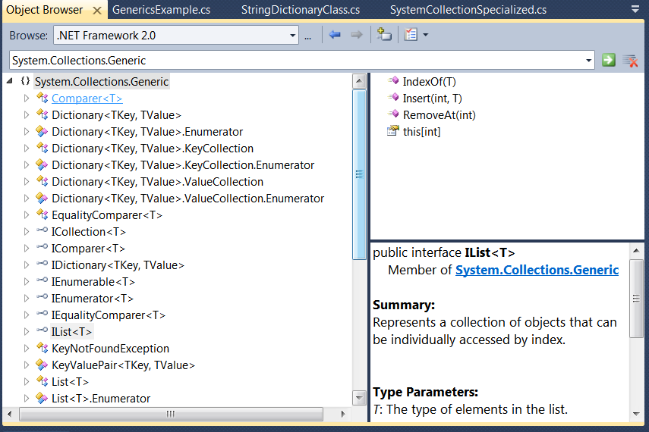
< > ?

Slide 86
What Are Generics?
Generics allow you to define type-safe classes without compromising type safety, performance, or productivity.
You implement the server only once as a generic server, while at the same time you can declare and use it with any type.
To do that, use the < and > brackets, enclosing a generic type parameter.

Slide 87
Example:
Stack<int> stack = new Stack<int>();
stack.Push(1);
stack.Push(2);
int number = stack.Pop();

Slide 88
System.Collections.Generic Namespace
Dictionary<TKey, TValue>
List<T>
LinkedList<T>
Queue<T>
SortedDictionary<TKey,TValue>
SortedList<T>
Stack<T>

Slide 89
Creating Custom Generic Methods
static void Swap(ref int a, ref int b)
{
int temp;
temp = a;
a = b;
b = temp;
}
static void Swap(ref Person a, ref Person b)
{
Person temp;
temp = a;
a = b;
b = temp;
}

Slide 90
Generic Method
Generic method is defined by specifying the type parameters after the method name
static void Swap<T>(ref T a, ref T b)
{
T temp;
temp = a;
a = b;
b = temp;
}

Slide 91
Constraining Type Parameters
where T : struct
where T : class
where T : new()
where T : NameOfBaseClass
where T : NameOfInterface

Slide 92
Delegate
A delegate is a type-safe object that points to another method (or possibly a list of methods) in the application
A delegate maintains three important pieces of information:
The address of the method on which it makes calls
The parameters (if any) of this method
The return type (if any) of this method

Slide 93
SQL

Slide 94
SQL
Introduction
RDBMS
Introduction to SQL Server
Data Definition Language
Create & Alter and Drop Table
Implementing Constraints
Create & Alter and Drop Constraints
Joins
SubQuery

Slide 95
SQL
Stands for Structural Query Language
Accepted as Standard Language(ISO,ANSI) for Relational database
Non Procedural Language
(what should be done/not how it should be done)
Interface used to access data from database

Slide 96
Select Command Query
Syntax : SELECT (column_list )
FROM (table_list )
WHERE (row restriction)
GROUP BY (attribute names)
HAVING (group restriction)
ORDER BY (attribute name or names)

Slide 97
SQL Datatype
The different Datatypes available are:
CHAR :To store character type of data
VARCHAR :Similar to CHAR but can store variable number of characters
NUMERIC :Stores fixed and floating point numbers
DATE : Stores point-in-time values (i,e. date and time) in a table

Slide 98
Commands
1. To Create Table
Create Table Tablename
(
field Name DataType (Size)
)
2. To Display The Content Of Table
Select * From Tablename;
3. To Display Structure Of Table
Desc Tablename;
4.To Display All Tables (For Current User)
Select * From Tab;

Slide 99
OPERATORS USED WITH WHERE
OPERATOR TYPE | OPERATOR
COMPARISON | =,<=,>=,<>
LOGICAL | AND,OR,NOT
SPECIAL | IN,NOT IN ,BETWEEN
PATTERN MATCHING | LIKE,NOT LIKE
NULL | IS NULL,IS NOT NULL

Slide 100
Pattern Matching(Like operator)
COMMAND | DESCRIPTION
S% | BEGIN WITH S
%S | END WITH S
_S% | SECOND LETTER STARTING WITH S
_____ | EXACTLY 5 LETTERS

Slide 101
Aggregate Functions
COUNT(*)
MIN
MAX
AVG
SUM
DATE
CHARACTER
NUMERIC
NUMERIC
GROUP BY
HAVING
TO GROUP RESULTS
TO RESTRICT GROUPS

Slide 102
Aggregate Functions
The aggregate functions produce a single value for an entire
group or table
COUNT determines the number of rows or non NULL
column values
SUM determines the sum of all selected columns
MAX : determines the largest of all selected values of a
column
MIN : determines the smallest of all selected values of a
column
AVG : determines the average of all selected values of a
column
In all the above functions, NULLs are ignored

Slide 103
Group by and Having Clause
The GROUP BY clause is used to divide the rows in a table
into smaller groups
The GROUP BY clause is used with SELECT clause
SQL groups the result after it retrieves the rows from a table
Conditional retrieval of rows from a grouped result is possible
with the HAVING clause
The syntax for GROUP BY clause is
SELECT[DISTINCT] <column list> | <expr>
FROM <table>[,<table>] [WHERE condition]
GROUP BY <col | expr>
[HAVING <cond>]
ORDER BY clause can be used to order the final result

Slide 104
Order of Execution
It chooses rows based on the where clause
It groups those rows together based on the group by.
It calculates the results of the group functions for each group.
It chooses and eliminates groups based on the having clause
It orders the groups based on the results of the group
functions in the order by. The order by must use either a
group function or a column in the group by clause.

Slide 105
JOINS
Joins are used to combine columns
from different tables
From clause will have table formats (O) eg: EMP,DEPT or EMP E,DEPT D
Type of Join Specified (S)
Join condition uses Where(O), ON(S)
Column Names should have format
eg: emp.ename or e.ename

Slide 106
JOIN SYNTAX
SQL 99 SYNTAX (S)
Inner
Outer Join(Left,Right,Full)
Cross
Natural
Using

Slide 107

EQUI JOIN/INNER JOIN
* Used for tables with common columns
* Uses = operator
SQL 99 SYNTAX
SELECT E.ENAME,D.DNAME FROM EMP E INNER JOIN DEPT D ON E.DEPTNO=D.DEPTNO

Slide 108
OUTER JOIN
* OUTER JOIN=EQUIJOIN+MISSING DATA
EMPNO | ENAME | JOB | MGR | HIREDATE | SAL | COMM | DEPTNO
7369 | SMITH | CLERK | 7902 | 17-DEC-80 | 800 |  | 20
7499 | ALLEN | SALESMAN | 7698 | 20-FEB-81 | 1600 | 300 | 30
7782 | CLARK | MANAGER | 7839 | 20-FEB-81 | 2450 |  | 10
DEPTNO | DNAME | LOC
10 | ACCOUNTIG | NEWYORK
20 | RESEARCH | DALLAS
30 | SALES | CHICKAGO
40 | OPERATIONS | BOSTON
MISSING DATA
SQL 99 SYNTAX
SELECT E.ENAME,D.DNAME FROM EMP E RIGHT OUTER JOIN DEPT D ON E.DEPTNO=D.DEPTNO

Slide 109
OUTER JOIN
EMPNO | ENAME | JOB | MGR | HIREDATE | SAL | COMM | DEPTNO
7369 | SMITH | CLERK | 7902 | 17-DEC-80 | 800 |  | 20
7499 | ALLEN | SALESMAN | 7698 | 20-FEB-81 | 1600 | 300 | 30
7782 | CLARK | MANAGER | 7839 | 20-FEB-81 | 2450 |  | 10
1111 | RAMU
DEPTNO | DNAME | LOC
10 | ACCOUNTIG | NEWYORK
20 | RESEARCH | DALLAS
30 | SALES | CHICKAGO
40 | OPERATIONS | BOSTON
MISSING DATA
SQL 99 SYNTAX
SELECT E.ENAME,D.DNAME FROM EMP E LEFT OUTER JOIN DEPT D ON E.DEPTNO=D.DEPTNO

Slide 110
OUTER JOIN
DEPTNO | DNAME | LOC
10 | ACCOUNTIG | NEWYORK
20 | RESEARCH | DALLAS
30 | SALES | CHICKAGO
40 | OPERATIONS | BOSTON
EMPNO | ENAME | JOB | MGR | HIREDATE | SAL | COMM | DEPTNO
7369 | SMITH | CLERK | 7902 | 17-DEC-80 | 800 |  | 20
7499 | ALLEN | SALESMAN | 7698 | 20-FEB-81 | 1600 | 300 | 30
7782 | CLARK | MANAGER | 7839 | 20-FEB-81 | 2450 |  | 10
1111 | RAMU
MISSING DATA
SQL 99 SYNTAX
SELECT E.ENAME,D.DNAME FROM EMP E FULL OUTER JOIN DEPT D ON E.DEPTNO=D.DEPTNO

Slide 111
NON EQUI JOIN
* Used for tables without common columns
* Uses other than = operator
SQL 99 SYNTAX
SELECT E.ENAME,E.SAL,S.GRADE FROM EMP E JOIN SALGRADE S ON E.SAL BETWEEN S.LOSAL AND S.HISAL

Slide 112


SELF JOIN
* Table is joined to the table itself
EMP E
EMP M
=
EMPNO | ENAME | MGR
7369 | SMITH | 7902
7902 | FORD | 7566
7566 | JONES | 7839
7839 | KING | -
EMPNO | ENAME | MGR
7369 | SMITH | 7902
7902 | FORD | 7566
7566 | JONES | 7839
7839 | KING | -

Slide 113
SELF JOIN
* Table is joined to the table itself
 | SQL 99 SYNTAX
 | SELECT E.ENAME “EMPLOYEE”, M.ENAME “MANAGER” FROM EMP E JOIN EMP M ON E.MGR=M.EMPNO

Slide 114
Cross Joins
(Cartesian product )
A Cartesian product is formed when:
A join condition is omitted
A join condition is invalid
All rows in the first table are joined to all rows in the second table
To avoid a Cartesian product, always include a valid join condition in a WHERE clause.

Slide 115
Generating a Cartesian Product
EMPLOYEES (20 rows)
DEPARTMENTS (8 rows)
Cartesian product: 20x8=160 rows
SQL > SELECT * FROM EMP CROSS JOIN DEPT;
SQL > SELECT EMPNO,ENAME,JOB,EMP.DEPTNO,DNAME,LOC
FROM EMP CROSS JOIN DEPT
Notes:
Generating Cartesian Products
A Cartesian product is generated if a join condition is omitted. The example in the slide displays employee last name and department name from the EMPLOYEES and DEPARTMENTS tables. Because no WHERE clause has been specified, all rows (20 rows) from the EMPLOYEES table are joined with all rows (8 rows) in the DEPARTMENTS table, thereby generating 160 rows in the output.
SELECT last_name, department_name dept_name
FROM employees, departments;
Instructor Note
Demonstration: 4_cart.sql
Purpose: To illustrate executing a Cartesian product.

Slide 116
What Is a Subquery?
A subquery is a SELECT statement embedded in a clause of another SQL statement.
Main
query
SELECT ...
FROM ...
WHERE ...
(SELECT ...
FROM ...
WHERE ...)
Subquery
Notes:
What Is a Subquery?
A subquery is a SELECT statement that is embedded in a clause of another SQL statement, called the parent statement.
The subquery (inner query) returns a value that is used by the parent statement. Using a nested subquery is equivalent to performing two sequential queries and using the result of the inner query as the search value in the outer query (main query).
Subqueries can be used for the following purposes:
To provide values for conditions in WHERE, HAVING, and START WITH clauses of SELECT statements
To define the set of rows to be inserted into the target table of an INSERT or CREATE TABLE statement
To define the set of rows to be included in a view or snapshot in a CREATE VIEW or CREATE SNAPSHOT statement
To define one or more values to be assigned to existing rows in an UPDATE statement
To define a table to be operated on by a containing query. (You do this by placing the subquery in the FROM clause. This can be done in INSERT, UPDATE, and DELETE statements as well.)
Note: A subquery is evaluated once for the entire parent statement.
Instructor Note
You can skip this slide if the students are already familiar with these concepts.

Slide 117
Subquery
SELECT select_list
FROM table
WHERE expr operator (SELECT select_list
FROM table);
The subquery (inner query) executes once before the main query.
The result of the subquery is used by the main query (outer query).
Sub query should be enclosed in brackets
Notes:
Subqueries
You can build powerful statements out of simple ones by using subqueries. Subqueries can be very useful when you need to select rows from a table with a condition that depends on the data in the table itself or some other table. Subqueries are very useful for writing SQL statements that need values based on one or more unknown conditional values.
In the syntax:
operator includes a comparison operator such as >, =, or IN
Note: Comparison operators fall into two classes: single-row operators (>, =, >=, <, <>, <=) and multiple-row operators (IN, ANY, ALL).
The subquery is often referred to as a nested SELECT, sub-SELECT, or inner SELECT statement. The inner and outer queries can retrieve data from either the same table or different tables.
Instructor Note
You can skip this slide if the students are already familiar with these concepts.

Slide 118
Subquery
OUTER QUERY
SELECT ename
FROM emp
WHERE sal >
>
2975
SUB QUERY
(SELECT sal
FROM emp
WHERE ename=‘JONES’)
ENAME
----------
SCOTT
KING
FORD
Notes:
Using a Subquery
In the example in the slide, the inner query returns the salary of the employee with employee number 149. The outer query uses the result of the inner query to display the names of all the employees who earn more than this amount.
Example
Display the names of all employees who earn less than the average salary in the company.
SELECT last_name, job_id, salary
FROM employees
WHERE salary < (SELECT AVG(salary)
FROM employees);
Instructor Note
You can skip this slide if the students are already familiar with these concepts.

Slide 119
Subquery
TYPES
SINGLE ROW
MULTIPLE ROW
MULTIPLE COLUMN
NESTED
CORRELATED
Notes:
Using a Subquery
In the example in the slide, the inner query returns the salary of the employee with employee number 149. The outer query uses the result of the inner query to display the names of all the employees who earn more than this amount.
Example
Display the names of all employees who earn less than the average salary in the company.
SELECT last_name, job_id, salary
FROM employees
WHERE salary < (SELECT AVG(salary)
FROM employees);
Instructor Note
You can skip this slide if the students are already familiar with these concepts.

Slide 120
Subquery
Multiple row subquery using IN
OUTER QUERY
SELECT ename,sal
FROM emp
WHERE sal IN
>
SUB QUERY
3000,1250
(SELECT sal
FROM emp
WHERE ename in(‘FORD’,’MARTIN’)
ENAME SAL
---------- -------
SCOTT 3000
WARD 1250
Notes:
Using a Subquery
In the example in the slide, the inner query returns the salary of the employee with employee number 149. The outer query uses the result of the inner query to display the names of all the employees who earn more than this amount.
Example
Display the names of all employees who earn less than the average salary in the company.
SELECT last_name, job_id, salary
FROM employees
WHERE salary < (SELECT AVG(salary)
FROM employees);
Instructor Note
You can skip this slide if the students are already familiar with these concepts.

Slide 121
Subquery
Multiple row subquery using ANY
OUTER QUERY
SELECT ename,sal
FROM emp
WHERE sal > ANY
>
(SELECT sal
FROM emp
WHERE ename in(‘TURNER’,’MILLER,’ADAMS’,)
1500,1300,1100
SUB QUERY
ENAME SAL
---------- ----------
KING 5000
FORD 3000
SCOTT 3000
JONES 2975
BLAKE 2850
CLARK 2450
ALLEN 1600
TURNER 1500
MILLER 1300
MARTIN 1250
WARD 1250
Notes:
Using a Subquery
In the example in the slide, the inner query returns the salary of the employee with employee number 149. The outer query uses the result of the inner query to display the names of all the employees who earn more than this amount.
Example
Display the names of all employees who earn less than the average salary in the company.
SELECT last_name, job_id, salary
FROM employees
WHERE salary < (SELECT AVG(salary)
FROM employees);
Instructor Note
You can skip this slide if the students are already familiar with these concepts.

Slide 122
Subquery
Multiple row subquery using ALL
OUTER QUERY
SELECT ename,sal
FROM emp
WHERE sal > ALL
>
(SELECT sal
FROM emp
WHERE ename in(‘TURNER’,’MILLER,’ADAMS’,)
1500,1300,1100
SUB QUERY
ENAME SAL
---------- ----------
KING 5000
FORD 3000
SCOTT 3000
JONES 2975
BLAKE 2850
CLARK 2450
Notes:
Using a Subquery
In the example in the slide, the inner query returns the salary of the employee with employee number 149. The outer query uses the result of the inner query to display the names of all the employees who earn more than this amount.
Example
Display the names of all employees who earn less than the average salary in the company.
SELECT last_name, job_id, salary
FROM employees
WHERE salary < (SELECT AVG(salary)
FROM employees);
Instructor Note
You can skip this slide if the students are already familiar with these concepts.

Slide 123
Subquery
Multiple COLUMN subquery
OUTER QUERY
SELECT ename,sal,deptno
FROM emp
WHERE (deptno,sal) IN
>
(SELECT deptno,max(sal)
FROM emp
WHERE deptno=20
GROUP BY deptno)
20,3000
SUB QUERY
ENAME DEPTNO SAL
---------- -------------- ----------
SCOTT 20 3000
FORD 20 3000
Notes:
Using a Subquery
In the example in the slide, the inner query returns the salary of the employee with employee number 149. The outer query uses the result of the inner query to display the names of all the employees who earn more than this amount.
Example
Display the names of all employees who earn less than the average salary in the company.
SELECT last_name, job_id, salary
FROM employees
WHERE salary < (SELECT AVG(salary)
FROM employees);
Instructor Note
You can skip this slide if the students are already familiar with these concepts.

Slide 124
Subquery
Correlated subquery
OUTER QUERY
SELECT ename,sal,deptno
FROM emp
WHERE sal >
>
Ename | Sal | deptno
Smith | 800 | 20
(SELECT avg(sal)
from emp
where deptno=?)
SUB QUERY
Notes:
Using a Subquery
In the example in the slide, the inner query returns the salary of the employee with employee number 149. The outer query uses the result of the inner query to display the names of all the employees who earn more than this amount.
Example
Display the names of all employees who earn less than the average salary in the company.
SELECT last_name, job_id, salary
FROM employees
WHERE salary < (SELECT AVG(salary)
FROM employees);
Instructor Note
You can skip this slide if the students are already familiar with these concepts.

Slide 125
CASE Expressions
SELECT ename,
CASE WHEN sal = 1000 THEN 'Minimum wage'
WHEN sal > 1000 THEN 'Over paid'
ELSE 'Under paid'
END AS "Salary Status"
FROM emp;

Slide 126
DDL commands
DDL -Data Definition Language
CREATE: to create a new data structure.
ALTER: to change an existing data structure.
DROP: to remove an entire data structure.
TRUNCATE : to remove all rows from table
RENAME : to rename existing table

Slide 127
DML commands
DML-Data Manipulation Language
INSERT: to add records into the table
UPDATE: to change column value in the table
DELETE: to remove rows from the table

Slide 128
DCL
DCL-Data Control Language
GRANT :Allow access privileges to users
REVOKE:Revoke or cancel access privileges

Slide 129
TCL
TCL-Transaction Control Language.
COMMIT :Save or enable DML changes to the database.
ROLLBACK: To undo DML changes till in a transaction
SAVEPOINT: To divide a transaction

Slide 130
SELECT command query
Syntax : SELECT (column_list )
FROM (table_list )
WHERE (row restriction)
GROUP BY (attribute names)
HAVING (group restriction)
ORDER BY (attribute name or names)

Slide 131
Commands
1. To Create Table
Create Table Tablename
(
field Name DataType (Size)
)
2. To Display The Content Of Table
Select * From Tablename;
3. To Display Structure Of Table
Desc Tablename;
4.To Display All Tables (For Current User)
Select * From Tab;

Slide 132
Creating Tables
Create the table.
Confirm creation of the table.
CREATE TABLE dept1 (deptno NUMBER(2),
dname VARCHAR2(14),
loc VARCHAR2(13));
Table created.
DESCRIBE dept1
Notes:
Creating Tables
The example on the slide creates the DEPT table, with three columns: namely, DEPTNO, DNAME, and LOC. It further confirms the creation of the table by issuing the DESCRIBE command.
Because creating a table is a DDL statement, an automatic commit takes place when this statement is executed.
Instructor Note
Explain that additional syntax for CREATE TABLE could include constraints and so on. For more information on the CREATE TABLE syntax, refer to: Oracle9i SQL Reference, “CREATE TABLE. ”

Slide 133
What Are Constraints?
Constraints enforce rules at the table level.
Constraints prevent the deletion of a table if there are dependencies.
The following constraint types are valid:
NOT NULL
UNIQUE
PRIMARY KEY
FOREIGN KEY
CHECK
Notes:
Constraints
The Oracle Server uses constraints to prevent invalid data entry into tables.
You can use constraints to do the following:
Enforce rules on the data in a table whenever a row is inserted, updated, or deleted from that table. The constraint must be satisfied for the operation to succeed.
Prevent the deletion of a table if there are dependencies from other tables
Provide rules for Oracle tools, such as Oracle Developer
Data Integrity Constraints
For more information, see Oracle9i SQL Reference, “CONSTRAINT.”

Slide 134
Constraint guidelines
Name a constraint or the Oracle server will generate a name by using the sys_cn format
Create a constraint:
At the same time as the table is created
After the table has been created
Define a constraint at the column or table level
View a constraint in the data dictionary.

Slide 135
Defining Constraints
Column Constraint level
Column[Constraint constraint_name] constraint_type,
Table Constraint level
Column,…
[Constraint constraint_name] Constraint_type(column,…),

Slide 136
Not null Constraint
Ensures that null values are not permitted for the column
Empno | Ename | Job | Comm | Deptno
7839 | King | President |  | 10
7698 | Blake | Manager |  | 30
7782 | Clark | Manager |  | 10
7566 | Jones | Manager |  | 20
Not null Constraint
Absence of Not null constraint

Slide 137
The NOT NULL constraint
Ensures values to be entered compulsorily
create table not_tab(i1 int not null,
i2 timestamp);
Table created.
SQL> insert into
not_tab values(1,systimestamp);
1 row created.
SQL> select * from not_tab;
I1 I2
---------- -------------------------------------
1 14-JUL-12 08.06.16.870000 AM
SQL> insert into
not_tab(i2) values(systimestamp);
SQL> /
insert into
*ERROR at line 1:
ORA-01400: cannot insert NULL into (“scott"."NOT_TAB"."I1“)
Not null violation

Slide 138
The Unique key constraint
Allows Null
Ensures entered values to be unique
CREATE TABLE dept (
deptno number(2),
dname varchar2(12),
loc varchar2(13),
Constraint dept_dname_uk UNIQUE(dname));

Slide 139
The Unique key constraint
Ensures entered values to be unique
create table uni_tab(c1 int unique,
c2 varchar2(20));
Table created.
SQL> insert into
uni_tab values(100,'hp');
1 row created.
SQL >insert into
uni_tab values(100,'wipro')
SQL> /
insert into
*
ERROR at line 1:
ORA-00001: unique constraint (SCOTT.SYS_C005035) violated
Unique violation

Slide 140
Primary Key
What is a primary key?
A primary key is a single field or combination of fields that uniquely defines a record.
A table can have only one primary key.
Note: In Oracle, a primary key can not contain more than 32 columns.
A primary key can be defined in either a CREATE TABLE statement or an ALTER TABLE statement.

Slide 141
The Primary key constraint
Ensures entered values to be unique
create table pri_tab(c1 int primary key,
c2 date);
Table created.
SQL> insert into
pri_tab values(500,sysdate);
1 row created.
SQL >insert into
pri_tab values(500,‘12-feb-2010')
SQL> /
insert into
*
ERROR at line 1:
ORA-00001: unique constraint (SCOTT.SYS_C005036) violated
Unique violation

Slide 142
The Primary key constraint
Does not allow NULLS
SQL> insert into
pri_tab(c2)
values ('01-jan-2010');
insert into
*
ERROR at line 1:
ORA-01400: cannot insert NULL into ("SCOTT"."PRI_TAB"."C1")

Slide 143
Foreign Key
What is a foreign key?
A foreign key means that values in one table must also appear in another table.
The referenced table is called the parent table while the table with the foreign key is called the child table. The foreign key in the child table will generally reference a primary key in the parent table.
A foreign key can be defined in either a CREATE TABLE statement or an ALTER TABLE statement.
ALTER TABLE <TABLE_NAME>
ADD CONSTRAINT <constraint_name>
FOREIGN KEY (COL_NAME, COL_NAME)
REFERENCEs
PARENT_TABLE(COL_NAME1, COL_NAME2)

Slide 144
Check Constraints
Values within certain range
Check constraints allow users to restrict possible attribute values for a column to admissible ones.
Syntax
[ constraint <name>] check(<condition>)
Example: The minimum salary of an employee is 500
create table EMP
( . . . ,
SAL number(5,2) constraint check_sal check(SAL >= 500),
…
);
ALTER TABLE <table_name>
ADD CONSTRAINT <constraint_name> CHECK ( COL_NAME) CONDITION;

Slide 145
Check Constraints
SQL> create table
vote(age int check (age>=18),
name varchar2(10));
Table created.
SQL> insert into
vote values(17,'rahul');
insert into
*
ERROR at line 1:
ORA-02290: check constraint (SCOTT.SYS_C005043) violated

Slide 146
Adding a Column
New column
DEPT80
Add a new column to the DEPT80 table.
DEPT80
Notes:
Adding a Column
The graphic in the slide adds the JOB_ID column to the DEPT80 table. Notice that the new column becomes the last column in the table.

Slide 147
Adding a Constraint
SYNTAX
alter table <TABLENAME>
add constraint
<CONSTRAINT NAME>
<CONSTRAINT TYPE> ( Column name)
alter table e2
add constraint
pk_pe
primary key ( empno)

Slide 148
Dropping a Column
Use the DROP COLUMN clause to drop
columns you no longer need from the
table.
ALTER TABLE dept80
DROP COLUMN job_id;
Table altered.
Notes:
Dropping a Column
You can drop a column from a table by using the ALTER TABLE statement with the DROP COLUMN clause. This is a feature available in Oracle8i and later release.
Guidelines
The column may or may not contain data.
Using the ALTER TABLE statement, only one column can be dropped at a time.
The table must have at least one column remaining in it after it is altered.
Once a column is dropped, it cannot be recovered.
Instructor Note
When a column is dropped from a table, any other columns in that table that are marked with the SET UNUSED option are dropped, too.

Slide 149
Dropping a Constraint
SYNTAX
alter table <TABLENAME>
Drop constraint
<CONSTRAINT NAME>
Alter table e2
drop constraint
pk_pe;

Slide 150
Dropping a Table
All data and structure in the table is deleted.
Any pending transactions are committed.
All indexes are dropped.
You cannot roll back the DROP TABLE statement.
DROP TABLE dept80;
Table dropped.
Notes:
Dropping a Table
The DROP TABLE statement removes the definition of an Oracle table. When you drop a table, the database loses all the data in the table and all the indexes associated with it.
Syntax
DROP TABLE table
In the syntax:
table is the name of the table
Guidelines
All data is deleted from the table.
Any views and synonyms remain but are invalid.
Any pending transactions are committed.
Only the creator of the table or a user with the DROP ANY TABLE privilege can remove a table.
Note: The DROP TABLE statement, once executed, is irreversible. The Oracle Server does not question the action when you issue the DROP TABLE statement. If you own that table or have a high-level privilege, then the table is immediately removed. As with all DDL statements, DROP TABLE is committed automatically.

Slide 151
Truncating a Table
The TRUNCATE TABLE statement:
Removes all rows from a table
Releases the storage space used by that table
You cannot roll back row removal when using TRUNCATE.
Alternatively, you can remove rows by using the DELETE statement.
TRUNCATE TABLE detail_dept;
Table truncated.
Notes:
Truncating a Table
Another DDL statement is the TRUNCATE TABLE statement, which is used to remove all rows from a table and to release the storage space used by that table. When using the TRUNCATE TABLE statement, you cannot rollback row removal.
Syntax
TRUNCATE TABLE table;
In the syntax:
table is the name of the table
You must be the owner of the table or have DELETE TABLE system privileges to truncate a table.
The DELETE statement can also remove all rows from a table, but it does not release storage space. The TRUNCATE command is faster. Removing rows with the TRUNCATE statement is faster than removing them with the DELETE statement for the following reasons:
The TRUNCATE statement is a data definition language (DDL) statement and generates no rollback information.
Truncating a table does not fire the delete triggers of the table.
If the table is the parent of a referential integrity constraint, you cannot truncate the table. Disable the constraint before issuing the TRUNCATE statement.

Slide 152
DDL
STATEMENT | DESCRIPTION
CREATE TABLE | Creates a table
ALTER TABLE | Modifies table structures
DROP TABLE | Removes the rows & table structure
RENAME | Changes the name of object (table, view etc)
TRUNCATE | Removes all rows from table
Notes:
Summary
In this lesson, you should have learned how to use DDL commands to create, alter, drop, and rename tables. You also learned how to truncate a table and add comments to a table.
CREATE TABLE
Create a table
Create a table based on another table by using a subquery
ALTER TABLE
Modify table structures
Change column widths, change column data types, and add columns
DROP TABLE
Remove rows and a table structure
Once executed, this statement cannot be rolled back
RENAME
Rename a table, view, sequence, or synonym
TRUNCATE
Remove all rows from a table and release the storage space used by the table
The DELETE statement removes only rows
COMMENT
Add a comment to a table or a column
Query the data dictionary to view the comment

Slide 153
INSERT Statement
Default order
Changed order
Substitution
variable
Copying Rows
from Another Table
Inserting Nulls
Notes:
Renaming a Table
Additional DDL statements include the RENAME statement, which is used to rename a table, view, sequence, or a synonym.
Syntax
RENAME old_name TO new_name;
In the syntax:
old_name is the old name of the table, view, sequence, or synonym.
new_name is the new name of the table, view, sequence, or synonym.
You must be the owner of the object that you rename.

Slide 154
INSERT Statement
DESCRIBE dept1
INSERT INTO
DEPT1 VALUES (&DEPTNO,’&DNAME’,’&LOC’)
SUBSTITUTION VARIABLES
Notes:
Renaming a Table
Additional DDL statements include the RENAME statement, which is used to rename a table, view, sequence, or a synonym.
Syntax
RENAME old_name TO new_name;
In the syntax:
old_name is the old name of the table, view, sequence, or synonym.
new_name is the new name of the table, view, sequence, or synonym.
You must be the owner of the object that you rename.

Slide 155
UPDATE Statement
Modify existing rows with the UPDATE statement.
Update more than one row at a time, if required.
UPDATE table
SET column = value [, column = value, ...]
[WHERE condition];
Notes:
Renaming a Table
Additional DDL statements include the RENAME statement, which is used to rename a table, view, sequence, or a synonym.
Syntax
RENAME old_name TO new_name;
In the syntax:
old_name is the old name of the table, view, sequence, or synonym.
new_name is the new name of the table, view, sequence, or synonym.
You must be the owner of the object that you rename.

Slide 156
UPDATE Statement
Specific row or rows are modified if you specify the WHERE clause.
UPDATE emp
SET sal=1.1*sal
WHERE empno=7566;
1 row updated.
Notes:
Renaming a Table
Additional DDL statements include the RENAME statement, which is used to rename a table, view, sequence, or a synonym.
Syntax
RENAME old_name TO new_name;
In the syntax:
old_name is the old name of the table, view, sequence, or synonym.
new_name is the new name of the table, view, sequence, or synonym.
You must be the owner of the object that you rename.

Slide 157
DELETE Statement
You can remove existing rows from a table
by using the DELETE statement.
DELETE [FROM] table
[WHERE condition];
Notes:
Renaming a Table
Additional DDL statements include the RENAME statement, which is used to rename a table, view, sequence, or a synonym.
Syntax
RENAME old_name TO new_name;
In the syntax:
old_name is the old name of the table, view, sequence, or synonym.
new_name is the new name of the table, view, sequence, or synonym.
You must be the owner of the object that you rename.

Slide 158
Drop and Truncate
Difference between DROP and TRUNCATE Statement:
If a table is dropped, all the relationships with other tables will no longer be valid, the integrity constraints will be dropped, grant or access privileges on the table will also be dropped, if you want use the table again it has to be recreated with the integrity constraints, access privileges and the relationships with other tables should be established again. But, if a table is truncated, the table structure remains the same, therefore any of the above problems will not exist.

Slide 159
Delete and Truncate
DELETE Statement: This command deletes only the rows from the table based on the condition given in the where clause or deletes all the rows from the table if no condition is specified. But it does not free the space containing the table.
TRUNCATE statement: This command is used to delete all the rows from the table and free the space containing the table.

Slide 160
Introduction to HTML

Slide 161
Definitions
W W W – World Wide Web.
HTML – HyperText Markup Language – The Language of Web Pages on the World Wide Web.
HTML is a text formatting language.
URL – Uniform Resource Locator.
Browser – A software program which is used to show web pages.

Slide 162
“Normal text” surrounded by bracketed tags that tell browsers how to display web pages
Pages end with “.htm” or “.html”
HTML Editor – A word processor that has been specialized to make the writing of HTML documents more effortless.
Notes:
09/22/97
3
University of Minnesota Extension Service
Master Internet Volunteer Program
Provide information in an organized way
Chat Groups
Specialized information areas
Internet access

Slide 163
Tags
Codes enclosed in brackets
Usually paired
<TITLE>My Web Page</TITLE>
Not case sensitive
<TITLE> = <title> = <TITLE>

Slide 164
Choosing Text Editor
There are many different programs that you can use to create web documents.
HTML Editors enable users to create documents quickly and easily by pushing a few buttons. Instead of entering all of the HTML codes by hand.
These programs will generate the HTML Source Code for you.

Slide 165
Creating a Basic Starting Document
<HTML>
<HEAD>
<TITLE>Al al-Bayt University</TITLE>
</HEAD>
<BODY>
This is what is displayed.
</BODY>
</HTML>
Notes:
09/22/97
9
University of Minnesota Extension Service
Master Internet Volunteer Program
Tech help should be a local or toll-free call
Is it available when you are using the net?
Will you get a real person or have to leave voice mail? (voice mail is OK if the response time is fast and during a time you are not connected)
Try calling tech support before subscribing.

Slide 166
Using Image Background
The BODY element also gives you ability of setting an image as the document’s background.
An example of a background image’s HTML code is as follows:
<BODY BACKGROUND=“hi.gif” BGCOLOR=“#FFFFFF”></BODY>

Slide 167
Previewing Your Work
Once you have created your basic starting document and set your document properties it is a good idea to save your file.
To save a file, in NotePad, follow these steps:
Locate and click on the menu called “File”.
Select the option under File Menu labeled “Save As”.
In the “File Name” text box, type in the entire name of your file (including the extension name .html).

Slide 168
Headings, Paragraphs, Breaks & Horizontal Rules
In this chapter you will add headings to your page, insert paragraphs, add some breaks, and add horizontal rules.
Objectives
Upon completing this section, you should be able to
List and describe the different Heading elements.
Use Paragraphs to add text to a document.
Insert breaks where necessary.
Add a Horizontal Rule.

Slide 169
Headings, <Hx> </Hx>
Inside the BODY element, heading elements H1 through H6 are generally used for major divisions of the document. Headings are permitted to appear in any order, but you will obtain the best results when your documents are displayed in a browser if you follow these guidelines:
H1: should be used as the highest level of heading, H2 as the next highest, and so forth.
You should not skip heading levels: e.g., an H3 should not appear after an H1, unless there is an H2 between them.

Slide 170
Headings, <Hx> </Hx>
<HTML>
<HEAD>
<TITLE> Example Page</TITLE>
</HEAD>
<BODY>
<H1> Heading 1 </H1>
<H2> Heading 2 </H2>
<H3> Heading 3 </H3>
<H4> Heading 4 </H4>
<H5> Heading 5 </H5>
<H6> Heading 6 </H6>
</BODY>
</HTML>
Heading 1
Heading 2
Heading 3
Heading 4
Heading 5
Heading 6

Slide 171
Paragraphs, <P> </P>
Paragraphs allow you to add text to a document in such a way that it will automatically adjust the end of line to suite the window size of the browser in which it is being displayed. Each line of text will stretch the entire length of the window.

Slide 172
Break, <BR>
Line breaks allow you to decide where the text will break on a line or continue to the end of the window.
A <BR> is an empty Element, meaning that it may contain attributes but it does not contain content.
The <BR> element does not have a closing tag.

Slide 173
Horizontal Rule, <HR>
The <HR> element causes the browser to display a horizontal line (rule) in your document.
<HR> does not use a closing tag, </HR>.

Slide 174
Horizontal Rule, <HR>
Attribute | Description | Default Value
SIZE | Height of the rule in pixels | 2 pixels
WIDTH | Width of the rule in pixels or percentage of screen width | 100%
NOSHADE | Draw the rule with a flat look instead of a 3D look | Not set (3D look)
ALIGN | Aligns the line (Left, Center, Right) | Center
COLOR | Sets a color for the rule (IE 3.0 or later) | Not set

Slide 175
Bold, Italic and other Character Formatting Elements
<FONT SIZE=“+2”> Two sizes bigger</FONT>
The size attribute can be set as an absolute value from 1 to 7 or as a relative value using the “+” or “-” sign. Normal text size is 3 (from -2 to +4).
<B> Bold </B>
<I> Italic </I>
<U> Underline </U>
Color = “#RRGGBB” The COLOR attribute of the FONT element. E.g., <FONT COLOR=“#RRGGBB”>this text has color</FONT>
<PRE> Preformatted </PRE> Text enclosed by PRE tags is displayed in a mono-spaced font. Spaces and line breaks are supported without additional elements or special characters.

Slide 176
Bold, Italic and other Character Formatting Elements
<EM> Emphasis </EM> Browsers usually display this as italics.
<STRONG> STRONG </STRONG> Browsers display this as bold.
<TT> TELETYPE </TT> Text is displayed in a mono-spaced font. A typewriter text, e.g. fixed-width font.
<CITE> Citation </CITE> represents a document citation (italics). For titles of books, films, etc. Typically displayed in italics. (A Beginner's Guide to HTML)

Slide 177
Alignment
Some elements have attributes for alignment (ALIGN) e.g. Headings, Paragraphs and Horizontal Rules.
The Three alignment values are : LEFT, RIGHT, CENTER.
<CENTER></CENTER> Will center elements.

Slide 178
Alignment
<DIV ALIGN=“value”></DIV> Represents a division in the document and can contain most other element type. The alignment attribute of the DIV element is well supported.
<TABLE></TABLE> Inside a TABLE, alignment can be set for each individual cell.

Slide 179
Special Characters & Symbols
These Characters are recognized in HTML as they begin with an ampersand and end with with a semi-colon e.g. &value; The value will either be an entity name or a standard ASCII character number. They are called escape sequences.
The next table represents some of the more commonly used special characters. For a comprehensive listing, visit the W3C’s section on special characters at: http://www.w3.org/MarkUp/HTMLPlus/htmlplus_13.html

Slide 180
Special Characters & Symbols
Special Character | Entity Name | Special Character | Entity Name
Ampersand | &amp; & | Greater-than sign | &gt; >
Asterisk | &lowast; ∗∗ | Less-than sign | &lt; <
Cent sign | &cent; ¢ | Non-breaking space | &nbsp;
Copyright | &copy; © | Quotation mark | &quot; "
Fraction one qtr | &frac14; ¼ | Registration mark | &reg; ®
Fraction one half | &frac12; ½ | Trademark sign | &trade; ™

Slide 181
Special Characters & Symbols
Additional escape sequences support accented characters, such as:
&ouml;
a lowercase o with an umlaut: ö
&ntilde;
a lowercase n with a tilde: ñ
&Egrave;
an uppercase E with a grave accent: È
NOTE: Unlike the rest of HTML, the escape sequences are case sensitive. You cannot, for instance, use &LT; instead of &lt;.

Slide 182
Additional Character Formatting Elements
<STRIKE> strike-through text</STRIKE>
DEL is used for STRIKE at the latest browsers
<BIG> places text in a big font</BIG>
<SMALL> places text in a small font</SMALL>
<SUB> places text in subscript position </SUB>
<SUP> places text in superscript style position </SUP>

Slide 183
Example
<P><STRIKE> strike-through text </STRIKE></BR>
<BIG>places text in a big font </BIG><BR>
<SMALL> places text in a small font</SMALL><BR>
<SUB> places text in subscript position </SUB>
Normal
<SUP> places text in superscript style position </SUP><BR> </P>

Slide 184
Lists
In this chapter you will learn how to create a variety of lists.
Objectives
Upon completing this section, you should be able to
Create an unordered list.
Create an ordered list.
Create a defined list.
Nest Lists.

Slide 185
List Elements
HTML supplies several list elements. Most list elements are composed of one or more <LI> (List Item) elements.
UL : Unordered List. Items in this list start with a list mark such as a bullet. Browsers will usually change the list mark in nested lists.
<UL>
<LI> List item …</LI>
<LI> List item …</LI>
</UL>
List item …
List item …

Slide 186
List Elements
You have the choice of three bullet types: disc(default), circle, square.
These are controlled in Netscape Navigator by the “TYPE” attribute for the <UL> element.
<UL TYPE=“square”>
<LI> List item …</LI>
<LI> List item …</LI>
<LI> List item …</LI>
</UL>
List item …
List item …
List item …

Slide 187
List Elements
TYPE | Numbering | Styles
1 | Arabic numbers | 1,2,3, ……
a | Lower alpha | a, b, c, ……
A | Upper alpha | A, B, C, ……
i | Lower roman | i, ii, iii, ……
I | Upper roman | I, II, III, ……

Slide 188
Images
<IMG>This element defines a graphic image on the page.
Image File (SRC:source): This value will be a URL (location of the image) E.g. http://www.domain.com/dir/file.ext or /dir/file.txt.
Alternate Text (ALT): This is a text field that describes an image or acts as a label. It is displayed when they position the cursor over a graphic image.
Alignment (ALIGN): This allows you to align the image on your page.

Slide 189
Anchors, URLs and Image Maps
In this chapter you will learn about Uniform Resource Locator, and how to add them as Anchor or Links inside your web pages.
Objectives
Upon completing this section, you should be able to
Insert links into documents.
Define Link Types.
Define URL.
List some commonly used URLs.
Plan an Image Map.

Slide 190
HOW TO MAKE A LINK
1) The tags used to produce links are the <A>
and </A>. The <A> tells where the link should start and
the </A> indicates where the link ends. Everything between
these two will work as a link.
2) The example below shows how to make the word
Here work as a link to yahoo.
Click <A HREF="http://www.yahoo.com">here</A> to
go to yahoo.

Slide 191
Image Maps
Image maps are images, usually in gif format that have been divided into regions; clicking in a region of the image cause the web surfer to be connected to a new URL. Image maps are graphical form of creating links between pages.
There are two type of image maps:
Client side and server side
Both types of image maps involve a listing of co-ordinates
that define the mapping regions and which URLs those
coordinates are associated with. This is known as the map
file.

Slide 192
Tables
In this chapter you will learn that tables have many uses in
HTML.
Objectives:
Upon completing this section, you should be able to:
Insert a table.
Explain a table’s attributes.
Edit a table.
Add a table header.

Slide 193
Tables
The <TABLE></TABLE> element has four sub-elements:
Table Row<TR></TR>.
Table Header <TH></TH>.
Table Data <TD></TD>.
Caption <CAPTION></CAPTION>.
The table row elements usually contain table header elements or table data elements.

Slide 194
Tables
<table border=“1”>
<tr>
<th> Column 1 header </th>
<th> Column 2 header </th>
</tr>
<tr>
<td> Row1, Col1 </td>
<td> Row1, Col2 </td>
</tr>
<tr>
<td> Row2, Col1 </td>
<td> Row2, Col2 </td>
</tr>
</table>

Slide 195
Tables
Column 1 Header | Column 2 Header
Row1, Col1 | Row1, Col2
Row2, Col1 | Row2, Col2

Slide 196
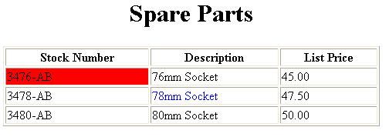
Basic Table Code
<TABLE BORDER=1 width=50%>
<CAPTION> <h1>Spare Parts <h1> </Caption>
<TR><TH>Stock Number</TH><TH>Description</TH><TH>List Price</TH></TR>
<TR><TD bgcolor=red>3476-AB</TD><TD>76mm Socket</TD><TD>45.00</TD></TR>
<TR><TD >3478-AB</TD><TD><font color=blue>78mm Socket</font> </TD><TD>47.50</TD></TR>
<TR><TD>3480-AB</TD><TD>80mm Socket</TD><TD>50.00</TD></TR>
</TABLE>

Slide 197
Forms
Forms add the ability to web pages to not only provide the person viewing the document with dynamic information but also to obtain information from the person viewing it, and process the information.
Objectives:
Upon completing this section, you should be able to
Create a FORM.
Add elements to a FORM.
Define CGI (Common Gateway Interface).
Describe the purpose of a CGI Application.
Specify an action for the FORM.
Forms work in all browsers.
Forms are Platform Independent.

Slide 198
Forms
To insert a form we use the <FORM></FORM> tags. The rest of the form elements must be inserted in between the form tags.
<HTML> <HEAD>
<TITLE> Sample Form</TITLE>
</HEAD>
<BODY BGCOLOR=“FFFFFF”>
<FORM ACTION = http://www.xnu.com/formtest.asp>
<P> First Name: <INPUT TYPE=“TEXT” NAME=“fname” MAXLENGTH=“50”> </P>
<P> <INPUT TYPE=“SUBMIT” NAME=“fsubmit1” VALUE=“Send Info”> </P>
</FORM>
</BODY> </HTML>

Slide 199
Form Elements
Form elements have properties: Text boxes, Password boxes, Checkboxes, Option(Radio) buttons, Submit, Reset, File, Hidden and Image.
The properties are specified in the TYPE Attribute of the HTML element <INPUT></INPUT>.

Slide 200
Form Elements
<INPUT> Element’s Properties
TYPE= Type of INPUT entry field.
NAME = Variable name passed to CGI application
VALUE= The data associated with the variable name to be passed to the CGI application
CHECKED= Button/box checked
SIZE= Number of visible characters in text field
MAXLENGHT= Maximum number of characters accepted.

Slide 201
Text Box
Text boxes: Used to provide input fields for text, phone numbers, dates, etc.
<INPUT TYPE= " TEXT " >
Browser will display
Textboxes use the following attributes:
TYPE: text.
SIZE: determines the size of the textbox in characters. Default=20 characters.
MAXLENGHT : determines the maximum number of characters that the field will accept.
NAME: is the name of the variable to be sent to the CGI application.
VALUE: will display its contents as the default value.

Slide 202
<HTML><HEAD>
<TITLE>RADIOBox</TITLE> </HEAD>
<BODY>
Form #1:
<FORM>
<INPUT TYPE="radio" NAME="choice" VALUE="one"> Yes.
<INPUT TYPE="radio" NAME="choice" VALUE="two"> No.
</FORM>
<HR color=red size="10" >
Form #2:
<FORM>
<INPUT TYPE="radio" NAME="choice" VALUE="three" CHECKED> Yes.
<INPUT TYPE="radio" NAME="choice" VALUE="four"> No.
</FORM>
</BODY></HTML>

Slide 203
<BODY bgcolor=lightblue>
<form>
<TEXTAREA COLS=40 ROWS=20 Name="comments" >
From observing the apathy of those
about me during flag raising I
concluded that patriotism if not
actually on the decline is at least
in a state of dormancy.
Written by Khaled Al-Fagih
</TEXTAREA>:
</form>
</BODY>

Slide 204
Password
Password: Used to allow entry of passwords.
<INPUT TYPE= " PASSWORD " >
Browser will display
Text typed in a password box is starred out in the browser
display.
Password boxes use the following attributes:
TYPE: password.
SIZE: determines the size of the textbox in characters.
MAXLENGHT: determines the maximum size of the password in characters.
NAME: is the name of the variable to be sent to the CGI application.
VALUE: is usually blank.

Slide 205
Example on Password Box
<HTML><HEAD>
<TITLE>Form_Password_Type</TITLE></HEAD>
<BODY>
<h1> <font color=red>To Access, Please
enter:</font></h1>
<FORM name="fome2" Action="url" method="get">
User Name: <INPUT TYPE="TEXT" Name="FName"
SIZE="15" MAXLENGTH="25"><BR>
Password: <INPUT TYPE="PASSWORD"
NAME="PWord" value="" SIZE="15”
MAXLENGTH="25"><BR>
</FORM></BODY> </HTML>

Slide 206
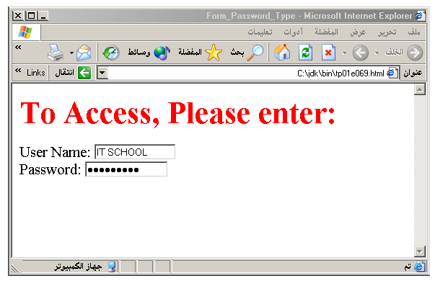
Output

Slide 207
Hidden
Hidden: Used to send data to the CGI application that you don’t want the web surfer to see, change or have to enter but is necessary for the application to process the form correctly.
<INPUT TYPE=“HIDDEN”>
Nothing is displayed in the browser.
Hidden inputs have the following attributes:
TYPE: hidden.
NAME: is the name of the variable to be sent to the CGI application.
VALUE: is usually set a value expected by the CGI application.

Slide 208
Check Box
Check Box: Check boxes allow the users to select more than one option.
<INPUT TYPE=“CHECKBOX”>
Browser will display
Checkboxes have the following attributes:
TYPE: checkbox.
CHECKED: is blank or CHECKED as the initial
status.
NAME: is the name of the variable to be sent to the
CGI application.
VALUE: is usually set to a value.

Slide 209
<HTML> <HEAD><TITLE>CheckBoxType</TITLE> </HEAD>
<BODY>
<h1> <font color=green>Please check one of the following</font></h1>
<FORM name="fome3" Action="url" method="get">
<font color=red> Select Country: </font><BR>
jordan:<INPUT TYPE="CheckBox" Name="country" CHECKED><BR>
Yemen<INPUT TYPE="CheckBox" Name="country"><BR>
Qatar:<INPUT TYPE="CheckBox" Name="country"><BR> <BR>
<font color=blue>Select Language:</font><BR>
Arabic:<INPUT TYPE="CheckBox" Name="language" CHECKED><BR> English:<INPUT TYPE="CheckBox" Name="language"><BR>
French:<INPUT TYPE="CheckBox" Name="language"> <BR></FORM> </BODY></HTML>

Slide 210
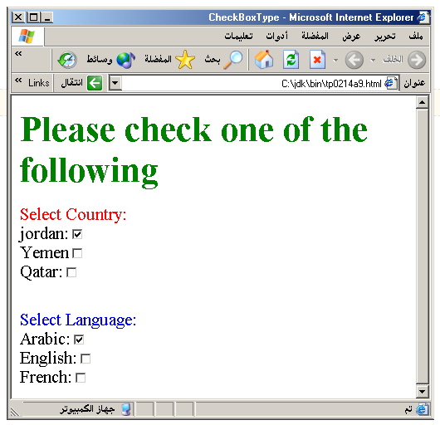
Output

Slide 211
Radio Button
Radio Button: Radio buttons allow the users to select
only one option.
<INPUT TYPE=“RADIO”>
Browser will display
Radio buttons have the following attributes:
TYPE: radio.
CHECKED: is blank or CHECKED as the initial
status. Only one radio button can be
checked
NAME: is the name of the variable to be sent to the
CGI application.
VALUE: usually has a set value.

Slide 212
<HTML> <HEAD><TITLE>CheckBoxType</TITLE> </HEAD>
<BODY>
<h1> <font color=green>Please check one of the following</font></h1>
<FORM name="fome3" Action="url" method="get">
<font color=red> Select Country: </font><BR>
jordan:<INPUT TYPE= "RADIO" Name="country" CHECKED><BR>
Yemen<INPUT TYPE="RADIO " Name="country"><BR>
Qatar:<INPUT TYPE="RADIO" Name="country"><BR> <BR>
<font color=blue>Select Language:</font><BR>
Arabic:<INPUT TYPE="RADIO" Name="language" CHECKED><BR> English:<INPUT TYPE=" RADIO " Name="language"><BR>
French:<INPUT TYPE=" RADIO " Name="language"> <BR></FORM> </BODY></HTML>

Slide 213
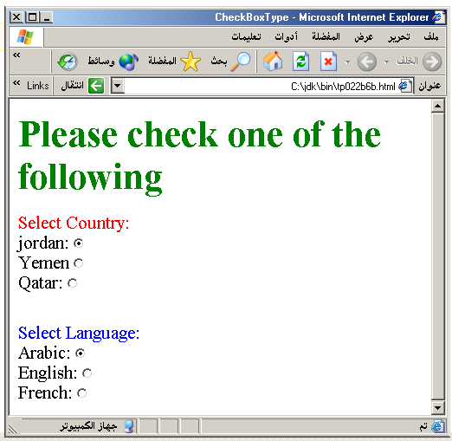

Slide 214
<HTML><HEAD>
<TITLE>RADIOBox</TITLE> </HEAD>
<BODY>
Form #1:
<FORM>
<INPUT TYPE="radio" NAME="choice" VALUE="one"> Yes.
<INPUT TYPE="radio" NAME="choice" VALUE="two"> No.
</FORM>
<HR color=red size="10" >
Form #2:
<FORM>
<INPUT TYPE="radio" NAME="choice" VALUE="three" CHECKED> Yes.
<INPUT TYPE="radio" NAME="choice" VALUE="four"> No.
</FORM>
</BODY></HTML>

Slide 215
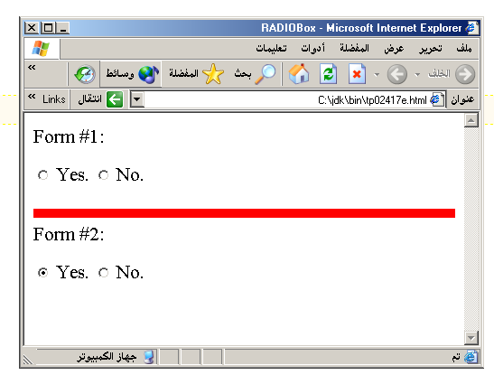
Output

Slide 216
Submit Button
Submit: Every set of Form tags requires a Submit button. This is the element causes the browser to send the names and values of the other elements to the CGI Application specified by the ACTION attribute of the FORM element.
<INPUT TYPE=“SUBMIT”>
The browser will display
Submit has the following attributes:
TYPE: submit.
NAME: value used by the CGI script for processing.
VALUE: determines the text label on the button, usually Submit Query.

Slide 217
<FORM Action="URL" method="get">
First Name: <INPUT TYPE="TEXT" Size=25 name="firstName"><BR>
Family Name: <INPUT TYPE="TEXT" Size=25 name="LastName"><BR>
<BR>
<FONT Color=red>
Press Here to submit the data:<BR>
<INPUT TYPE="submit" VALUE="SubmitData " >
</FORM>

Slide 218
Reset Button
Reset: It is a good idea to include one of these for each form where users are entering data. It allows the surfer to clear all the input in the form.
<INPUT TYPE=“RESET”>
Browser will display
Reset buttons have the following attributes:
TYPE: reset.
VALUE: determines the text label on the button, usually Reset.

Slide 219
<FORM Action="URL" method="get">
First Name: <INPUT TYPE="TEXT" Size=25 name="firstName"> <BR>
Family Name: <INPUT TYPE="TEXT" Size=25 name="LastName"><BR>
<BR>
<FONT Color = red>
<STRONG><font size=5>Press Here to submit the data:</font></STRONG><BR>
<INPUT TYPE="submit" VALUE="SubmitData">
<INPUT TYPE="RESET" VALUE="Reset">
</FORM>

Slide 220
<BODY bgcolor=lightblue>
<form>
<TEXTAREA COLS=40 ROWS=20 Name="comments" >
From observing the apathy of those
about me during flag raising I
concluded that patriotism if not
actually on the decline is at least
in a state of dormancy.
Written by Khaled Al-Fagih
</TEXTAREA>:
</form>
</BODY>

Slide 221
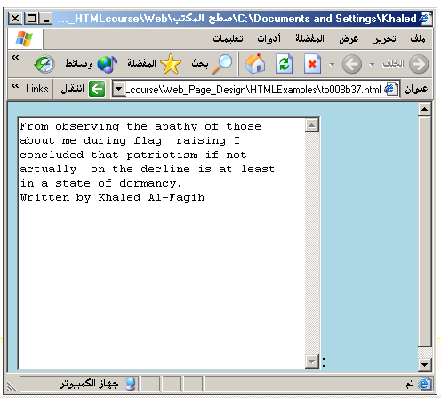

Slide 222
Other Elements used in Forms
Option
The list items are added to the <SELECT> element by inserting <OPTION></OPTION> elements.
The Option Element’s attributes are:
SELECTED: When this attribute is present, the option is selected when the document is initially loaded. It is an error for more than one option to be selected.
VALUE: Specifies the value the variable named in the select element.

Slide 223
<HEAD> <TITLE>SELECT with Mutiple </TITLE> </HEAD>
<BODY>
<h2><font color=blue>What type of Computer do you have?</font><h2>
<FORM>
<SELECT NAME="ComputerType" size=5 multiple>
<OPTION value="IBM" > IBM</OPTION>
<OPTION value="INTEL"> INTEL</OPTION>
<OPTION value=" Apple"> Apple</OPTION>
<OPTION value="Compaq" SELECTED> Compaq</OPTION>
<OPTION value=" other"> Other</OPTION>
</SELECT>
</FORM></BODY></HTML>

Slide 224
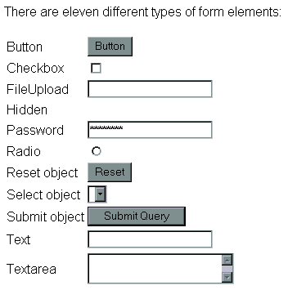

Slide 225
Style Sheet Languages
Cascading Style Sheets (CSS)
Applies to HTML as well as XML documents in general

Slide 226
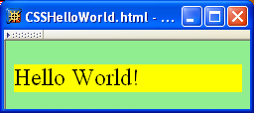
CSS Introduction
A styled HTML document produced by the style sheet style1.css:

Slide 227
CSS Introduction
link element associates style sheet with doc.

Slide 228
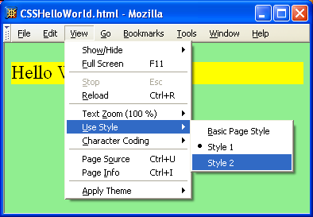
CSS Introduction

Slide 229
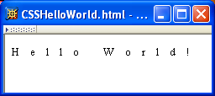
CSS Introduction
A styled HTML document produced by the style sheet style2.css:

Slide 230
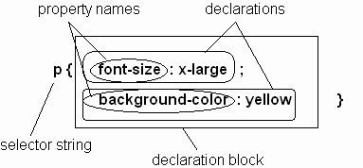
CSS Syntax
Parts of a style rule (or statement)

Slide 231
CSS Syntax: Selector Strings
Single element type:
Multiple element types:
All element types:
Specific elements by id:

Slide 232
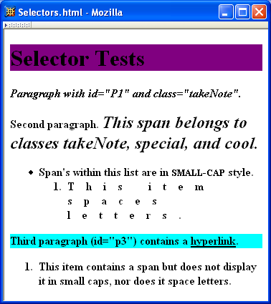
CSS Syntax: Selector Strings

Slide 233
CSS Syntax: Selector Strings
Elements belonging to a style class:
Referencing a style class in HTML:
Elements of a certain type and class:
class selector: begins with a period .

Slide 234
CSS Syntax: Selector Strings
Elements belonging to a style class:
Referencing a style class in HTML:
Elements of a certain type and class:
this span belongs to three style classes

Slide 235
CSS Syntax: Selector Strings
Elements belonging to a style class:
Referencing a style class in HTML:
Elements of a certain type and class:
this rule applies only to span’s belonging to class special

Slide 236
CSS Syntax: Selector Strings
Source anchor elements:
Element types that are descendents:
pseudo-classes

Slide 237
Types of style sheet
External Stylesheet
Internal Stylesheet
Embedded Stylesheet

Slide 238
Style Sheets and HTML
Rules of thumb:
Use external style sheets to define site-wide style
Prefer style sheets (either external or embedded) to style attributes

Slide 239
CSS Font Properties
A font family is a collection of related fonts (typically differ in size, weight, etc.)
font-family property can accept a list of families, including generic font families
first choice font

Slide 240
CSS Font Properties
A font family is a collection of related fonts (typically differ in size, weight, etc.)
font-family property can accept a list of families, including generic font families
second choice font

Slide 241
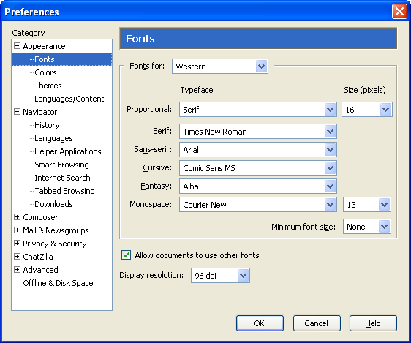
CSS Font Properties
generic
fonts are
system-
specific

Slide 242
CSS Text Color
Font color specified by color property
Two primary ways of specifying colors:
Color name: black, gray, silver, white, red, lime, blue, yellow, aqua, fuchsia, maroon, green, navy, olive, teal, purple, full list at http://www.w3.org/TR/SVG11/types.html#ColorKeywords
red/green/blue (RGB) values

Slide 243
Internal Stylesheet Example
An internal style sheet should be used when a single document has a unique style. You define internal styles in the head section of an HTML page, by using the <style> tag

Slide 244
Example
<head> <style> hr {color:sienna;} p {margin-left:20px;} body {background-image:url("images/background.gif");} </style> </head>

Slide 245
Inline Stylesheet
An inline style loses many of the advantages of style sheets by mixing content with presentation. Use this method sparingly!
To use inline styles you use the style attribute in the relevant tag. The style attribute can contain any CSS property.
<p style="color:sienna;margin-left:20px;">This is a paragraph.</p>

Slide 246
CSS 3
CSS3 is the latest standard for CSS.
CSS3 is completely backwards-compatible with earlier versions of CSS.

Slide 247
New Features of CSS 3
Box Model
Backgrounds and Borders
Image Values and Replaced Content
Text Effects
2D/3D Transformations
Animations
Multiple Column Layout

Slide 248
Borders
div
{
border:2px solid;
padding:10px 40px;
background:green;
width:300px;
border-radius:25px;
}

Slide 249
The box-shadow Property
In CSS3, the box-shadow property is used to add shadow to boxes:
div { box-shadow: 10px 10px 5px pink; }

Slide 250
CSS3 Backgrounds
background properties:
background-size
background-origin
Eg
body
{
background:url(img_flwr.gif);
background-size:80px 60px;
background-repeat:no-repeat;
padding-top:40px;
}

Slide 251
CSS Text Effects
text-shadow
h1 { text-shadow: 5px 5px 5px #FF0000; }

Slide 252
CSS text style
word-wrap
p
{
width:11em;
border:1px solid #000000;
word-wrap:break-word;
}

Slide 253
CSS3 2D Transforms
2d transform methods:
translate()
rotate()
scale()
skew()
matrix()
Notes:
div
{
-ms-transform: rotate(30deg); /* IE 9 */
-webkit-transform: rotate(30deg); /* Chrome, Safari, Opera */
transform: rotate(30deg);
}
div
{
-ms-transform: translate(50px,100px); /* IE 9 */
-webkit-transform: translate(50px,100px); /* Chrome, Safari, Opera */
transform: translate(50px,100px);
}
div
{
-ms-transform: rotate(30deg); /* IE 9 */
-webkit-transform: rotate(30deg); /* Chrome, Safari, Opera */
transform: rotate(30deg);
}
div
{
-ms-transform: scale(2,4); /* IE 9 */
-webkit-transform: scale(2,4); /* Chrome, Safari, Opera */
transform: scale(2,4);
}
div
{
-ms-transform: skew(30deg,20deg); /* IE 9 */
-webkit-transform: skew(30deg,20deg); /* Chrome, Safari, Opera */
transform: skew(30deg,20deg);
}
div
{
-ms-transform:matrix(0.866,0.5,-0.5,0.866,0,0); /* IE 9 */
-webkit-transform:matrix(0.866,0.5,-0.5,0.866,0,0); /* Chrome, Safari, Opera */
transform:matrix(0.866,0.5,-0.5,0.866,0,0);
}

Slide 254
CSS3 Transitions
CSS3 transitions are effects that let an element gradually change from one style to another.
The CSS property you want to add an effect to
The duration of the effect
Notes:
<!DOCTYPE html>
<html>
<head>
<style>
div
{
width:100px;
height:100px;
background:red;
-webkit-transition:width 2s; /* For Safari 3.1 to 6.0 */
transition:width 2s;
}
div:hover
{
width:300px;
}
</style>
</head>
<body>
<div></div>
<p>Hover over the div element above, to see the transition effect.</p>
</body>
</html>

Slide 255
Bind the animation to a selector (element) by specifying at least these two properties:
the name of the animation
the duration of the animation
Notes:
<!DOCTYPE html>
<html>
<head>
<style>
div
{
width:100px;
height:100px;
background:red;
-webkit-animation:myfirst 5s; /* Chrome, Safari, Opera */
animation:myfirst 5s;
}
/* Chrome, Safari, Opera */
@-webkit-keyframes myfirst
{
0% {background:red;}
25% {background:yellow;}
50% {background:blue;}
100% {background:green;}
}
/* Standard syntax */
@keyframes myfirst
{
0% {background:red;}
25% {background:yellow;}
50% {background:blue;}
100% {background:green;}
}
</style>
</head>
<body>
<div></div>
</body>
</html>

Slide 256
CSS Multiple Column
.newspaper { -webkit-column-count:3; /* Chrome, Safari, Opera */ -moz-column-count:3; /* Firefox */ column-count:3; }
Usage
<div class=“newspaper”>……</div>

Slide 257
Assignment
Design a web page using HTML which is for creating a brochure for a Cultural Fest 2014 at ITC Learning Center on 21st June 2013.
Include registration form which registers participants for various cultural events like Light Music,Inaguration song ,Dance,Mimickery and other cultural events.
Apply styles,HTML 4 and HTML 5 tags

Slide 259
JAVA Script

Slide 260
client-side programming with JavaScript
scripts vs. programs
JavaScript vs. JScript vs. VBScript
common tasks for client-side scripts
JavaScript
data types & expressions
control statements
functions & libraries
strings & arrays
Date, document, navigator, user-defined classes

Slide 261
Client-Side Programming
HTML is good for developing static pages
can specify text/image layout, presentation, links, …
Web page looks the same each time it is accessed
in order to develop interactive/reactive pages, must integrate programming in some form or another
client-side programming
programs are written in a separate programming (or scripting) language
e.g., JavaScript, JScript, VBScript
programs are embedded in the HTML of a Web page, with (HTML) tags to identify the program component
e.g., <script type="text/javascript"> … </script>
the browser executes the program as it loads the page, integrating the dynamic output of the program with the static content of HTML
could also allow the user (client) to input information and process it, might be used to validate input before it’s submitted to a remote server

Slide 262
Scripts vs. Programs
a scripting language is a simple, interpreted programming language
scripts are embedded as plain text, interpreted by application
simpler execution model: don't need compiler or development environment
saves bandwidth: source code is downloaded, not compiled executable
platform-independence: code interpreted by any script-enabled browser
but: slower than compiled code, not as powerful/full-featured
JavaScript: the first Web scripting language, developed by Netscape in 1995
syntactic similarities to Java/C++, but simpler, more flexible in some respects,
limited in others
(loose typing, dynamic variables, simple objects)
JScript: Microsoft version of JavaScript, introduced in 1996
same core language, but some browser-specific differences
fortunately, IE, Netscape, Firefox, etc. can (mostly) handle both
JavaScript & JScript
JavaScript 1.5 & JScript 5.0 cores both conform to ECMAScript standard
VBScript: client-side scripting version of Microsoft Visual Basic

Slide 263
Common Scripting Tasks
adding dynamic features to Web pages
validation of form data (probably the most commonly used application)
image rollovers
time-sensitive or random page elements
handling cookies
defining programs with Web interfaces
utilize buttons, text boxes, clickable images, prompts, etc
limitations of client-side scripting
since script code is embedded in the page, it is viewable to the world
for security reasons, scripts are limited in what they can do
e.g., can't access the client's hard drive
since they are designed to run on any machine platform, scripts do not contain platform specific commands
script languages are not full-featured
e.g., JavaScript objects are very crude, not good for large project development

Slide 264
JavaScript
JavaScript code can be embedded in a Web page using <script> tags
the output of JavaScript code is displayed as if directly entered in HTML
document.write displays text in the page
text to be displayed can include HTML tags
the tags are interpreted by the browser when the text is displayed
as in C++/Java, statements end with ;
but a line break might also be interpreted as the end of a statement (depends upon browser)
JavaScript comments similar to C++/Java
// starts a single line comment
/*…*/ enclose multi-line comments
<html>
<!–- COMP519 js01.html 16.08.06 -->
<head>
<title>JavaScript Page</title>
</head>
<body>
<script type="text/javascript">
// silly code to demonstrate output
document.write("<p>Hello world!</p>");
document.write(" <p>How are <br/> " +
" <i>you</i>?</p> ");
</script>
<p>Here is some static text as well.</p>
</body>
</html>

Slide 265
JavaScript Data Types & Variables
JavaScript has only three primitive data types
String : "foo" 'how do you do?' "I said 'hi'." ""
Number: 12 3.14159 1.5E6
Boolean : true false *Find info on Null, Undefined
assignments are as in C++/Java
message = "howdy";
pi = 3.14159;
variable names are sequences of letters, digits, and underscores that start with a letter or an underscore
variables names are case-sensitive
you don't have to declare variables, will be created the first time used, but it’s better if you use var statements
var message, pi=3.14159;
variables are loosely typed, can be assigned different types of values (Danger!)
<html>
<!–- COMP519 js02.html 16.08.06 -->
<head>
<title>Data Types and Variables</title>
</head>
<body>
<script type="text/javascript">
var x, y;
x= 1024;
y=x; x = "foobar";
document.write("<p>x = " + y + "</p>");
document.write("<p>x = " + x + "</p>");
</script>
</body>
</html>

Slide 266
JavaScript Operators & Control Statements
standard C++/Java operators & control statements are provided in JavaScript
+, -, *, /, %, ++, --, …
==, !=, <, >, <=, >=
&&, ||, !,
if , if-else, switch
while, for, do-while, …
<html>
<!–- COMP519 js03.html 08.10.10 -->
<head>
<title>Folding Puzzle</title>
</head>
<body>
<script type="text/javascript">
var distanceToSun = 93.3e6*5280*12;
var thickness = .002;
var foldCount = 0;
while (thickness < distanceToSun) {
thickness *= 2;
foldCount++;
}
document.write("Number of folds = " +
foldCount);
</script>
</body>
</html>

Slide 267
JavaScript Math Routines
<html>
<!–- COMP519 js04.html 08.10.10 -->
<head>
<title>Random Dice Rolls</title>
</head>
<body>
<div style="text-align:center">
<script type="text/javascript">
var roll1 = Math.floor(Math.random()*6) + 1;
var roll2 = Math.floor(Math.random()*6) + 1;
document.write("<img src='http://www.csc.liv.ac.uk/"+
"~martin/teaching/comp519/Images/die" +
roll1 + ".gif‘ alt=‘dice showing ‘ + roll1 />");
document.write("&nbsp;&nbsp;");
document.write("<img src='http://www.csc.liv.ac.uk/"+
"~martin/teaching/comp519/Images/die" +
roll2 + ".gif‘ alt=‘dice showing ‘ + roll2 />");
</script>
</div>
</body>
</html>
the built-in Math object contains functions and constants
Math.sqrt
Math.pow
Math.abs
Math.max
Math.min
Math.floor
Math.ceil
Math.round
Math.PI
Math.E
Math.random function returns a real number in [0..1)

Slide 268
User-Defined Functions
function definitions are similar to C++/Java, except:
no return type for the function (since variables are loosely typed)
no variable typing for parameters (since variables are loosely typed)
by-value parameter passing only (parameter gets copy of argument)
function isPrime(n)
// Assumes: n > 0
// Returns: true if n is prime, else false
{
if (n < 2) {
return false;
}
else if (n == 2) {
return true;
}
else {
for (var i = 2; i <= Math.sqrt(n); i++) {
if (n % i == 0) {
return false;
}
}
return true;
}
}
Can limit variable scope to the function.
if the first use of a variable is preceded with var, then that variable is local to the function
for modularity, should make all variables in a function local

Slide 269
Function Example
<html>
<!–- COMP519 js06.html 16.08.2006 -->
<head>
<title>Prime Tester</title>
<script type="text/javascript">
function isPrime(n)
// Assumes: n > 0
// Returns: true if n is prime
{
// CODE AS SHOWN ON PREVIOUS SLIDE
}
</script>
</head>
<body>
<script type="text/javascript">
testNum = parseFloat(prompt("Enter a positive integer", "7"));
if (isPrime(testNum)) {
document.write(testNum + " <b>is</b> a prime number.");
}
else {
document.write(testNum + " <b>is not</b> a prime number.");
}
</script>
</body>
</html>
Function definitions (usually) go in the <head> section
<head> section is loaded first, so then the function is defined before code in the <body> is executed (and, therefore, the function can be used later in the body of the HTML document)

Slide 270
Array Example
<html>
<!–- COMP519 js10.html 11.10.2011 -->
<head>
<title>Die Statistics</title>
<script type="text/javascript"
src="http://www.csc.liv.ac.uk/~martin/teaching/comp519/JS/random.js">
</script>
</head>
<body>
<script type="text/javascript">
numRolls = 60000;
dieSides = 6;
rolls = new Array(dieSides+1);
for (i = 1; i < rolls.length; i++) {
rolls[i] = 0;
}
for(i = 1; i <= numRolls; i++) {
rolls[randomInt(1, dieSides)]++;
}
for (i = 1; i < rolls.length; i++) {
document.write("Number of " + i + "'s = " +
rolls[i] + "<br />");
}
</script>
</body>
</html>
suppose we want to simulate die rolls and verify even distribution
keep an array of counters:
initialize each count to 0
each time you roll X, increment rolls[X]
display each counter

Slide 271
Date Object
String & Array are the most commonly used objects in JavaScript
other, special purpose objects also exist
the Date object can be used to access the date and time
to create a Date object, use new & supply year/month/day/… as desired
today = new Date(); // sets to current date & time
newYear = new Date(2002,0,1); //sets to Jan 1, 2002 12:00AM
methods include:
newYear.getYear() can access individual components of a date
newYear.getMonth()
newYear.getDay()
newYear.getHours()
newYear.getMinutes()
newYear.getSeconds()
newYear.getMilliseconds()

Slide 272
Date Example
<html>
<!–- COMP519 js11.html 16.08.2006 -->
<head>
<title>Time page</title>
</head>
<body>
Time when page was loaded:
<script type="text/javascript">
now = new Date();
document.write("<p>" + now + "</p>");
time = "AM";
hours = now.getHours();
if (hours > 12) {
hours -= 12;
time = "PM"
}
else if (hours == 0) {
hours = 12;
}
document.write("<p>" + hours + ":" +
now.getMinutes() + ":" +
now.getSeconds() + " " +
time + "</p>");
</script>
</body>
</html>
by default, a date will be displayed in full, e.g.,
Sun Feb 03 22:55:20 GMT-0600 (Central Standard Time) 2002
can pull out portions of the date using the methods and display as desired
here, determine if "AM" or "PM" and adjust so hour between 1-12
10:55:20 PM

Slide 273
Another Example
<html>
<!–- COMP519 js12.html 12.10.2012 -->
<head>
<title>Time page</title>
</head>
<body>
<p>Elapsed time in this year:
<script type="text/javascript">
now = new Date();
newYear = new Date(2012,0,1);
secs = Math.round((now-newYear)/1000);
days = Math.floor(secs / 86400);
secs -= days*86400;
hours = Math.floor(secs / 3600);
secs -= hours*3600;
minutes = Math.floor(secs / 60);
secs -= minutes*60
document.write(days + " days, " +
hours + " hours, " +
minutes + " minutes, and " +
secs + " seconds.");
</script>
</p>
</body>
</html>
you can add and subtract Dates:
the result is a number of milliseconds
here, determine the number of seconds since New Year's day
(note: January is month 0)
divide into number of days, hours, minutes and seconds

Slide 274
document Object
Internet Explorer, Firefox, Opera, etc. allow you to access information about an HTML document using the document object
<html>
<!–- COMP519 js13.html 2.10.2012 -->
<head>
<title>Documentation page</title>
</head>
<body>
<table width="100%">
<tr>
<td><i>
<script type="text/javascript">
document.write(document.URL);
</script>
</i></td>
<td style="text-align: right;"><i>
<script type="text/javascript">
document.write(document.lastModified);
</script>
</i></td>
</tr>
</table>
</body>
</html>
document.write(…)
method that displays text in the page
document.URL
property that gives the location of the HTML document
document.lastModified
property that gives the date & time the HTML document was last changed

Slide 275
Object Example
<html>
<!–- COMP519 js15.html 11.10.2011 -->
<head>
<title>Dice page</title>
<script type="text/javascript"
src="Die.js">
</script>
</head>
<body>
<script type="text/javascript">
die6 = new Die(6);
die8 = new Die(8);
roll6 = -1; // dummy value to start loop
roll8 = -2; // dummy value to start loop
while (roll6 != roll8) {
roll6 = die6.roll();
roll8 = die8.roll();
document.write("6-sided: " + roll6 +
"&nbsp;&nbsp;&nbsp;&nbsp;" +
"8-sided: " + roll8 + "<br />");
}
document.write("<br />Number of rolls: " +
die6.numRolls);
</script>
</body>
</html>
create a Die object using new (similar to String and Array)
here, the argument to Die initializes numSides for that particular object
each Die object has its own properties (numSides & numRolls)
Roll(), when called on a particular Die, accesses its numSides property and updates its NumRolls

Slide 276
User-Defined Objects
can define new objects, but the notation can be somewhat awkward
simply define a function that serves as a constructor
specify data fields & methods using this
no data hiding: can't protect data or methods
// COMP519 Die.js 11.10.2011 //
// Die class definition
////////////////////////////////////////////
function Die(sides)
{
this.numSides = sides;
this.numRolls = 0;
this.roll = roll; // define a pointer to a function
}
function roll()
{
this.numRolls++;
return Math.floor(Math.random()*this.numSides) + 1;
}
define Die function (i.e., the object's constructor)
initialize data fields in the function, preceded with "this"
similarly, assign method to separately defined function (which uses this to access data)

Slide 277


HTML 5 Tutorial
Chapter 1
Introduction

Slide 278

What is HTML5?
HTML5 will be the new standard for HTML, XHTML, and the HTML DOM.
The previous version of HTML came in 1999. The web has changed a lot since then.
HTML5 is still a work in progress. However, most modern browsers have some HTML5 support.

Slide 279
How Did HTML5 Get Started?
HTML5 is a cooperation between the World Wide Web Consortium (W3C) and the Web Hypertext Application Technology Working Group (WHATWG).
WHATWG was working with web forms and applications, and W3C was working with XHTML 2.0. In 2006, they decided to cooperate and create a new version of HTML.
Some rules for HTML5 were established:
New features should be based on HTML, CSS, DOM, and JavaScript
Reduce the need for external plugins (like Flash)
Better error handling
More markup to replace scripting
HTML5 should be device independent
The development process should be visible to the public

Slide 280
New Features
Some of the most interesting new features in HTML5 :
The canvas element for drawing
The video and audio elements for media playback
Better support for local offline storage
New content specific elements, like article, footer, header, nav, section
New form controls, like calendar, date, time, email, url, search

Slide 281
Browser Support
HTML5 is not yet an official standard, and no browsers have full HTML5 support.
But all major browsers (Safari, Chrome, Firefox, Opera, Internet Explorer) continue to add new HTML5 features to their latest versions.

Slide 282
To start
<!doctype html>
And then
<meta charset=utf-8>

Slide 283
<header>,<nav>
<header>
<h1>My interesting life</h1>
</header>
<nav>
<h2>Menu</h2>
<ul>
<li><a href=”last-week.html”>Last week</a></li>
<li><a href=”archive.html”>Archives</a></li>
</ul>
</nav>

Slide 284
<article>
<article>
<h2>Yesterday</h2>
<p>Today I drank coffee for breakfast. 14 hours later,
I went to bed.</p>
</article>
<article>
<h2>Tuesday</h2>
<p>Ran out of coffee, so had orange juice for breakfast.
It was from concentrate.</p>
</article>

Slide 285
<footer>
<footer>
<small>&copy;2007 Ross Bruniges. Design by Blogging Tips
and Pearsonified</small>
</footer>

Slide 286
Canvas Element
Create a Canvas
<!DOCTYPE html>
<html>
<body>
<canvas id="myCanvas" width="200" height="100" style="border:1px solid #000000;">
Your browser does not support the HTML5 canvas tag.
</canvas>
</body>
</html>

Slide 287
JavaScript
All drawing on the canvas must be done inside a JavaScript:
<script> var c = document.getElementById("myCanvas"); var ctx = c.getContext("2d"); ctx.fillStyle = "#FF0000"; ctx.fillRect(0,0,150,75); </script>

Slide 288
Straight Line
<script>
var c = document.getElementById("myCanvas"); var ctx = c.getContext("2d"); ctx.moveTo(0,0); ctx.lineTo(200,100); ctx.stroke();
</script>

Slide 289
Circle on Canvas
To draw a circle on a canvas, we will use the following method:
arc(x,y,r,start,stop)
Eg:
<script>
var c=document.getElementById("myCanvas");
var ctx=c.getContext("2d");
ctx.beginPath();
ctx.arc(95,50,40,0,2*Math.PI);
ctx.stroke();
</script>

Slide 290
Canvas - Text
To draw text on a canvas, the most important property and methods are:
font - defines the font properties for text
fillText(text,x,y) - Draws "filled" text on the canvas
strokeText(text,x,y) - Draws text on the canvas (no fill)
Eg:
var c = document.getElementById("myCanvas"); var ctx = c.getContext("2d"); ctx.font = "30px Arial"; ctx.fillText("Hello World",10,50);
ctx.strokeText(“Hello World”,120,150);

Slide 291
Canvas - Gradients
Gradients can be used to fill rectangles, circles, lines, text, etc. Shapes on the canvas are not limited to solid colors.
There are two different types of gradients:
createLinearGradient(x,y,x1,y1) - Creates a linear gradient
createRadialGradient(x,y,r,x1,y1,r1) - Creates a radial/circular gradient
Once we have a gradient object, we must add two or more color stops.
The addColorStop() method specifies the color stops, and its position along the gradient. Gradient positions can be anywhere between 0 to 1.

Slide 292
Canvas-Gradients
var c = document.getElementById("myCanvas"); var ctx = c.getContext("2d"); // Create gradient var grd = ctx.createLinearGradient(0,0,200,0); grd.addColorStop(0,"red"); grd.addColorStop(1,"white"); // Fill with gradient ctx.fillStyle = grd; ctx.fillRect(10,10,150,80);

Slide 293
Canvas - Images
To draw an image on a canvas, we will use the following method:
drawImage(image,x,y)
Eg:
<img id=“flower" src=“tulips.jpg" alt="The Flower" width="220" height="277"><p>Canvas:</p>
<canvas id="myCanvas" width="250" height="300" style="border:1px solid #d3d3d3;">
Your browser does not support the HTML5 canvas tag.</canvas>

Slide 294
Canvas - Images
<script>
var c=document.getElementById("myCanvas");
var ctx=c.getContext("2d");
var img=document.getElementById(“flower");
ctx.drawImage(img,10,10);
</script>

Slide 295
Video
<!DOCTYPE html>
<html>
<body>
<video width="320" height="240" controls>
<source src="movie.mp4" type="video/mp4">
<source src="movie.ogg" type="video/ogg">
Your browser does not support the video tag.
</video>
</body>
</html>

Slide 296
MIME Types support for video
MP4 video/mp4
WebM video/webm
Ogg video/ogg

Slide 297
Audio
<!DOCTYPE html>
<html>
<body>
<audio controls>
<source src="horse.ogg" type="audio/ogg">
<source src="horse.mp3" type="audio/mpeg">
Your browser does not support the audio element.
</audio>
</body>
</html>

Slide 298
HTML5 Web Storage Objects
HTML5 Web Storage provides two new objects for storing data on the client:
window.localStorage - stores data with no expiration date
code.sessionStorage - stores data for one session (data is lost when the tab is closed)

Slide 299
Local Storage
<!DOCTYPE html>
<html>
<body>
<div id="result"></div>
<script>
// Check browser support
if (typeof(Storage) != "undefined")
{
// Store
localStorage.setItem("lastname", "Smith");

Slide 300
Local Storage(Contd)
// Retrieve
document.getElementById("result").innerHTML=localStorage.getItem("lastname");
}
else
{
document.getElementById("result").innerHTML="Sorry, your browser does not support Web Storage...";
}
</script>

Slide 301
Session Storage
Example
Notes:
<!DOCTYPE html>
<html>
<head>
<script>
function clickCounter()
{
if(typeof(Storage)!=="undefined")
{
if (sessionStorage.clickcount)
{
sessionStorage.clickcount=Number(sessionStorage.clickcount)+1;
}
else
{
sessionStorage.clickcount=1;
}
document.getElementById("result").innerHTML="You have clicked the button " + sessionStorage.clickcount + " time(s) in this session.";
}
else
{
document.getElementById("result").innerHTML="Sorry, your browser does not support web storage...";
}
}
</script>
</head>
<body>
<p><button onclick="clickCounter()" type="button">Click me!</button></p>
<div id="result"></div>
</body>
</html>

Slide 302
New Input Elements
The new input types:
color
date
datetime
datetime-local
email
month
number
range
search
tel
time
url
week
Notes:
<!DOCTYPE html>
<html>
<head>
<script>
function clickCounter()
{
if(typeof(Storage)!=="undefined")
{
if (sessionStorage.clickcount)
{
sessionStorage.clickcount=Number(sessionStorage.clickcount)+1;
}
else
{
sessionStorage.clickcount=1;
}
document.getElementById("result").innerHTML="You have clicked the button " + sessionStorage.clickcount + " time(s) in this session.";
}
else
{
document.getElementById("result").innerHTML="Sorry, your browser does not support web storage...";
}
}
</script>
</head>
<body>
<p><button onclick="clickCounter()" type="button">Click me!</button></p>
<div id="result"></div>
</body>
</html>

Slide 303
Input type-Color
Input Type: color
The color type is used for input fields that should contain a color.
Example
Select a color from a color picker:
Select your favorite color: <input type="color" name="favcolor">

Slide 304
Input Type: date
Define a date control:
Birthday: <input type="date" name="bday">
Input Type: datetime
Define a date and time control (with time zone):
Birthday (date and time): <input type="datetime" name="bdaytime">
Input Type: datetime-local
Define a date and time control (no time zone):
Birthday (date and time): <input type="datetime-local" name="bdaytime">

Slide 305
Input type-Email
The email type is used for input fields that should contain an e-mail address.
Define a field for an e-mail address (will be automatically validated when submitted):
E-mail: <input type="email" name="email">

Slide 306
Input type-Month
Input Type: month
The month type allows the user to select a month and year.
Example
Define a month and year control (no time zone):
Birthday (month and year): <input type="month" name="bdaymonth">

Slide 307
Input Type-Number
The number type is used for input fields that should contain a numeric value.
Define a numeric field (with restrictions):
Quantity (between 1 and 5): <input type="number" name="quantity" min="1" max="5">

Slide 308
Input type-Search
The search type is used for search fields (a search field behaves like a regular text field).
Define a search field (like a site search, or Google search):
Search Google: <input type="search" name="googlesearch">

Slide 309
Input type-tel
The tel type is used for input fields that should contain a telephone number.
Define a field for entering a telephone number:
Telephone: <input type="tel" name="usrtel">
Not Supported by any browser

Slide 310
Input type-time
The time type allows the user to select a time.
Example
Define a control for entering a time (no time zone):
Select a time: <input type="time" name="usr_time">

Slide 311
Input type-URL
The url type is used for input fields that should contain a URL address.
The value of the url field is automatically validated when the form is submitted.
Example
Define a field for entering a URL:
Add your homepage: <input type="url" name="homepage">

Slide 312
Input type-Week
The week type allows the user to select a week and year.
Define a week and year control (no time zone):
Select a week: <input type="week" name="week_year">

Slide 313
XML

Slide 314
XML for Beginners
1. XML – the Snake Oil of the Internet age?
2. Basic XML Concepts
3. Defining XML Data Formats
4. Querying XML Data

Slide 315
XML is not…
A replacement for HTML (but HTML can be generated from XML)
A presentation format (but XML can be converted into one)
A programming language (but it can be used with almost any language)
A network transfer protocol (but XML may be transferred over a network)
A database (but XML may be stored into a database)

Slide 316
But then – what is it?
XML is a meta markup language for text documents / textual data
XML allows to define languages („applications“) to represent text documents / textual data

Slide 317
XML by Example
<article>
<author>Gerhard Weikum</author>
<title>The Web in 10 Years</title>
</article>
Easy to understand for human users
Very expressive (semantics along with the data)
Well structured, easy to read and write from programs
This looks nice, but…

Slide 318
XML by Example
… this is XML, too:
<t108>
<x87>Gerhard Weikum</x87>
<g10>The Web in 10 Years</g10>
</t108>
Hard to understand for human users
Not expressive (no semantics along with the data)
Well structured, easy to read and write from programs

Slide 319
Possible Advantages of Using XML
Truly Portable Data
Easily readable by human users
Very expressive (semantics near data)
Very flexible and customizable (no finite tag set)
Easy to use from programs (libs available)
Easy to convert into other representations (XML transformation languages)
Many additional standards and tools
Widely used and supported

Slide 320



App. Scenario 1: Content Mgt.
Clients
XML2HTML
XML2WML
XML2PDF
Converters
Database with XML documents

Slide 321
App. Scenario 2: Data Exchange
Buyer
Supplier
XML Adapter
XML
XML Adapter
(BMECat, ebXML, RosettaNet, BizTalk, …)
Legacy System (e.g., SAP R/2)
Legacy System (e.g., Cobol)
Order
A

Slide 322
A Simple XML Document
Freely definable tags
<article>
<author>Gerhard Weikum</author>
<title>The Web in Ten Years</title>
<text>
<abstract>In order to evolve...</abstract>
<section number=“1” title=“Introduction”>
The <index>Web</index> provides the universal...
</section>
</text>
</article>

Slide 323
A Simple XML Document
Start Tag
<article>
<author>Gerhard Weikum</author>
<title>The Web in Ten Years</title>
<text>
<abstract>In order to evolve...</abstract>
<section number=“1” title=“Introduction”>
The <index>Web</index> provides the universal...
</section>
</text>
</article>
Content of the Element (Subelements and/or Text)
End Tag
Element

Slide 324
A Simple XML Document
<article>
<author>Gerhard Weikum</author>
<title>The Web in Ten Years</title>
<text>
<abstract>In order to evolve...</abstract>
<section number=“1” title=“Introduction”>
The <index>Web</index> provides the universal...
</section>
</text>
</article>
Attributes with name and value

Slide 325
Elements in XML Documents
(Freely definable) tags: article, title, author
with start tag: <article> etc.
and end tag: </article> etc.
Elements: <article> ... </article>
Elements have a name (article) and a content (...)
Elements may be nested.
Elements may be empty: <this_is_empty/>
Element content is typically parsed character data (PCDATA), i.e., strings with special characters, and/or nested elements (mixed content if both).
Each XML document has exactly one root element and forms a tree.
Elements with a common parent are ordered.

Slide 326
Elements vs. Attributes
Elements may have attributes (in the start tag) that have a name and
a value, e.g. <section number=“1“>.
What is the difference between elements and attributes?
Only one attribute with a given name per element (but an arbitrary number of subelements)
Attributes have no structure, simply strings (while elements can have subelements)
As a rule of thumb:
Content into elements
Metadata into attributes
Example:
<person born=“1912-06-23“ died=“1954-06-07“>
Alan Turing</person> proved that…

Slide 327
XML Documents as Ordered Trees
article
author
title
text
number=“1“
abstract
section
Gerhard Weikum
title=“…“
In order …
The
index
provides …
The Web in 10 years
Web

Slide 328
Well-Formed XML Documents
A well-formed document must adher to, among others, the following rules:
Every start tag has a matching end tag.
Elements may nest, but must not overlap.
There must be exactly one root element.
Attribute values must be quoted.
An element may not have two attributes with the same name.
Comments and processing instructions may not appear inside tags.
No unescaped < or & signs may occur inside character data.

Slide 329
Well-Formed XML Documents
A well-formed document must adher to, among others, the following rules:
Every start tag has a matching end tag.
Elements may nest, but must not overlap.
There must be exactly one root element.
Attribute values must be quoted.
An element may not have to attributes with the same name.
Comments and processing instructions may not appear inside tags.
No unescaped < or & signs may occur inside character data.
Only well-formed documents can be processed by XML parsers.

Slide 330
Document Type Definitions
Sometimes XML is too flexible:
Most Programs can only process a subset of all possible XML applications
For exchanging data, the format (i.e., elements, attributes and their semantics) must be fixed
Document Type Definitions (DTD) for establishing the vocabulary for one XML application (in some sense comparable to schemas in databases)
A document is valid with respect to a DTD if it conforms to the rules specified in that DTD.
Most XML parsers can be configured to validate.

Slide 331
More on Element Declarations
Elements with mixed content:
<!ELEMENT text (#PCDATA|index|cite|glossary)*>
Elements with empty content:
<!ELEMENT image EMPTY>
Elements with arbitrary content (this is nothing for production-level DTDs):
<!ELEMENT thesis ANY>

Slide 332
Attribute Declarations in DTDs
Attributes are declared per element:
<!ATTLIST section number CDATA #REQUIRED
title CDATA #REQUIRED>
declares two required attributes for element section.
element name
attribute name
attribute type
attribute default

Slide 333
Attribute Declarations in DTDs
Attributes are declared per element:
<!ATTLIST section number CDATA #REQUIRED
title CDATA #REQUIRED>
declares two required attributes for element section.
Possible attribute defaults:
#REQUIRED is required in each element instance
#IMPLIED is optional
#FIXED default always has this default value
default has this default value if the attribute is omitted from the element instance

Slide 334
Flaws of DTDs
No support for basic data types like integers, doubles, dates, times, …
No structured, self-definable data types
No type derivation
id/idref links are quite loose (target is not specified)
⇒ XML Schema

Slide 335
XML Schema Basics
XML Schema is an XML application
Provides simple types (string, integer, dateTime, duration, language, …)
Allows defining possible values for elements
Allows defining types derived from existing types
Allows defining complex types
Allows posing constraints on the occurrence of elements
Allows forcing uniqueness and foreign keys
Way too complex to cover in an introductory talk

Slide 336
Simplified XML Schema Example
<xs:schema>
<xs:element name=“article“>
<xs:complexType>
<xs:sequence>
<xs:element name=“author“ type=“xs:string“/>
<xs:element name=“title“ type=“xs:string“/>
<xs:element name=“text“>
<xs:complexType>
<xs:sequence>
<xs:element name=“abstract“ type=“xs:string“/>
<xs:element name=“section“ type=“xs:string“
minOccurs=“0“ maxOccurs=“unbounded“/>
</xs:sequence>
</xs:complexType>
</xs:element>
</xs:sequence>
</xs:complexType>
</xs:element>
</xs:schema>

Slide 337
XML Schema
• An XML Schema:
- defines elements that can appear in a document
- defines attributes that can appear within elements
- defines which elements are child elements
- defines the sequence in which the child elements can appear
- defines the number of child elements
- defines whether an element is empty or can include text
- defines default values for attributes
• The purpose of a Schema is to define the legal building blocks of an XML
document, just like a DTD.
XML Schema – Better than DTDs
• XML Schemas:
- are easier to learn than DTD
- are extensible to future additions
- are richer and more useful than DTDs
- are written in XML
- support data types
- 15 -
XML_TR AIN IN G.pptx

Slide 338
Example:
Shipping
Order
<?xml version="1.0"?>
<shipOrder>
<shipTo>
<name>Svendson</name>
<street>Oslo St</street>
<address>400 Main</address>
<country>Norway</country>
</shipTo>
<items>
<item>
<title>Wheel</title>
<quantity>1</quantity>
<price>10.90</price>
</item>
<item>
<title>Cam</title>
<quantity>1</quantity>
<price>9.90</price>
</item>
</items>
</shipOrder>
- 16 -
XML_TR AIN IN G.pptx

Slide 339
XML Schema
for Shipping
Order
<xsd:schema xmlns:xsd=http://www.w3.org/1999/XMLSchema>
<xsd:element name="shipOrder" type="order"/>
<xsd:complexType name="order">
<xsd:element name="shipTo" type="shipAddress"/>
<xsd:element name="items" type="cdItems"/>
</xsd:complexType>
<xsd:complexType name="shipAddress">
<xsd:element name="name“ type="xsd:string"/>
<xsd:element name="street" type="xsd:string"/>
<xsd:element name="address" type="xsd:string"/>
<xsd:element name="country" type="xsd:string"/>
</xsd:complexType>
<xsd:complexType name="cdItems">
<xsd:element name="item" minOccurs="0" maxOccurs="unbounded"
type="cdItem"/>
</xsd:complexType>
<xsd:complexType name="cdItem">
<xsd:element name="title" type="xsd:string"/>
<xsd:element name="quantity“ type="xsd:positiveInteger"/>
<xsd:element name="price" type="xsd:decimal"/>
</xsd:complexType>
</xsd:schema>
- 17 -
XML_TR AIN IN G.pptx

Slide 340
XSL and XSLT
• It stands for eXtensible Stylesheet Language,
• A general-purpose language to define the presentation
and formatting of XML
data.
• XSL - More Than a Style Sheet Language
• XSL consists of three parts:
- XSLT - a language for transforming XML documents
- XPath - a language for navigating in XML documents
- XSL-FO - a language for formatting XML documents
XSLT
• XSLT stands for XSL Transformations
• XSLT is the most important part of XSL
• XSLT transforms an XML document into another XML document
• XSLT can be used to transform XML into HTML, before it is displayed
by a browser
- 18 -
XML_TR AIN IN G.pptx

Slide 341
Example
XML Code
<?xml version="1.0" encoding="ISO-8859-1"?>
<catalog>
<cd>
<title>Empire Burlesque</title>
<artist>Bob Dylan</artist>
<country>USA</country>
<company>Columbia</company>
<price>10.90</price>
<year>1985</year>
</cd>
<cd>
<title>Hide your heart</title>
<artist>Bonnie Tyler</artist>
<country>UK</country>
<company>CBS Records</company>
<price>9.90</price>
<year>1988</year>
</cd>
</catalog>
XSLT Code
<?xml version="1.0" encoding="ISO-8859-1"?>
<xsl:stylesheet version="1.0"
orm">
<html>
<h2>My CD Collection</h2>
<tr bgcolor="#9acd32">
<th>Artist</th>
<xsl:for-each select="catalog/cd">
<td><xsl:value-of
<td><xsl:value-of
</tr>
</table>
</body>
</html>
</xsl:template>
</xsl:stylesheet>
xmlns:xsl="http://www.w3.org/1999/XSL/Transf
<xsl:template match="/">
<body>
<table border="1">
<th>Title</th>
</tr>
<tr>
select="title"/></td>
select="artist"/></td>
</xsl:for-each>
- 19 -
XML_TR AIN IN G.pptx

Slide 342
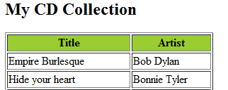
Result
- 20 -
XML_TR AIN IN G.pptx

Slide 343




Valid XML Documents
• An XML document is valid if it has an associated DTD or Schema and if the document complies with the constraints
expressed in it
• If an XML
document is valid, it is also well-formed.
Well-formed
XML Document
Valid
XML Document
- 21 -
XML_TR AIN IN G.pptx

Slide 344
Applications of XML
• XML can be used to Store Data
- XML can also be used to store data in files or in databases.
• XML is used to create configuration files for different applications.
- Most Servers use XML configuration files.
- Typically used for small configuration information which has to be both human and machine readable.
• XML is used to Exchange Data in cross-platform applications
- data can be exchanged between incompatible systems.
• Used in Web applications
- XML application development, programming and contracting services are using
services.
• XML can be used to Create new data representative Languages
- The Wireless Markup Language (WML) is written in XML
- CML (Chemical Markup Language).
in a variety
of web applications
and
- 22 -
XML_TR AIN IN G.pptx

Slide 345
ADO.NET - 1
The Connected Layer

Slide 346
Overview
ADO.NET provides consistent access to data sources such as Microsoft SQL Server and XML, as well as to data sources exposed through OLE DB and ODBC.
Data-sharing consumer applications can use ADO.NET to connect to these data sources and retrieve, manipulate, and update the data that they contain.

Slide 347
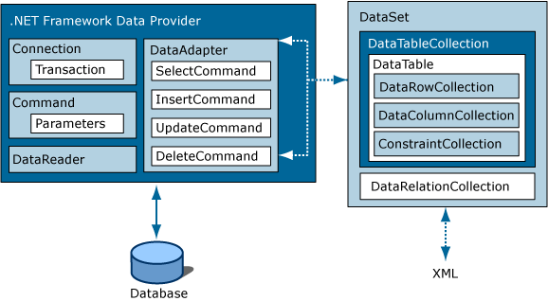
Architecture

Slide 348
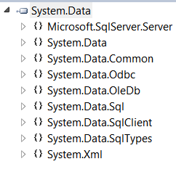
ADO.NET
System.Data Namespace that allow you to interact with local and remote relational databases.

Slide 349
ADO.NET Data providers
ADO.NET supports multiple data providers, each of which is optimized to interact with a specific DBMS.
You can program a specific data provider to access any unique features of a particular DBMS.
A specific data provider can connect directly to the underlying engine of the DBMS without an intermediate mapping layer standing between the tiers.
A data provider is a set of types defined in a given namespace that understand how to communicate with a specific type of data source.

Slide 350
.NET Framework data provider
Data Provider | NameSpace | Assembly
OLE DB | System.Data.OleDb | System.Data.dll
SQL Server | System.Data.SqlClient | System.Data.dll
SQL Server Mobile | System.Data.SqlServerCe | System.Data.SqlServerCe.dll
ODBC | System.Data.Odbc | System.Data.dll
Oracle 8.1.7 + | System.Data.OracleClient | System.Data.OracleClient

Slide 351
The Core Objects of an ADO.NET Data Provider
Type of Object | Usage
Connection | Provides connectivity to a data source.
Command | Enables access to database commands to return data, modify data, run stored procedures, and send or retrieve parameter information.
DataReader | Provides forward-only, read-only access to data using a server-side cursor.
DataAdapter | Provides the bridge between the DataSet object and the data source. The DataAdapter uses Command objects to execute SQL commands at the data source to both load the DataSet with data, and reconcile changes made to the data in the DataSet back to the data source.
Parameter | Represents a named parameter within a parameterized query
Transaction | Encapsulates a database transaction

Slide 352
Connection Objects
BeginTransaction() : You use this method to begin a database transaction.
ChangeDatabase() : You use this method to change the database on an open connection.
ConnectionTimeout : This read-only property returns the amount of time to wait while establishing a connection before terminating and generating an error (the default value is 15 seconds). If you wish to change the default,specify a Connect Timeout segment in the connection string (e.g., Connect Timeout=30).
Database : This read-only property gets the name of the database maintained by the connection object.
DataSource : This read-only property gets the location of the database maintained by the connection object.
GetSchema() : This method returns a DataTable object that contains schema information from the data source.
State : This read-only property gets the current state of the connection, which is represented by the ConnectionState enumeration.

Slide 353
Command Objects
CommandTimeout : Gets or sets the time to wait while executing the command before terminating the attempt and generating an error. The default is 30 seconds.
Connection : Gets or sets the DbConnection used by this instance of the DbCommand.
Parameters : Gets the collection of DbParameter objects used for a parameterized query.
Cancel() : Cancels the execution of a command.
Prepare() Creates a prepared (or compiled) version of the command on the datasource. As you might know, a prepared query executes slightly faster and is useful when you wish to execute the same query multiple times (typically with different parameters each time).

Slide 354
Command Object Contd..
CommandType : OO representation of a SQL query, table name, or stored procedure
ExecuteReader() : Executes a SQL query and returns the data provider’s DbDataReader object, which provides forward-only, read-only access for the result of the query.
ExecuteNonQuery() : Executes a SQL non-query (e.g., an insert, update, delete, or create table).
ExecuteScalar() : A lightweight version of the ExecuteReader() method that was designed specifically for singleton queries (e.g., obtaining a record count).

Slide 355
DataReader
Once you establish the active connection and SQL command, the next step is to submit the query to the data source
Demo

Slide 356
DbParameter Type
DbType : Gets or sets the native data type of the parameter, represented as a CLR data type.
Direction : Gets or sets whether the parameter is input-only, output-only, bidirectional, or a return value parameter.
IsNullable : Gets or sets whether the parameter accepts null values.
ParameterName : Gets or sets the name of the DbParameter.
Size : Gets or sets the maximum parameter size of the data in bytes; this is only useful for textual data.
Value : Gets or sets the value of the parameter.

Slide 357
Dataset
Disconnected layer: Model relational data using an in-memory object

Slide 358
Understanding DataSet : Role
A DataSet is an in-memory representation of relational data.
More specifically, a DataSet is a class type that internally maintains three strongly typed collections
DataTableCollection
DataRelationCollection
PropertyCollection

Slide 359
Anatomy
Tables property of the DataSet allows you to access the DataTableCollection
DataTableCollection contains the individual DataTables.
DataRelationCollection is used to represent the parent/child relationships
You can add DataRelation Type to the DataRelationCollection with the Relations property
ExtendedProperties property provides access to the PropertyCollection object, which allows you to associate any extra information to the DataSet as name/value pairs.

Slide 360
DataColumn
The DataColumn type represents a single column within a DataTable.
Collectively speaking, the set of all DataColumn types bound to a given DataTable represents the foundation of a table’s schema information.
The DataColumn type does not typically exist as a stand-alone entity; however, you do typically insert it into a related DataTable.

Slide 361
DataRow
A collection of DataColumn objects represents the schema of a DataTable. In contrast, a collection of DataRow objects represents the actual data in the table.

Slide 362
DataRowVersion Property
Current : This represents the current value of a row, even after changes have been made.
Default :This is the default version of DataRowState. For a DataRowState value of Added,Modified, or Deleted, the default version is Current. For a DataRowState value of Detached, the version is Proposed.
Original : This represents the value first inserted into a DataRow or the value the last time AcceptChanges() was called.
Proposed : This is the value of a row currently being edited due to a call to BeginEdit().

Slide 363
ORM
Object Relational Mapper
Drawbacks of ADO.NET
Drawbacks of LINQ
Features of Entity Framework

Slide 364
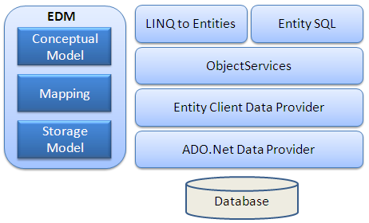
Entity Framework Architecture

Slide 365
EDM Architecture
Entity Framework Architecture
Following figure shows the overall architecture of the Entity Framework. Let’s see each component of the architecture
EDM (Entity Data Model): EDM consist three main parts- Conceptual model, Mapping and Storage model.
Conceptual Model: Conceptual model is your model classes and their relationships. This will be independent from your database table design.
Storage Model: Storage model is your database design model which includes tables, views, stored procedures and their relationships and keys.
Mapping: Mapping consist information about how your conceptual model is mapped to storage model.

Slide 366
EDM Architecture
LINQ to Entities:LINQ to Entities is query language used to write queries against the object model. It returns entities which are defined in the conceptual model. You can use your LINQ skills here.
Entity SQL:Entity SQL is again a query language same as LINQ to Entities. However it is little more difficult than L2E and also developer need to learn it separately.
Object Service:Object service is a main entry point for accessing data from database and to return it back. Object service is responsible for materialization which is process of converting data returned from entity client data provider (next layer) to an entity object structure.
Entity Client Data Provider:The main responsibility of this layer is to convert L2E or Entity SQL queries into SQL query which is understood by underlying database. It communicates with ADO.Net data provider which in turn sends or retrieves data from database.
ADO.Net Data Provider:This layer communicates with database using standard ADO.Net.

Slide 367
Types of Entities
Code First
Model First
Database First

Slide 368
Code First
Code First: In the Code First approach, you avoid working with visual model designer (EDMX) completely. You write your POCO classes first and then create database from these POCO classes. Developers who follow the path of Domain-Driven Design (DDD) principles prefer to begin by coding their classes first and then generating the database required to persist their data.
One important thing to understand is that there are two new types introduced for Code First approach, DbContext and DbSet. DbContext is a simplified alternative to ObjectContext and is the primary object for interacting with a database using a specific model. DbSet(Of TEntity) is a simplified alternative to ObjectSet(Of TEntity) and is used to perform CRUD operations against a specific type from the model in Code First approach.

Slide 369
Model First
Model First: In Model First approach, you create Entities, relationships, and inheritance hierarchies directly on the design surface of EDMX. So in Model First approach, when you add ADO.NET Entity Data Model, you should select ‘Empty Model’ instead of ‘Generate from database’.

Slide 370
Database First
So when you generate EDMX from existing database then it is a Database First approach.

Slide 371
Language Integrated Query (LINQ)

Slide 372
What is LINQ?
“Language Integrated Query”
Evolution of application data management
Coming with C# 3.0 and VB.NET 9.0

Slide 373
The Problem
Worlds of OO and data access are far, far apart
OO language types and native database types are often different
SQL code is “inside the quotes”
No strong typing or compile-time type checking
No Intellisense
No Statement completion
SQL and XML have query languages, objects to not
LINQ seeks to bridge the gap

Slide 374
What is LINQ?
C#
VB
Others…
.NET Language Integrated Query
Standard Query Operators
DLinq (ADO.NET)
XLinq
(System.Xml)
<book>
<title/>
<author/>
<year/>
<price/>
</book>
Objects
SQL
WinFS
XML
Source: Anders Hejlsberg’s PDC Presentation
Notes:
Standard Query Operators – can query anything implementing IEnumerable<T>
XLinq – Provide LINQ for .NET and address issues found over the past ten years of using the DOM

Slide 375
Language Enhancements
Lambda Expressions
Extension Methods
Local Variable Type Inference
Object Initializers
Anonymous Types
Query Expressions
C => c.Name
c.Customers.Where(…).Select(…)
var n = 5;
New {c.Name, c.Phone}
from..where…select
new Point {x=1, y=2}

Slide 376
Standard Query Operators
Restriction | Where
Projection | Select, SelectMany
Ordering | OrderBy, ThenBy
Grouping | GroupBy
Quantifiers | Any, All
Partitioning | Take, Skip, TakeWhile, SkipWhile
Sets | Distinct, Union, Intersect, Except
Elements | First, FirstOrDefault, ElementAt
Aggregation | Count, Sum, Min, Max, Average
Conversion | ToArray, ToList, ToDictionary
Casting | OfType<T>
Source: Anders Hejlsberg’s PDC Presentation

Slide 377
DLinq
A means of managing relational data
Queries in quotes
Accessing data today:
SqlConnection c = new SqlConnection(…);
c.Open();
SqlCommand cmd = new SqlCommand(
@"SELECT c.Name, c.Phone
FROM Customers c
WHERE c.City = @p0");
cmd.Parameters.AddWithValue("@p0", "London“);
DataReader dr = c.Execute(cmd);
while (dr.Read()) {
string name = dr.GetString(0);
string phone = dr.GetString(1);
DateTime date = dr.GetDateTime(2);
}
dr.Close();
Loosely bound arguments
Loosely typed result sets
No compile time checks

Slide 378
DLinq
Accessing data with DLinq
Classes describe data
public class Customer { … }
public class Northwind: DataContext
{
public Table<Customer> Customers;
…
}
Tables are like collections
Strongly typed connection
Northwind db = new Northwind(…);
var contacts =
from c in db.Customers
where c.City == "London"
select new { c.Name, c.Phone };
Integrated query syntax
Strongly typed results

Slide 379
DLinq
Language integrated data access
Maps tables and rows to classes and objects
Builds on ADO.NET and .NET Transactions
Mapping
Encoded in attributes
Relationships map to properties
Persistence
Automatic change tracking
Updates through SQL or stored procedures
Notes:
Not replacing anything in ADO.NET – it is all purely additive
Mapping is a lightweight ORM with LINQ

Slide 380
XLinq
Programming XML today
Imperative model
XmlDocument doc = new XmlDocument();
XmlElement contacts = doc.CreateElement("contacts");
foreach (Customer c in customers)
if (c.Country == "USA") {
XmlElement e = doc.CreateElement("contact");
XmlElement name = doc.CreateElement("name");
name.InnerText = c.CompanyName;
e.AppendChild(name);
XmlElement phone = doc.CreateElement("phone");
phone.InnerText = c.Phone;
e.AppendChild(phone);
contacts.AppendChild(e);
}
doc.AppendChild(contacts);
Document centric
No integrated queries
Memory intensive
<contacts>
<contact>
<name>Great Lakes Food</name>
<phone>(503) 555-7123</phone>
</contact>
…
</contacts>
Notes:
Programming with XML today is a very “imperitive” exercise
Can’t do anything without an XML document
XPath does offer some query intergration, but it isn’t integrated with the programming language
Programming with the DOM is a lot like working in assembler
You have to focus on how you want something done, not on what you want done

Slide 381
XLinq
Programming XML with XLinq
Declarative model
XElement contacts = new XElement("contacts",
from c in customers
where c.Country == "USA"
select new XElement("contact",
new XElement("name", c.CompanyName),
new XElement("phone", c.Phone)
)
);
Element centric
Integrated queries
Smaller and faster
Notes:
Declaritive model
You focus on what you want done and less on how you want to do it
30 to 50 percent less overhead than the DOM

Slide 382
XLinq
Language integrated query for XML
Expressive power of XPath / XQuery
But with C# or VB as programming language
Leverages experience with DOM
Element centric, not document centric
Functional construction
Text nodes are just strings
Simplified XML namespace support
Faster and smaller

Slide 383
What is LINQ?
The LINQ project is:
Language Integrated Query for .NET
Native query syntax for .NET languages
Standard Query Operators
SQL-like method extensions for any .NET collection
System.Query namespace
DLinq
Code name for future version of ADO.NET
Query enabled data access framework
System.Data.Xlinq namespace
XLinq
Query enabled, smaller, faster XML DOM
System.XML.Xlinq namespace

Slide 384
Benefits of LINQ
Unified querying of objects, relational, XML
Type checking and IntelliSense for queries
SQL and XQuery-like power in C# and VB
Extensibility model for languages / APIs

Slide 385
Closing Thoughts
Not sure where use of LINQ will coincide with SQL
Use may well be driven by data management standards of an organization
Where should data access really “live”
ORM synchronization
This could really be a revolution

Slide 386
C# Nullable Types
CLR data types have a fixed range and are represented as a type in the System namespace
Value types can never be assigned the value of null, as that is used to establish an empty object reference
Since the release of .NET 2.0, it has been possible to create nullable data types.

Slide 387
Nullable Contd…
A nullable type can represent all the values of its underlying type, plus the value null.
Example : bool? nullableBool = null;

Slide 388
ASP.NET v2+ Compilation
Dynamic compile
File containing separated code
Class that the page-gen inherits from
An (optional) class-name for the page-gen class
<%@ Page codefile=“default.aspx.cs” inherits=“_Default” classname=“MyClass”
public partial class _Default : System.Web.UI.Page
Class is ‘partial’. Combined to auto-gen’ partial class
Base Class. Final base is System.Web.UI.Page
Auto-generated partial class
Default2
Partial class defined in codefile
Auto-generated page class
Default2
MyClass2
Auto-generated page class
MyClass
Auto-generated partial class
_Default
Partial class defined in codefile
_Default
System.Web.UI.Page

Slide 389
Server Controls
These controls are created and configured as objects.
They run on the web server and they automatically provide their own HTML

Slide 390
HTML Server Controls
These are server-based equivalents for standard HTML elements.
These controls are ideal if you’re a seasoned web programmer who prefers to work with familiar HTML tags (at least at first).
They are also useful when migrating ordinary HTML pages or ASP pages to ASP.NET, because they require the fewest changes.

Slide 391
Web Controls
These are similar to the HTML server controls, but they provide a richer object model with a variety of properties for style and formatting details.
Provide more events and more closely resemble the controls used for Windows development.
Web controls also feature some user interface elements that have no direct HTML equivalent, such as the GridView, Calendar, and validation controls.

Slide 392
Field Validator controls
Control | Description | HTML or JavaScript Code Example
RequiredFieldValidator | Allows you to check a control on the form to see if it is filled in with anything. If it isn't, the ErrorMessage that you set will be displayed in this control. | <asp:RequiredFieldValidator id=RequiredFieldValidator1 runat="server" ErrorMessage= "RequiredFieldValidator"> < /asp:RequiredFieldValidator>
CompareValidator | Allows you to check the contents of one control against the contents of another control on the form to see if they match. If they don't, the ErrorMessage that you set will be displayed into this control. | <asp:CompareValidator id=CompareValidator1 runat="server" ErrorMessage= "CompareValidator"> < /asp:CompareValidato>
RangeValidator | Allows you to check to see whether the value you entered in a control is within a specified range. If it isn't, the ErrorMessage that you set will be displayed into this control. | <asp:RangeValidator id=RangeValidator1 runat="server" ErrorMessage= "RangeValidator"> < /asp:RangeValidator>

Slide 393
Field Validator Contd..
RegularExpressionValidator | Allows you to check to see if a control's contents match the input mask (regular expression) you defined. If it doesn't, the ErrorMessage that you set will be displayed into this control. | <asp:RegularExpressionValidator id=RegularExpressionValidator1 runat="server" ErrorMessage= "RegularExpressionValidator"> < /asp:RegularExpressionValidator>
CustomValidator | Allows you to specify either a server-side or client-side script function to validate the contents of a particular control. You must return a True or False value from these functions. If a True value is returned, processing continues; if a False value is returned, the ErrorMessage specified for this control is displayed. | <asp:CustomValidator id=CustomValidator1 runat="server" ErrorMessage= "CustomValidator"> < /asp:CustomValidator>

Slide 394
Tracing messages
Page Level
Application Level
Custom trace message output
Web Events

Slide 395
Page-Level Tracing
Trace Object
<% Page Trace = "true" %>
Trace.Write()
Trace.Warn()
Both writing a message in trace log
Warn - Red and Write - Black
Optionally, Use System.Diagnostics.Trace

Slide 396
Application-Level Tracing
Setting in Web.config
<trace enabled = "true" />
Accessed via URL
http://localhost/trace.axd
Additional Settings
traceMode
requestLimit
pageOutput
localOnly

Slide 397
Custom Trace Message Output
TraceContext object
TraceContext.TraceFinished Event
TraceRecords
Passed in the 'e' object Parameter
TraceContextRecord

Slide 398
ASP.NET

Slide 399
INTERNET
WEBSERVER
Browser
Output HTML
ASP.Net File
Request
HTML File
Client

Slide 400
Difference between ASP and ASP.net
ASP. net is a compiled code but ASP is interpreted ,so ASP.Net is faster than ASP
ASP is based on COM architecture but ASP.Net is based on XML and CLR
ASP was supported by few languages like JavaScript, VBScript but ASP.Net supports multiple language kept in .net framework
ASP.Net has no dependency on browser as compared to ASP
ASP.Net has its own set of user-interface control which was lacking in ASP
ASP.Net has in-built validation controls which generates validation scripts automatically

Slide 401
Kinds of Application in ASP.Net
WebForm :- Webapplication which uses user-interface controls to develop portals and other website elements
Webservices:- Are sharable component which can be accessed by any type of client in distributed environment (uses XML with SOAP protocol)
Simple Object Access Protocol which uses HTTP and XML

Slide 402
ASP.Net file
Earlier ASP was having HTML as a part of User-Interface and ASP code as a Business logic
ASP.net file has single file which manages both UI and Logics but still it maintains separation of UI and Business logic which helps in easier development
ASP.Net page can generate server side events which is new thing compared to ASP which was making possible to send the same page back to the server for processing. It is called PostBack Event.
ASP.net application can be put with some configuration and security level which is new in .net which is done using XML

Slide 403
ASP.Net Controls
WebServer Controls:- asp controls for user-interface and has corresponding classes in framework
Validation Controls:- used to generate automatic validation scripts at run-time which a programmer was supposed to write in earlier ASP page using client-side scripting with JavaScript or VBScript
Html Controls:- These are included to give compatibility to previous HTML tags. They have corresponding classes in framework.

Slide 404
Files Used in ASP.Net Application
AssemblyInfo.cs:- This file contains a set of attributes that contain general information about the assembly such as the name, description, and version of the assembly
Global.asax:- Each Web application will have one Global.asax file attached to it. It contains scripts that define the start and end events of the application and its sessions. This file is global to an application
Web.config:- This is the configuration file for your application. It is an XML file that contains configuration data on each URL resource used in the project.

Slide 405
Files Used in ASP.Net Application
WebApplication.vsdisco:- This is an XML file containing URLs that link to resources with information related to dynamic discovery of Web services.
WebForm1.aspx:- This file is the default Web Form created by IDE when you start a new application. It is a page file that consists of the user interface for the visual representation of the Web Forms page.

Slide 406
Understanding the Automatically Generated Code
In HTML mode, the first line of a .aspx
file contains the following line of code:
<%@ Page language=“vb”
Codebehind=“WebForm1.aspx.vb” AutoEventWireup=“false” Inherits=“WebApplication1.WebForm1”
Language:-Any .NET Framework supported language.
Codebehind:- The code-behind for a page
Inherits:- The class in the code-behind file that a page inherits. This class can be any class derived from the Page class

Slide 407
Page Events
Init:- The page is initialized
Load:- The page is loaded into memory
Unload:- The page is unloaded from memory
Note:- You can avoid firing of Init and Load events by using IsPostBack property of a Web page. A false value indicates that the page is displayed for the first time. A true value indicates the page is run as a result of a round trip.

Slide 408
ASP.Net Built-in Objects
Application:- used to store information shared among all users of an application
Request:- used to access information sent in a request from browser to the server from an HTML form
Response:- used to send information to the browser as a output
Session:- used to store and retrieve information about particular user session

Slide 409
Validation Controls in ASP.Net
RequiredFieldvalidator:- used to check whether a server control has a value or not.
CompareValidator:- used to perform comparisons between a value entered with another value
RangeValidator:- used to check whether the value of a Web form field is within the minimum number and the maximum number. It can be a dates, number, currency or strings
ValidationSummary:- used to summarize all errors and display the error list in a user-specified location in the Web page

Slide 410
Data Binding Server Controls
Single-value Data binding
Binding to a property
Binding to a Method
Binding to an expression
Multi-Record Data Binding
Binding to an Array Lists
Binding to a Data View
Binding to Datagrid, DataList and Repeator

Slide 411
ASP.NET Controls

Slide 412
Objectives
Different Controls in ASP.NET
Validation Control
User Control
Master Page
Thems and Skins
Data binding
Different Data bound controls

Slide 413
What is Validation?
Often when your ASP.NET applications are collecting information from a user, you want to ensure that the data that you collect is valid
Validation is testing to determine whether the user entered something into the field.
After you determine that something was entered, you can then also check to see whether what was entered is a number or a character and if it is in the correct format.
From there, you can compare user input in different fields or against values that might be held in other repositories, such as a database.

Slide 414
Client-side and Server-side Validation
Server-side Validation
After the user enters data into a Web form, clicks the Submit button, and sends the form data to the server as a request, you can perform server-side validation on the data.
If the data is incorrect or not valid, you can send back a response stating this.
Client-side Validation
If, however, when the user clicks the Submit button, a scripting language that is part of the overall HTML page is initiated to check the validity of the data before it is sent to the server, this is client-side validation.

Slide 415
Validation Technique Before ASP.NET
Developers who used classic Active Server Pages 3.0 to develop Web pages used to spend a considerable amount of their time developing validation mechanics in their pages.
It was time consuming.
It was never quite sure if the requesting browser would understand the scripting code that used for the validation.
So, it was usually better, especially for critical Web applications, to bring the validation to the server.
ASP.NET provides a set of validation controls that provide an easy-to-use but powerful way to check for errors and, if necessary, display messages to the user.

Slide 416
Benefits of using Validation Controls
when an ASP.NET page containing these controls is requested, it is the ASP.NET engine that decides whether to perform the validation on the client or on the server depending on the browser that is making the request.
Therefore, your page's functionality changes depending on the requesting browser—thus enabling you to make your Web pages the best they can possibly be
Validation server controls are the only type of ASP.NET server controls that also generate client-side script.
All the other controls work with the idea of making postbacks to the server (a request to the server to get a response).

Slide 417
Different Validation Controls
Presently, six different validation server controls are available for ASP.NET:
Validation Server Control | Description
RequiredFieldValidator | Ensures that the user does not skip a form entry field
CompareValidator | Allows for comparisons between the user's input and another item using a comparison operator (equals, greater than, less than, and so on)
RangeValidator | Checks the user's input based upon a lower- and upper-level range of numbers or characters
RegularExpressionValidator | Checks that the user's entry matches a pattern defined by a regular expression. This is a good control to use to check e-mail addresses and phone numbers
CustomValidator | Checks the user's entry using custom-coded validation logic
ValidationSummary | Displays all the error messages from the validators in one specific spot on the page

Slide 418
Not All Button Clicks are Equal
Normally, in a series of HTML form elements, there is some sort of Button, ImageButton, or LinkButton control on the page that submits the form and causes the validation to initiate.
You may not want each and every button on the ASP.NET page to initiate validation.
For instance, you might have a Cancel or Reset button on the Web page. If the user clicks one of these buttons, you don't want that button click to validate the contents contained in the Web form.
To prevent this, you have to set the CausesValidation property for the control to False.

Slide 419
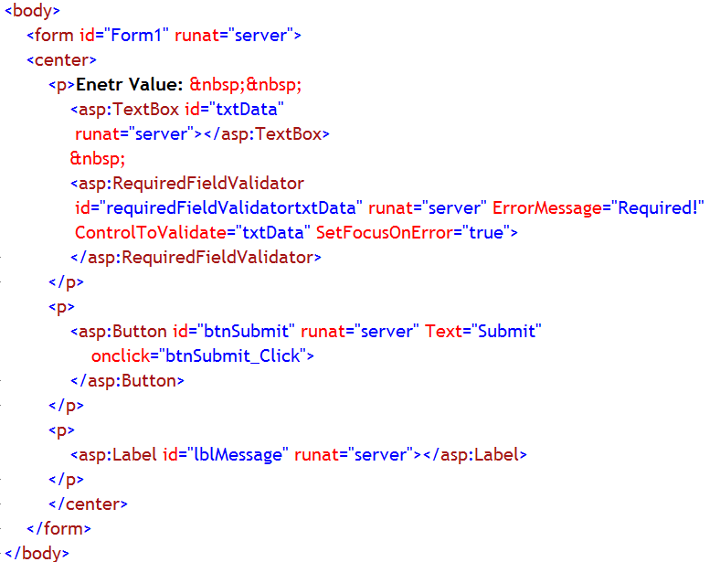
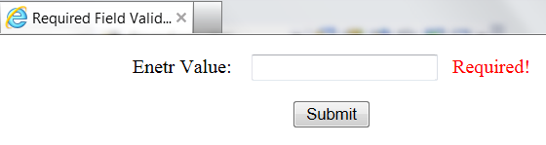
RequiredFieldValidator Control
The RequiredFieldValidator server control makes sure that the user enters something into the field that it is associated with in the form.
You need to tie the RequiredFieldValidator to each control that is a required field in the form.
Notes:
Note:
In this example a Web form contains a TextBox server control, Label server control and a Button server control.
Next to the text box, a RequiredFieldValidator server control is placed, whose job is to check whether user entered any data in the text box or not.
When the page is run the user is expected to enter some text in the TextBox control
If the button is clicked without entering anything in the TextBox control, RequiredFieldValidator control will display the error message
Otherwise, the Label control displays the data entered in the text box control.

Slide 420
Important Properties of RequiredFieldValidator Control
Property | Description
ControlToValidate | Gets or sets the input control to validate.
ErrorMessage | Gets or sets the text for the error message displayed in a ValidationSummary control when validation fails.
SetFocusOnError | Gets or sets a value that indicates whether focus is set to the control specified by the ControlToValidate property when validation fails.
Text | Gets or sets the text displayed in the validation control when validation fails.

Slide 421
CompareValidatorControl
The CompareValidator server control compares the value entered into the form field to another field, a database value, or other value that you specify.
When comparing against data types, you just set the Operator—DataTypeCheck.
After that is done, you can set the Type attribute to String, Integer, Double, Date, or Currency in the CompareValidator control to make sure that the user's input into the field is the specified type.

Slide 422
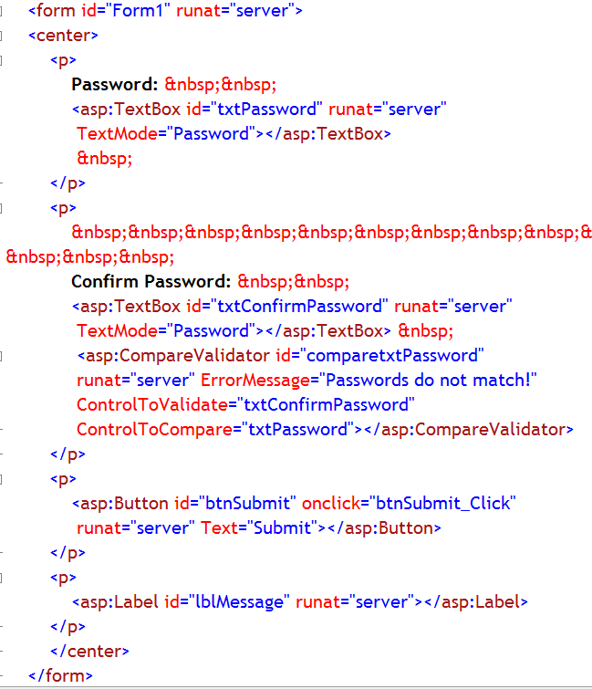
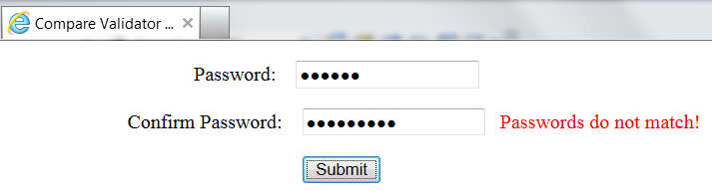
Example
Notes:
Note:
In this example a Web form contains two TextBox server controls. One to accept a password and another to retype the same password from the user. Also a Button and a Label server control are placed on the page
Next to the second text box (for retyping the password), a CompareValidator server control is placed. It’s job is to compare the password entered in the second text box with that of the first text box.
When the page is run the user is expected to enter same password in both the text boxes.
If user clicks the button after entering two different passwords in those text boxes, then CompareValidator control will display the error message
Otherwise Label control will display a message “Password match”

Slide 423
Important Properties of CompareValidatorControl
Property | Description
ControlToValidate | Gets or sets the input control to validate
ControlToCompare | Gets or sets the input control to compare with the input control being validated.
Operator | Gets or sets the comparison operation to perform
ErrorMessage | Gets or sets the text for the error message displayed in a ValidationSummary control when validation fails.
SetFocusOnError | Gets or sets a value that indicates whether focus is set to the control specified by the ControlToValidate property when validation fails.
Text | Gets or sets the text displayed in the validation control when validation fails.
Type | Gets or sets the data type that the values being compared are converted to before the comparison is made

Slide 424
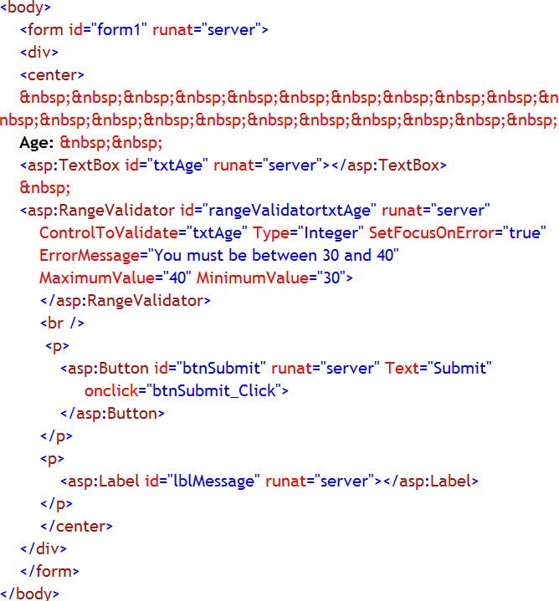
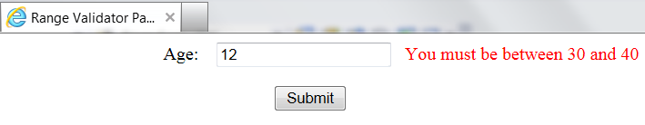
RangeValidator Control
The RangeValidator server control is similar to the CompareValidator server control, but the RangeValidator server control compares what is entered into the form field with two values and makes sure that what was entered by the user is between these two specified values.
Notes:
Note:
In this example a Web form contains a TextBox server control, a Button server control and a Label server control.
Next to the text box, a RangeValidator server control is placed, whose job is to check whether the age entered by the user falls between 30 and 40 or not.
When the page is run the user is expected to enter age between 30 and 40 and not outside the mentioned range in the TextBox control
If the user button clicks the button, after entering an age, which falls outside the mentioned range, in the TextBox control, RangeValidator control will display the error message
Otherwise Label control will display “VALID PAGE”.

Slide 425
Important Properties of RangeValidatorControl
Property | Description
ControlToValidate | Gets or sets the input control to validate
ErrorMessage | Gets or sets the text for the error message displayed in a ValidationSummary control when validation fails.
MaximumValue | Gets or sets the maximum value of the validation range.
MinimumValue | Gets or sets the minimum value of the validation range.
SetFocusOnError | Gets or sets a value that indicates whether focus is set to the control specified by the ControlToValidate property when validation fails.
Text | Gets or sets the text displayed in the validation control when validation fails.
Type | Gets or sets the data type that the values being compared are converted to before the comparison is made

Slide 426
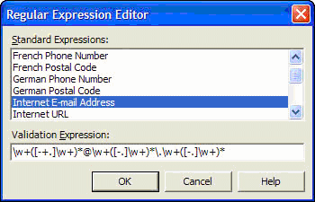
RegularExpressionValidator Control
In the Properties window for the RegularExpressionValidator server control, click the button in the ValidationExpression box, and Visual Studio.NET provides you with a short list of expressions to use in your form via the Regular Expression Editor. However, you are not limited to these regular expressions in your ASP.NET applications.
The RegularExpressionValidator server control is a validation control that enables you to check the user's input based on a pattern defined by a regular expression.
This is a great control to check whether the user has entered a valid e-mail address or telephone number.
In the past, these kinds of validations took a considerable amount of JavaScript coding.
The RegularExpressionValidator control with ASP.NET saves coding time

Slide 427
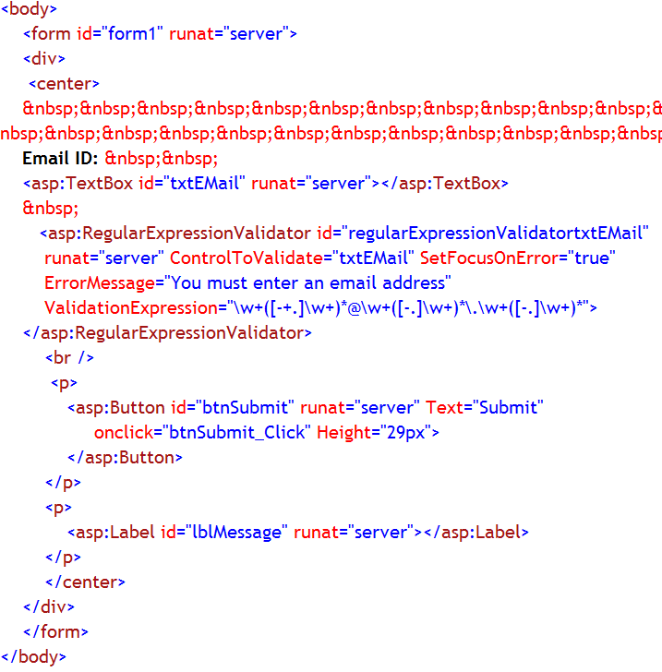
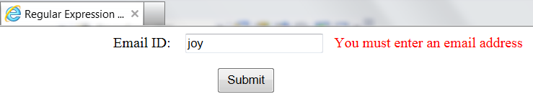
Example
Notes:
Note:
In this example a Web form contains a TextBox server control to accept an user id, Label server control and a Button server control.
Next to the text box, a RegularExpressionValidator server control is placed, whose job is to check whether user entered user id is in the email address format or not
When the page is run the user is expected to enter user id in the TextBox control
If user clicks the button after an user id, which does not match the email address format, in the TextBox control, RegularExpressionValidatorValidator control will display the error message
Otherwise, the Label control displays a message, “Thanks for entering email address…”.

Slide 428
Important Properties of RegularExpressionvalidator Control
Property | Description
ControlToValidate | Gets or sets the input control to validate
ErrorMessage | Gets or sets the text for the error message displayed in a ValidationSummary control when validation fails.
ValidationExpression | Gets or sets the regular expression that determines the pattern used to validate a field.
SetFocusOnError | Gets or sets a value that indicates whether focus is set to the control specified by the ControlToValidate property when validation fails.
Text | Gets or sets the text displayed in the validation control when validation fails.

Slide 429
CustomValidator Control
The CustomValidator server control enables you to develop your own custom server-side or client-side validations.
At times, you may want to compare the user's input to a value in a database, or to determine whether his input conforms to some arithmetic validation (for instance, if the number is even or odd) or password is strong or not.
You can do all this and more by using this type of validation control.
It supports both client and server side validation through custome code

Slide 430
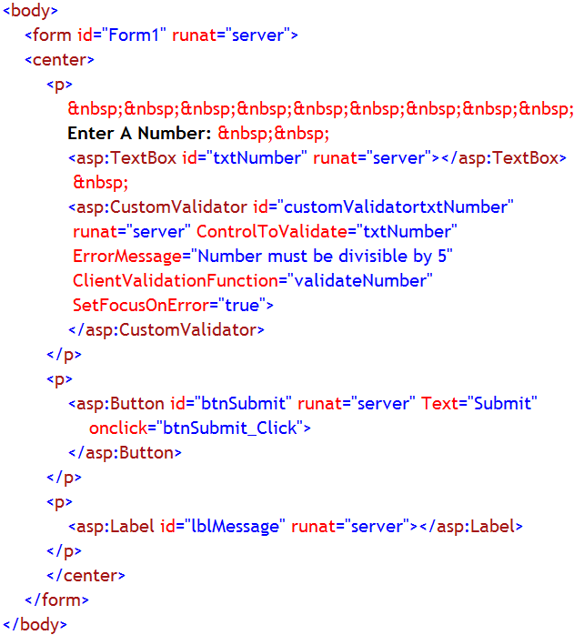
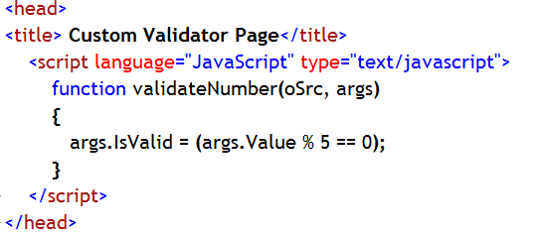
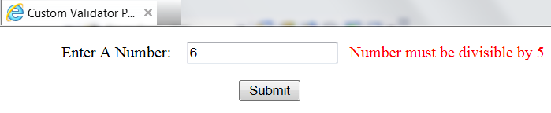
Client-side Validation by CustomValidator
Allows for client-side validation of certain HTML server controls.
You can create your own JavaScript functions that provide you with a higher level of validation capabilities.
Notes:
Note:
In this example a Web form contains a TextBox server control to accept a number, Label server control and a Button server control.
Next to the text box, CustomValidator server control is placed, whose job is to check whether user entered number is divisible by 5 or not
When the page is run the user is expected to enter a number in the TextBox control
If user clicks the button after entering any number, which is not divisible by 5, in the TextBox control, CustomValidatorValidator control will display the error message
Otherwise, the Label control displays a message, “VALID NUMBER..”
In this case, the custom validation code has been written in JavaScript in Source part of the .aspx file.
ClientValidationFunction property of CustomValidator control is used to accept the JavaScript function name.
When the submit button is clicked, even before page submission, the JavaScript method is called by the CustomValidator control and validation is done on the text box control.
If validation fails, then the page is not submitted to the server.

Slide 431
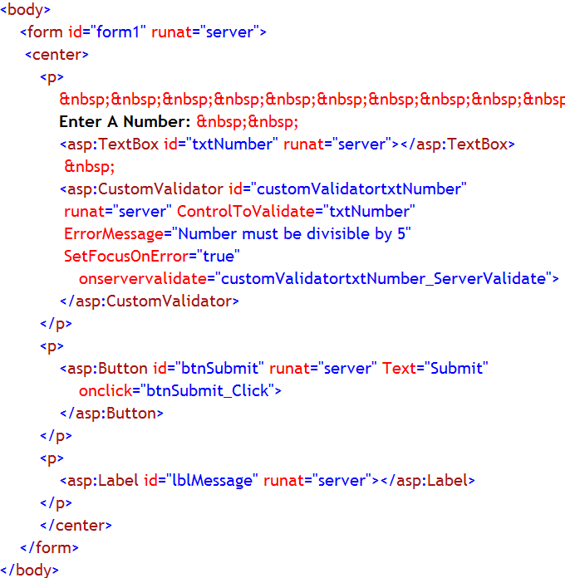
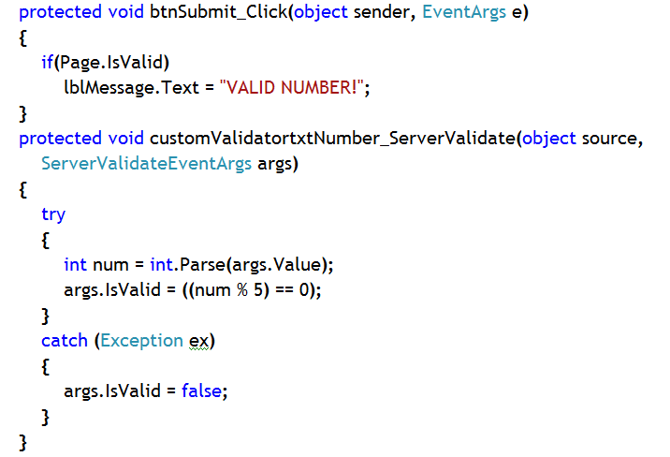
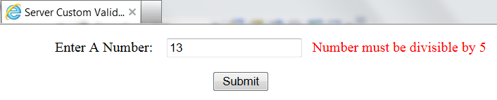
Server-side Validation By CustomValidator
The other way of performing validation on Web forms using the CustomValidator server control is to use server-side validation. This is just as easy as the client-side validation.
Server-side validation of your Web forms enables you to create rather elaborate validation capabilities
Notes:
Note:
In this example a Web form contains a TextBox server control to accept a number, Label server control and a Button server control.
Next to the text box, CustomValidator server control is placed, whose job is to check whether user entered number is divisible by 5 or not
When the page is run the user is expected to enter a number in the TextBox control
If user clicks the button after entering any number, which is not divisible by 5, in the TextBox control, CustomValidatorValidator control will display the error message
Otherwise, the Label control displays a message, “VALID NUMBER..”
In this case, the custom validation code has been written in server side C# code in Code-behind file (.aspx.cs file).
ServerValidate event of CustomValidator control has been handled by an event-handler, which accepts one argument of type ServerValidateEventArgs (inherited from EventArgs class). This class represents the argument (i.e., the number entered in the text box control) to be validated. It has a property Value to represent the argument to be validated and a property IsValid to check whether the argument is validated or not.
When the submit button is clicked, after page submission, the onServerValidate method invokes ServerValidate event of CustomValidator control and passes the number entered in the text box to the event handler and then validation is done on the text box control.
Validation has succeeded or not, is checked under Click event of the Button control, using IsValid property of the Page class.

Slide 432
Important Properties of CustomValidator Control
Property | Description
ControlToValidate | Gets or sets the input control to validate
ErrorMessage | Gets or sets the text for the error message displayed in a ValidationSummary control when validation fails.
ClientValidationFunction | Gets or sets the name of the custom client-side script function used for validation.
SetFocusOnError | Gets or sets a value that indicates whether focus is set to the control specified by the ControlToValidate property when validation fails.
Text | Gets or sets the text displayed in the validation control when validation fails.
ServerValidate Event: Occurs when validation is performed on the server.
OnServerValidate Method: Raises the ServerValidate event for the CustomValidator control.

Slide 433
ValidationSummary Control
The ValidationSummary server control works with all the validation server controls on the page.
It takes all the error messages that the other validation controls send back to the page and puts them all in one spot (that you specify) on the page.
These error messages can be displayed in a list, bulleted list, or paragraph.

Slide 434
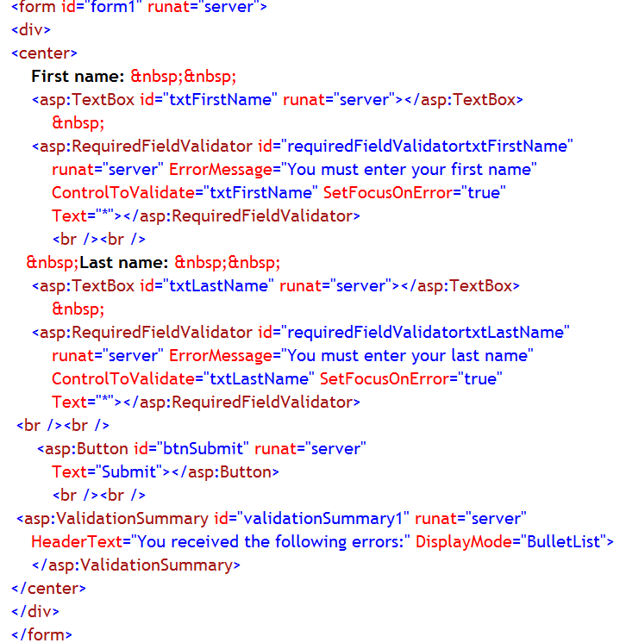
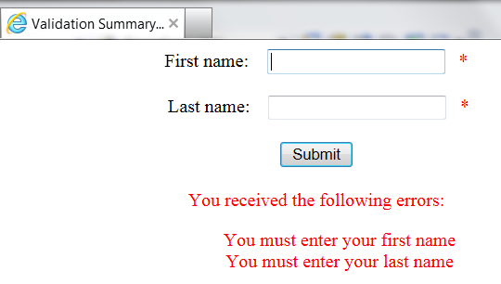
Example:
Notes:
Note:
In this example a Web form contains two TextBox server control to accept fisrt name and last name of a person and a Button server control.
Next to the text boxes, two RequiredFieldValidator server controls are placed, whose job is to check whether user entered anything in those text boxes or not.
Also, Text property of those two RequiredFieldValidator controls have been set to a special character (*), so that error messages are not directly displayed besides the text boxes.
A ValidationSummary control has been placed at the bottom of the page, to encapsulate all the error messages originating due to different validation failure.
When the page is run the user is expected to first and last names in those two TextBox controls
If user clicks the button without entering anything in those TextBox controls, RequiredValidator controls will display the special characters
And, ValidationSummary control will display both error messages supplied by RequiredFieldValidator controls.
In this case DisplayMode property of ValidationSummary control has been used to set the display style of those error messages for ValidationSummary control
Possible values of DisplayMode property are “List”,”BulltedList” and “SingleParagraph”.

Slide 435
Important Properties of Validation Summary Control
Property | Description
DisplayMode | Gets or sets the display mode of the validation summary.
ShowMessageBox | Gets or sets a value indicating whether the validation summary is displayed in a message box
ShowSummary | Gets or sets a value indicating whether the validation summary is displayed inline

Slide 436
User Controls
At times, you might need functionality in a control that is not provided by the built-in ASP.NET Web server controls.
In those cases, you can create your own controls.
You have two options. You can create:
User controls. User controls are containers into which you can put markup and Web server controls. You can then treat the user control as a unit and define properties and methods for it.
Custom controls. A custom control is a class that you write that derives from Control or WebControl
User controls are substantially easier to create than custom controls, because you can reuse existing controls. They make it particularly easy to create controls with complex user interface elements

Slide 437
User Control
What is User Control?
How to Use User Control?
User Control is used to apply common style on all or few pages of a Web Site
It is not a web page.
Extension: .ascx
Starts with @Control directive
No HTML mark-up
Has code-behind file, too
Registered with every page where you want to use that control
Can’t be used with a page if the control is not registered with the page
Add a WebUserControl.ascx file in the web site.
Rename it with a proper name
Create your desired style in it
Build the page
Register this control in the page on which you want to apply the style
Register the control in that web page using @Register directive
Use it on the page by adding the control manually through Source part of the page

Slide 438
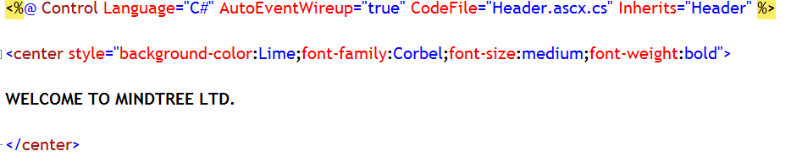
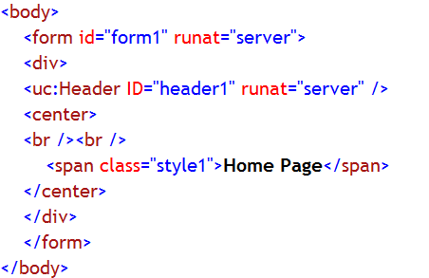
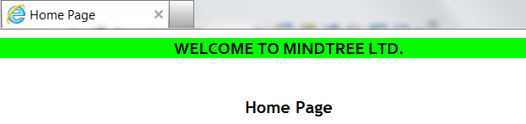
Example:
Control Directive
Header.ascx file source part
HomePage.aspx source part
Register Directive to register user control in web page
Using user control
Page displayed in browser with user control
Notes:
Note:
In this web site a WebUserControl, Header.ascx has been added and designed properly
Header.ascx has been built
Using Register directive the user control has been registered with HomePage.aspx
In the body section of the page, the control has been manually added on the Form.

Slide 439
Register Directive
This directive is used to register any web user control on a web page.
If the web user control is not registered with a page using Register directive, then the user control can’t be used on the page
The attributes of Register directive:
A TagPrefix attribute, which associates a prefix with the user control. This prefix will be included in opening tag of the user control element.
A TagName attribute, which associates a name with the user control. This name will be included in the opening tag of the user control element.
A Src attribute, which defines the virtual path to the user control file that you are including

Slide 440
Difference Between a Web Page and a Web User Control
A user controls differs from an ASP.NET Web page in these ways:
The file name extension for the user control is .ascx.
Instead of an @ Page directive, the user control contains an @ Control directive that defines configuration and other properties.
User controls cannot run as stand-alone files. Instead, you must add them to ASP.NET pages, as you would any control.
The user control does not have html, body, or form elements in it. These elements must be in the hosting page.

Slide 441
Advantages and Disadvantages of User Control
Advantage:
Once created, can be applied on all web pages or selected web pages
Existing controls can be used to create user control
Easier to use on web page, just use Register directive
Disadvantages:
It has to be registered with every web page manually
Not available in ToolBox. So, it has to be manually added in the body of the web page

Slide 442
Master Page
ASP.NET master pages allow you to create a consistent layout for the pages in your application.
A single master page defines the look and feel and standard behavior that you want for all of the pages (or a group of pages) in your application.
You can then create individual content pages that contain the content you want to display.
When users request the content pages, they merge with the master page to produce output that combines the layout of the master page with the content from the content page.

Slide 443
Master Page Details
A master page is an ASP.NET file with the extension .master (for example, MySite.master)
The master page is identified by a special @ Master directive that replaces the @ Page directive that is used for ordinary .aspx pages.
Has a predefined layout that can include static text, HTML elements, and server controls.
In addition to static text and controls that will appear on all pages, the master page also includes one or more ContentPlaceHolder controls.
These placeholder controls define regions where replaceable content will appear.
In turn, the replaceable content is defined in content pages.
<%@ Master Language="C#" CodeFile="MasterPage.master.cs" Inherits="MasterPage" %>

Slide 444
Applying Master Page Style: Content Page
You define the content for the master page's placeholder controls by creating individual ASP.NET pages that are bound to a specific master page.
These individual ASP.NET pages are known as Content Pages
The binding is established in the content page's @ Page directive by including a MasterPageFile attribute that points to the master page to be used.
For example, a content page might have the following @ Page directive, which binds it to the Master1.master page.
<%@ Page Language="C#" MasterPageFile="~/MasterPages/Master1.master" Title="Content Page"%>

Slide 445
Applying Master Page Style: Content Control
In the content page, you create the content by adding Content controls and mapping them to ContentPlaceHolder controls on the master page.
For example, the master page in the previous example have two content placeholders called Main and Footer.
In the content page, you can create two Content controls, one that is mapped to the ContentPlaceHolder control Main and the other mapped to the ContentPlaceHolder control Footer
<% @ Page Language="C#" MasterPageFile="~/Master.master" Title="Content Page 1" %>
<asp:Content ID="Content1" ContentPlaceHolderID="Main" Runat="Server"> Main content. </asp:Content>
<asp:Content ID="Content2" ContentPlaceHolderID="Footer" Runat="Server" > Footer content. </asp:content>

Slide 446
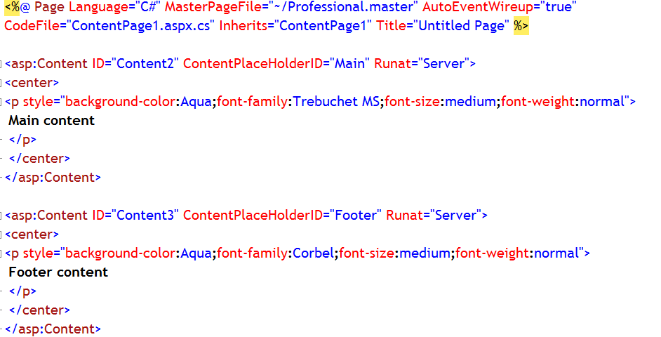
Example:
Content Control linked with Content Place Holder control of Master Page
Content Control
Notes:
Note:
This is the continuation of the previous example.
An web page has been added (ContentPage1) in the web site
While adding the page from “New Item” dialog box, “Select master Page” checkbox has been selected.
So, Master Page (Professional.master) has been applied on the page.
There are two content Content controls present on the page.
Content control, with ID, Content1 has been linked with ContentPlaceHolder1 of the Master Page through ContentPlaceHolderID property
Similarly, Content2 Content control has been linked with ContentPlaceHolder2 of the Master Page through ContentPlaceHolderID property
So, the content or design in the Content controls will be filling up the ContentplaceHolders of the Master page, while being displayed in the browser.

Slide 447
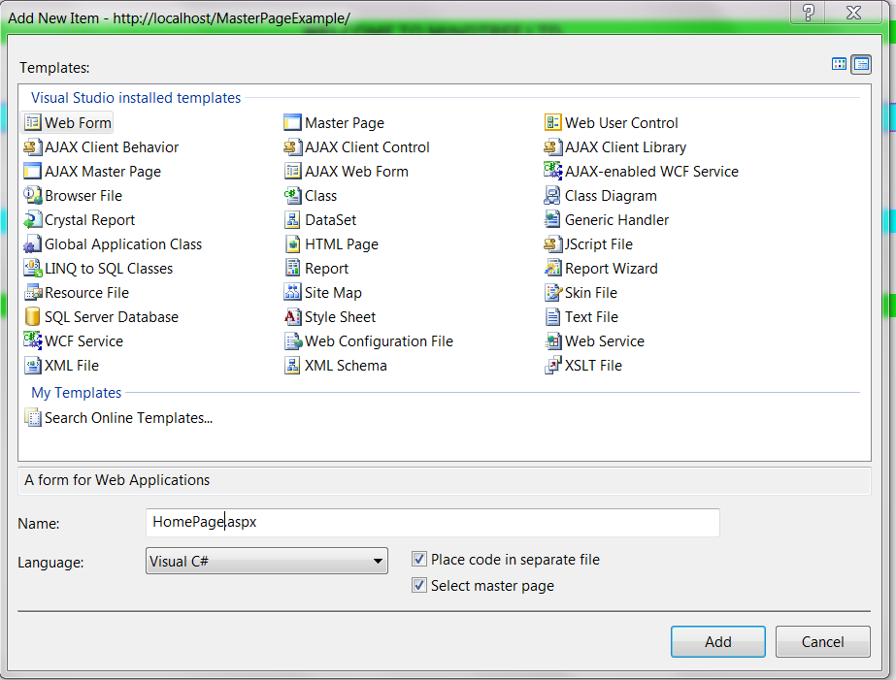
Technique to Add Content Page - 1
Add a web form in your web site
While adding, select the “Select Master Page” checkbox in “Add New Item” dialog box
The web page is added in the web site and it will not include HTML mark-up
Also, Content controls will be automatically added and linked to individual ContentPlaceHolder controls of the Master Page

Slide 448
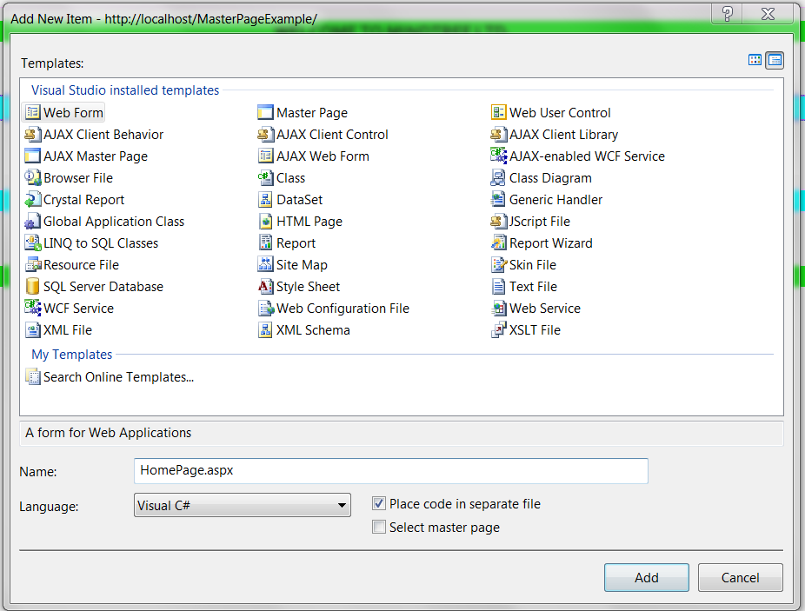
Technique to Add Content Page - 2
Add a web form in your web site
While adding, do not select the “Select Master Page” checkbox in “Add New Item” dialog box
Then manually remove total HTML mark-up section except the Page directive from source part of the .aspx file
Then manually add Content control(s) in the source part and add design in the Content control(s)
Link each and every Content control to individual ContentPlaceHolder control of the Master Page

Slide 449
Run-time Behavior of Master Pages
At run time, master pages are handled in the following sequence:
Users request a page by typing the URL of the content page.
When the page is fetched, the @ Page directive is read. If the directive references a master page, the master page is read as well. If this is the first time the pages have been requested, both pages are compiled.
The master page with the updated content is merged into the control tree of the content page.
The content of individual Content controls is merged into the corresponding ContentPlaceHolder control in the master page.
The resulting merged page is rendered to the browser.

Slide 450
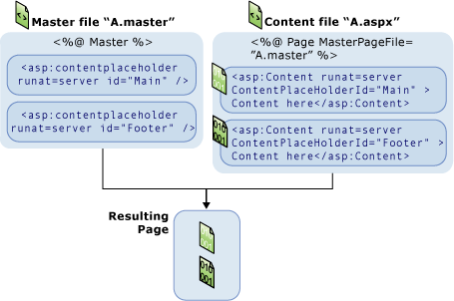
Run-time Behavior of Master Pages
From the user's perspective, the combined master and content pages are a single, discrete page. The URL of the page is that of the content page.
From a programming perspective, the two pages act as separate containers for their respective controls. The content page acts as a container for the master page. However, you can reference public master-page members from code in the content page, as described in the next section.

Slide 451
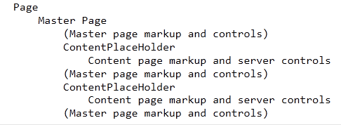
Run-time Behavior of Master Pages
Note that the master page becomes a part of the content page.
In effect, the master page acts in much the same way a user control acts — as a child of the content page and as a container within that page.
In this case, however, the master page is the container for all of the server controls that are rendered to the browser.
The control tree for a merged master and content page looks something like this

Slide 452
Advantages of Master Page
Master pages provide functionality that developers have traditionally created by copying existing code, text, and control elements repeatedly; using framesets; using include files for common elements; using ASP.NET user controls; and so on.
Advantages of master pages include the following:
They allow you to centralize the common functionality of your pages so that you can make updates in just one place.
They make it easy to create one set of controls and code and apply the results to a set of pages. For example, you can use controls on the master page to create a menu that applies to all pages.
They give you fine-grained control over the layout of the final page by allowing you to control how the placeholder controls are rendered.
They provide an object model that allows you to customize the master page from individual content pages.

Slide 453
Difference between Master Page and User Control
User Control | Master Page
1. Has @ Control directive | 1. Has @ Master directive
2. Does not contain HTML section | 2. Contains HTML section
3. Extension: .ascx | 3. Extension: .master
4. Has to be registered with web page using @ Register directive | 4. Not registered with web page, though web page should mention the name of the master page using MasterPageFile attribute of @ Page directive
5. This is used as any common control on the page, but added manually in the body section | 5. Master page and the page on which it is being applied are merged together
6. User control is used on a normal web page, which contains HTML mark-up, since User control does not contain any mark-up | 6. Master page style is applied on a page which does not contain HTML mark-up, since Master page contains HTML mark-up
7. Multiple user controls can be registered and used on a page at the same time | 7. Only one Master page style can be applied on a page at a time, though there could be multiple web pages in the web site

Slide 454
ASP.NET Themes
Themes:
Is a set of properties that are used to achieve a uniform look for the entire application.
Can also be used to provide a uniform look and feel for across all Web applications on a server.
Can include the following:
Skins – The property settings for the server controls are defined by these skins.
Cascading style sheet (.css files).
Graphics.
Need not contain all of the above – but it should at least contain the skins.
Are stored in a separate directory in the web application or the web server.
Notes:
Notes:
The theme folder can contain .skin files which can have several skins for various controls within them.
Default skins are matched exactly by control type - so a LinkButton control skin is applied to all LinkButton controls, but not to ImageButton controls

Slide 455
ASP.NET Skins
Skins:
Can contain the properties that can be applied to the server controls, such as Button, TextBox, etc. A skin file is stored as follows:
<filename>.skin where ‘.skin’ is the extension to the file and denotes that the file is a skin file.
Consist of two types of control skins:
Default skins - Are automatically applied to all the controls of the same type. If a control skin does not have the SkinID attribute defined, then it is a default skin.
Named skins – Are explicitly applied to a control by setting its SkinID property. Different instances of the same control can be applied with different skins.
Notes:
Notes:
The following is an example of a control skin for a Button control: <asp:button runat="server" BackColor="lightblue" ForeColor="black" />
You can define only one default skin per control.
Use the SkinID attribute in the skin's control declaration to create a named skin that you can apply to specific instances of a control.
If the SkinID property of a control skin is set, then it is a named skin.
Named skins have to be explicitly applied to a control by setting its SkinID property.
The advantage of using named skins is that different instances of the same control can be applied with different skins.

Slide 456
ASP.NET Themes
Themes can consist of one or more of the following:
Style sheets
Control skins
Supporting images or files
A page theme can be added to an application in the following way:
Create a new folder named App_Themes in the web site.
Now create a subfolder with the name of the theme under the App_Themes folder.
For example, to create a theme named AdminTheme, create a folder named \App_Themes\AdminTheme.
Now skins, style sheets, and images that make up the theme can be added to this folder.

Slide 457
Creating ASP.NET Skins
A skin can be created in the following way:
Right click on the theme folder and click Add New item. Select Skin file from the options available.
Any number of skin files can be created. The standard method is to have one .skin file per control.
Mention only the required properties to be set for the theme in the .skin file and do not include the ID attribute. The control definition must include the runat="server" attribute.
Example
<asp:button runat="server" BackColor="lightblue" ForeColor="black" Font-Name="Arial" Font-Size=“small" />
<asp:button runat="server" BackColor=“black" ForeColor=“white" SkinID="blackButton" />
Notes:
Notes
1. The example on this slide shows a default control skin and a named skin for a Button control, defining the color and font for all Button controls in the theme

Slide 458
Apply ASP.NET Themes
To apply a theme to a web site:
The <pages> element should be set to the name of the theme in the web.config file, as shown below:
To apply a theme to an individual page:
The Theme attribute of the @Page directive in that page should be set to the name of the theme, as shown below:
<configuration>
<system.web>
<pages theme ="AdminTheme"></pages>
</system.web>
</configuration>
<% @ Page Language="C#" Theme=“AdminTheme" %>
Notes:
Notes:
When a theme is set at the web site level, the styles and skins are applied to all the pages in that web site or application unless it overridden by specifically specifying another theme at the @page attribute in any individual page.
Themes can be made to apply only to the settings that have not been explicitly set on a control in a page by specifying the theme as a style sheet theme.

Slide 459
Apply ASP.NET Skins
To apply a named skin to a control:
Almost all the controls have the SkinID property, which can be used to apply a named skin to that control. For example:
Note the following points about named skins:
The Theme attribute in the @page directive should be set to the theme that contains the skin.
The default skin for the control is used if a control skin matching the SkinID property of the control cannot be found.
All the controls for which the SkinID has not been set, the default skin will be used.
<asp:Button ID=“btnSkin" runat="server" Text=“Search" SkinID=“greyButtonSkin" />

Slide 460
DataBinding
Every control can display data from certain source of data
Process of dynamically assigning a value to a property of a control during runtime, is known as DataBinding
Using some property of a control or using data binding syntax, you can mention the source of data
Then use DataBind() method of the control to bind the data from the source of data during runtime.

Slide 461
Different Types of Data Binding
Simple Data Binding
Where a single value is bound to the control
Such as, Label control’s Text property can be bound to a single value
Or,
DropdownListBox can be used to display data from a coulmn of a table present in DataSet
Complex Data Binding
Where multiple data can be bound to a control
Such as, GridView, DetailsView etc, controls can be bound to a DataSet table to display all or selected column data of the DatsSet table
Or,
TreeView Control, SiteMapPath or menu control is bound to web.sitemap file data to display an web site map.

Slide 462
DataBound Control
Any control that can be bound to data is known as DataBound control.
There are three types of DataBound Control
Simple DataBound Control: Which displays single or multiple data, but not in a tabular (table) format
Label, TextBox, DropdownListBoox control etc.
Composite DataBound Control: Which displays multiple records in a tabular format
Repeater, DetailsView, GridView etc.
Hierarchical DataBound Control: Which displays data in hierarchical or tree structure format
TreeView, SiteMapPath, menu etc.

Slide 463
Databinding to DataBound Controls
Use DataSource property of the controls
Such as, DropDownListBox, GridView etc.
If the control does not have DataSource property, then use DataBinding syntax
Such as, Label control etc.

Slide 464
DataBinding Syntax
Situation-1:
There are few controls for whom DataSource property is not available
Situation-2:
There are some controls which do display data in tabular or even in block format
They use DataSource property to get bound to some source of data
Then also columns of those controls can individually be bound to a specific value from that source of data
Soultion:
For them use a simple syntax to bind data to that control
Example:
In this example a Lable control is bound to current time using data binding syntax, since Label control does not have DataSource property
<asp:Label ID= "lblTime" runat="server"
Text="<%# DateTime.Now.ToShortTimeString() %>" ></asp:Label>

Slide 465
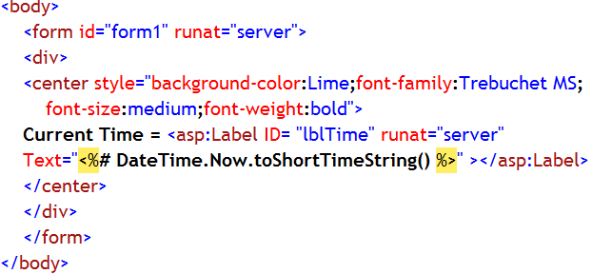
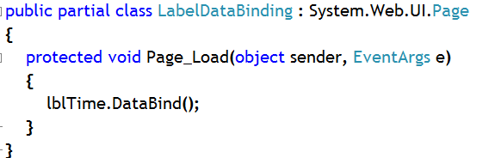
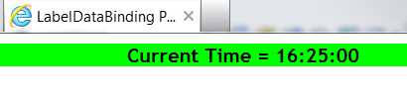
Example:
Binding Data To Label Control using DataBinding Syntax and DataBind() method
Calling DataBind() method on the lable to bind data during run time
The label is bound to current time using simple data binding syntax
Output

Slide 466
DataSource Controls
Generally we tend to bind any data bound control to an object (such as, DataSet table, Now propert of DateTime structure or an arraylist containing some data)using DataSource property of the data bound control
But, ASP.NET 2.0 introduces a new set of controls, known as DataSource controls
If configured, these controls gets bound to actual source of data (such, SQL Server table, xml file etc.) during design time itself
If any Data Bound Control is attached to these DataSource control, then data from DataSource control will be bound to data bound control and displayed during runtime
Data Source controls are added on the page but is not displayed when the page is viewed in browser

Slide 467
Different DataSource Controls
SqlDataSource: Gets the data from SQL server table and supplies to any data bound control
AccessDataSource: Gets the data from MS-Access table and supplies to any data bound control
ObjectDataSource: Gets the data from a business object and supplies to any data bound control
SiteMapDataSource:Gets the data from a sitemap file and supplies to any data bound control. Generally used by hierarchical data bound control
LinqDataSource: Gets the data from LINQ data source and supplies to any data bound control
XmlDataSource: Gets the data from an XML file and supplies to any data bound control

Slide 468
Binding to DataSource Control
Use DataSourceID property of data bound control to bind to a Datasource control
Example:
Difference with binding to an object:
gridView1.DataSourceID=“sqlDataSource1”;
gridView1.DataBind();
Passing the object to the DataSource property
gridView1.DataSource=ds.Table[“tbl_Category”];
gridView1.DataBind();
gridView1.DataSourceID=“sqlDataSource1”;
gridView1.DataBind();
Passing a string value, the ID of the SqlDataSource control, to the DataSourceID property

Slide 469
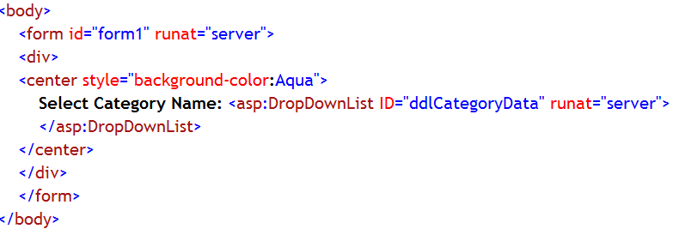
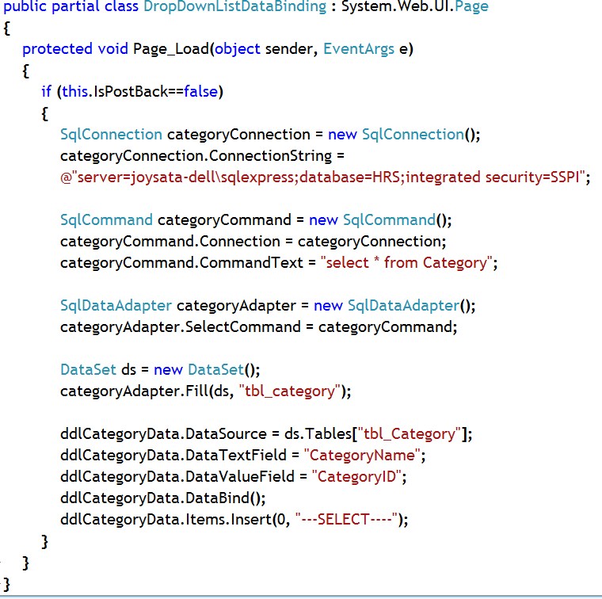
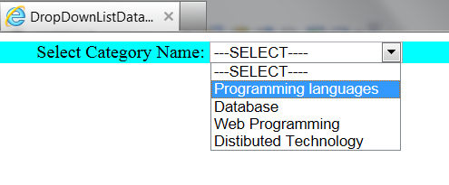
Example:
Binding Data To DropDownListBoxControl using Data Source property and DataBind() method
The DropDownListBox is bound to Category Table data in DataSet
Notes:
Note:
Use DataTextField property to display on one column value in the DropDownListBox
Use DataValueField property to keep another column value as hidden but linked with the corresponding text value

Slide 470
Repeater Control
A Repeater is a data-bound list control.
By repeating a specified template for each item displayed in the list, it provides custom layout.
Repeater control does not have built-in layout or styles.
You have to explicitly declare all HTML layout, formatting, and style tags within the control's templates.
Repeater control can be used to split HTML tags across the templates.
There is no built-in selection or editing support.
At a minimum, a Repeater must define an Item Template.
AlternatingItemTemplate, SeparatorTemplate, HeaderTemplate, FooterTemplate are optional templates that can be used to customize the appearance of the Repeater control.
Notes:
Note:
Use table tag (<table>) in the HeaderTemplate, single table row tag (<tr>) in the ItemTemplate, and end table tag (</table>) in the FooterTemplate to create a table using templates
To process control events that are raised from the templates to the control, use the ItemCommand event

Slide 471
Repeater Control Templates
TemplateName | Description
ItemTemplate | Defines the content and layout of the items that belong to the list.
AlternatingItemTemplate | Defines the content and layout of the alternating items, if this is not defined then the ItemTemplate is used.
SeparatorTemplate | Sets the separator between the items.
HeaderTemplate | Sets the layout and content for the header.
FooterTemplate | Sets the layout and content for the footer of the list.

Slide 472
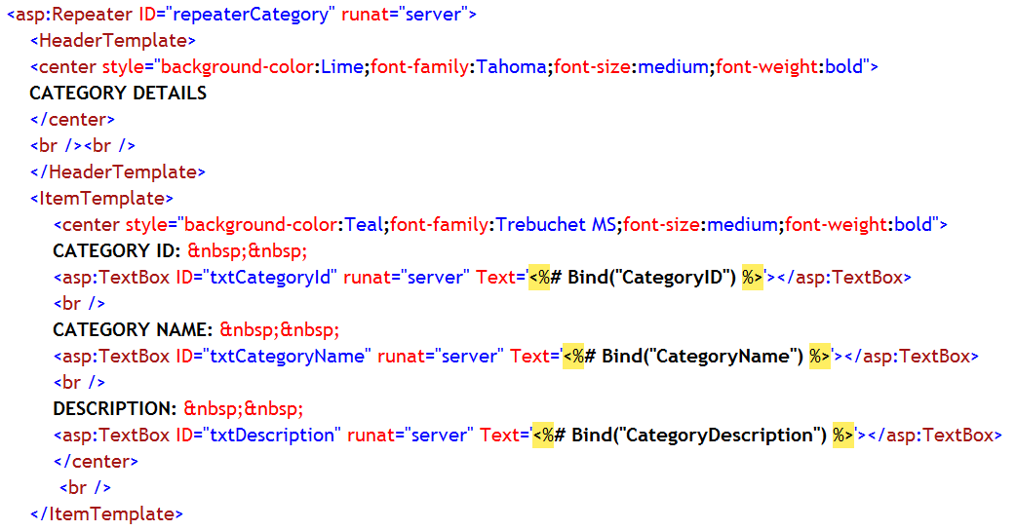

Example:
Header Template
Item Template
Binding each and every control to particular column of a data source
Alternating Item Template
Footer Template
Notes:
Note:
In this example the data is retrieved from Category table present in SQL Server database in this page (See the next slide)
Repeater control is bound to the data source using DataSource property
Using ItemTemplate and AlternatingItemTemplate different item are being displayed
Each and every text box is being bound to a particular column of data source (dataset) table.

Slide 473



Example:
Repeater is bound to the DataSet object and DataBind() method is called on Repeater

Slide 474
GridView
GridView is used to display the values of a data source in a table where each row represents a record and each column represents a field
It also allows selecting, sorting, and editing values of these items
It is a successor to the DataGrid control
It displays all the records on a single page or few records on the page at a time, depending on the paging feature
Namespace:
System.Web.UI.WebControls
Assembly:
System.Web.DLL

Slide 475
GridView Features
The GridView control supports the following built-in features:
Binding to data source controls like SqlDataSource
Sorting capabilities
Updating and deleting capabilities
Paging capabilities
Row selection capabilities
Customizable appearance through themes and styles
Multiple data fields for the hyperlink columns
Notes:
Notes:
Paging:
The AllowPaging property when set to true, enables users to page through records one at a time
You can programmatically access the GridView object model to dynamically set properties, handle events, and so on

Slide 476

Auto Formatting GridView
Smart Tag
Click the Smart Tag to get AddFormat dialog box and then choose desired format
Select a Formatting Style

Slide 477




Example:
Binding data source to GridView control
GridView Control
Notes:
Notes:
The above example shows how connection is made with the database, the way data is accessed and then displayed in customizable format using the GridView.
In the page load, connection with database has been made through the SqlConnection class object.
Then Command String is created which is the SQL query
Connection is opened
Then instantiate the dataset and SqlDataAdapter classes are created.
Fill method of the SqlDataAdapter has been used to fill up the DataSet
Then use the DataSource and DataBind properties of GridView to bind data to GridView\

Slide 478
Can you answer these questions?
What is the difference between DataSource and DatasourceID property?
What are different types of data binding?
When Data binding syntax is used?
What is the purpose of ValidationExpression property of RegularExpressionValidator control?
Which event is needed to handle for Customvalidator control if you want to write server side validation code?
What is the difference between Content page and normal web page?
What is Theme?
What is the difference between User Control and Master Page?
What is site map?
Name different site navigation controls

Slide 479
State Management
It is a process by which we can maintain application and session related information when multiple users request for the same page or different Web pages of an ASP.Net application. It is needed when the same user logs on to a Web page for multiple times. Also it maintain page-level information during the round trip of a web form page
Two type of State managements options:-
Client-side state management options
Server-side state management Options

Slide 480
Client-side state management
View state property
Hidden fields
Cookies
QueryString

Slide 481
Server-side state management
Application state
Session state
Database support

Slide 482
Cookies
It is a text file maintain on client machine by the server for state management.
It has entries with key field and its value
Cookie file entries are stored from the web page and its entries read where read wherever it is required to pass value
Disadvantage:-
It is insecure as it is maintained on client machine
It occupies space for entries
If cookies are disabled on client machine then this method will fail
It has limitation on size of max 4096 bytes of data transfer

Slide 483
View State
It enables you to retain page and control specific values between round trips. It is implemented with hidden field called _VIEWSTATE.
Disadvantage:-
since it carries the page data along with it so storing more data in this field may cause page to be slower.
It can be tampered as information stored in it can be seen from view source. So it is insecure

Slide 484
Session State (Server side state management)
In ASP.Net, session state is used to store session-specific information for a Web site.
The scope of session is limited to the current browser session.
If different users are accessing a Web application, each will have different session state. If user exits from application, the session is destroyed
Session_OnStart and Session_OnEnd events are handled using code
Automatically releases session data if a browser does not access an application within a specified timeout.

Slide 485
Session contd…
Syntax=>
for creating session variable
Session(“Variable_name”)=value
e.g. Session(“counter”)=1
To access or display
Response.write(Session(“variable_name”)
e.g.
Response.write(Session(“counter”))

Slide 486
Session contd…
Advantages:-
Session state is event-driven. Therefore, you can use session events to perform conditional execution of user-defined tasks, like redirecting a user to the home page of web site
Data in session state variables can survive even Web server restarts without losing session data because data is stored in another process space
Disadvantages:-
Session state variables are stored in memory until they are either removed or replaced which degrade web server performance

Slide 487
Application State (Server side state management)
This state means of storing global application-specific information.
The information in the application state is stored in a key-value pair and is used to maintained data consistency between server round trips and between pages
You can add simple variables like string, integer and complex objects like DataSet also to application state

Slide 488
Application state contd…
Syntax=>
To attach object to Application
Application (“Variable_name”)=value
e.g.
Dim ds as New DataSet()
Application (“DataSet”)=ds
To access object from application
ds=Application (“DataSet”)

Slide 489
Application contd…
Advantages:-
Storing information in application state involves maintaining only single copy of the information because application state is accessible to all the pages in an application
Disadvantages:-
The global data stored in an application state is lost when the web server process containing the application state fails due to server crash, upgrade, or shutdown
Application state requires memory and can affect the performance of the server.

Slide 490
Tracing and Debugging an Application
Tracing is a process of finding out logical errors that occur in the application with the help of tracing the execution path of application
ASP.Net supports two levels of tracing:
Page-level tracing
Application-level tracing

Slide 491
Page level tracing
It allows you to write debugging messages directly to the Web form
You can use Trace.Write() and Trace.Warn() method to display the messages within the Web page while tracing an application

Slide 492
Application level tracing
It allows you to trace the entire application. When you enable trace feature of an application, the trace feature is enabled for all pages of the application unless you have explicitly disabled the trace feature for a specific page
Application level tracing can be enabled by modifying the <trace> element present in <system.web> element in Web.config file.

Slide 493
WCF and Web Services
Introduction to SOA
Introduction to WCF

Slide 494
Programming Approaches
Procedural Programming Approach
-functions were everything
-Functionalities were encapsulated inside one or more functions , which call each pass some parameters and get some return value.
-One of the function was made as entry point.
Object Oriented Programming Approach
-Everything was treated as objects and classes
- They introduced four principals Data Abstraction ,Encapsulation,Inheritance and Polymorphism.

Slide 495
Drawbacks of Procedural Programming
How to reuse the same code?
Difficulties in code Management.

Slide 496
Drawbacks of Object Oriented Approach
How two or more applications will communicate each other, especially when they have been written using different languages or technologies.
For instance inventory module which is written using Java will not be able to call function inside classes of accounting module written in .NET

Slide 497

Service oriented Programming
In SOA functions and tasks are created as loosely connected independent services communicating via messages.
Service provider publishes the service via standard interfaces in a publicly accessible directory called Service Repository
Service consumer make a service request and in response gets the Service Response.

Slide 498
Characteristics of SOA
In SOA, Services should be independent of other services. Altering a service should not affect calling service.
Services should be self-contained.
Services should be able to define themselves.
Services should be published into a location (directory) where anyone can search for it.
Services should be able to communicate with each other asynchronously.
Services should support reliable messaging.
Services should support secure communication.

Slide 499
Key components of SOA
Service contains
Contract
message type definition, constraint,
description (comment)
Interface
set of operations
Implementation
Logic and data
Advertising and Discovery
Specification of associated data model

Slide 500
Examples of a Service
Creating a Purchase Order
Requesting and reserving a room in a
Hotel
Applying for a loan by filling out a loan
request form
Search books/music based on keywords

Slide 501
Potential Benefits of SOA
Reusability
Efficient Development Process
Independence from technology
Evolutionary Approach
Cost Savings

Slide 502

Why SOA

Slide 503
Why SOA?
Interoperation issues
-Heterogeneous network protocols
-Heterogeneous hardware platforms
-Heterogeneous operating systems
-Heterogeneous application formats
Enhancement of Business Capabilities
-no problem on Interoperability

Slide 504

SOA Design

Slide 505
SOA Design Contd
1. Standardized Service Contract Services adhere to a service-description. 2. Loose Coupling Services minimize dependencies on each other.
3. Service Abstraction Services hide the logic they encapsulate from the outside world.
4. Service Reusability Logic is divided into services with the intent of maximizing reuse.
5.Service Autonomy Services should have control over the logic they encapsulate.
6. Service Statelessness Ideally, services should be stateless.
7. Service Discoverability Services can be discovered (usually in a service registry).
8. Service Composability Services break big problems into little problems.
9. Service Interoperability Services should use standards that allow diverse subscribers to use the service. This is considered so obvious these days that it is often dropped as a principle.

Slide 506

WCF
WCF Architecture

Slide 507
Explaining WCF Architecture
Contracts
Contracts layer are next to that of Application layer. Developers will directly use this contract to develop the service.
Service Contracts
Service contracts describe the operation that service can provide. Example, Service provided to know the temperature of the city based on the zip code
Data Contract
It describes the custom data type which is exposed to the client. This defines the data types, and is passed to and from service. Data types like int, string are identified by the client because it is already mention in XML schema
E.g., Employee data type. By using Data Contract, we can make client aware that we are using Employee data type

Slide 508
Message Contract
Default SOAP message format is provided by the WCF runtime for communication between Client and service. If it is not meeting your requirements, then we can create our own message format.
Policies and Binding
Specify conditions required to communicate with a service, e.g., security requirement to communicate with service, protocol and encoding used for binding.

Slide 509
Service Runtime
It contains the behaviors that occur during runtime of service.
Throttling Behavior- Controls how many messages are processed
Error Behavior - Specifies what occurs, when internal error occurs on the service
Metadata Behavior - Tells how and whether metadata is available to outside world
Instance Behavior - Specifies how many instances of the service have to be created while running
Transaction Behavior - Enables the rollback of transacted operations if a failure occurs
Dispatch Behavior - Controls how a message is processed by the WCF Infrastructure

Slide 510
Messaging
Messaging layer is composed of channels.
A channel is a component that processes a message in some way, for example, by authenticating a message.
A set of channels is also known as a channel stack.
Channels are the core abstraction for sending messages to and receiving messages from an Endpoint.

Slide 511
Channels
Transport Channels
Handle sending and receiving messages from network. Protocols like HTTP, TCP, name pipes and MSMQ.
Protocol Channels
Implement SOAP based protocol by processing and possibly modifying message. E.g. WS-Security and WS-Reliability.

Slide 512
Activation and Hosting
WCF service can be hosted by the following mechanisms:
IIS
Internet information Service provides number of advantages if a Service uses Http as protocol. It does not require Host code to activate the service, it automatically activates service code.
Windows Activation Service
(WAS) is the new process activation mechanism that ships with IIS 7.0. In addition to HTTP based communication, WCF can also use WAS to provide message-based activation over other protocols, such as TCP and named pipes.
Self-Hosting
WCF service can be self hosted as console application, WinForms or WPF application with graphical UI.
Windows Service
WCF can also be hosted as a Windows Service, so that it is under the control of the Service Control Manager (SCM).

Slide 513
Fault and Error handling
Use FaultException class to handle all Exceptions
Use [FaultContract] to process Errors
In App.Config enable error handling by setting
<serviceDebug includeExceptionDetailInFaults="true"/> which is by default false.

Slide 514
IIS Hosting
IIS Service Endpoints
When you host your services with any version of IIS you must provide at a minimum the following:
An addressable Web Site or Virtual Directory for your service endpoints.
A file with the extension .svc that will represent the ServiceHost instance.
A service type that is linked to the .svc file for activation.

Slide 515
WAS Hosting
WAS is a process activation service installed with IIS 7.0 that decouples the activation architecture from IIS in order to support non-HTTP protocols such as named pipes, TCP, and MSMQ.
The new architecture relies on protocol listeners, listener adapters, and protocol handlers to process requests.
Protocol Listeners: A protocol listener is responsible for receiving requests for a particular protocol. There is a protocol listener provided for HTTP, named pipes, TCP, and MSMQ. For HTTP, the HTTP listener is http.sys (same as in IIS 6.0). Listeners for other protocols are provided by their respective listener adapter service.
Listener Adapters: A listener adapter is responsible for bridging requests between WAS and the worker process for a particular protocol. There is a listener adapter for HTTP, named pipes, TCP, and MSMQ. WWW Service provides the HTTP listener adapter. IIS provides Windows services for each of the other protocols, supplying a protocol listener and listener adapter pair
Protocol Handlers: A protocol handler channels requests through the service model for a particular protocol. WCF provides managed protocol handlers for HTTP, named pipes, TCP, and MSMQ.

Slide 516
Windows Service Hosting
Create a Windows Service Application
Invoke WCF Service in Service_start()
Configure APP.config with appropriate bindings
Create Installer Classes
Install service using InstallUtil –I WindowService1.dll
Start the service
Test by executing the client application.

Slide 517
Different types of WCF bindings
Basic binding
This binding is provided by the BasicHttpBinding class. It is designed to expose a WCF service as an ASMX web service, so that old clients (which are still using ASMX web service) can consume new service. By default, it uses Http protocol for transport and encodes the message in UTF - 8 text for-mat. You can also use Https with this binding.
Web binding
This binding is provided by the WebHttpBinding class. It is designed to expose WCF services as Http requests by using HTTP-GET, HTTP-POST. It is used with REST based services which may give output as an XML or JSON format.
Web Service (WS) binding
This binding is provided by the WSHttpBinding class. It is like as Basic binding and uses Http or Https protocols for transport. But this is designed to offer various WS - * specifications such as WS – Reliable Messaging, WS - Transactions, WS - Security and so on which are not supported by Basic binding.
WS Dual binding
This binding is provided by the WsDualHttpBinding class. It is like as wsHttpBinding except it sup-ports bi-directional communication means both clients and services can send and receive messages.

Slide 518
Binding(contd)
TCP binding
This binding is provided by the NetTcpBinding class. It uses TCP protocol for communication be-tween two machines with in intranet (means same network). It encodes the message in binary format. This is faster and more reliable binding as compared to the Http protocol bindings. It is only used when communication is WCF - to – WCF means both client and service should have WCF.
IPC binding
This binding is provided by the NetNamedPipeBinding class. It uses named pipe for Communication between two services on the same machine. This is the most secure and fastest binding among all the bindings.
MSMQ binding
This binding is provided by the NetMsmqBinding class. It uses MSMQ for transport and offers sup-port to disconnected message queued. It provides solutions for disconnected scenarios in which service processes the message at a different time than the client send the messages.
Federated WS binding
This binding is provided by the WSFederationHttpBinding class. It is a specialized form of WS binding and provides support to federated security.
Peer Network binding
This binding is provided by the NetPeerTcpBinding class. It uses TCP protocol but uses peer net-working as transport. In this networking each machine (node) acts as a client and a server to the other nodes. This is used in the file sharing systems like torrent.
MSMQ Integration binding
This binding is provided by the MsmqIntegrationBinding class. This binding offers support to communicate with existing systems that communicate via MSMQ.

Slide 519


Slide 520
Introduction to Web Services

Slide 521
Agenda
Motivation
History
Web service model
Web service components
A walkthrough examples

Slide 522
Motivation
The ability to program the Web.
Example: Consider an Excel spreadsheet that summarizes your whole financial picture : stocks, bank accounts, loans, etc. If some of this information is available through XML Web services, Excel can update it and present the update information to the user.

Slide 523
Web Service definition
A simple definition:
“a Web Service is an application component accessible over open protocols”.

Slide 524
History
Web services evolved from previous technologies that served the same purpose such as RPC, ORPC (DCOM, CORBA and JAVA RMI).
Web Services were intended to solve three main problems:
Interoperability
Firewall traversal
Complexity

Slide 525
Interoperability
Earlier distributed systems suffered from interoperability issues because each vendor implemented its own on-wire format for distributed object messaging.
Development of DCOM apps strictly bound to Windows Operating system.
Development of RMI bound to Java programming language.

Slide 526
Firewall traversal
Collaboration across corporations was an issue because distributed systems such as CORBA and DCOM used non-standard ports.
Web Services use HTTP as a transport protocol and most of the firewalls allow access though port 80 (HTTP), leading to easier and dynamic collaboration.

Slide 527
Complexity
Web Services is a developer-friendly service system.
Most of the above-mentioned technologies such as RMI, COM, and CORBA involve a whole learning curve.
New technologies and languages have to be learnt to implement these services.

Slide 528
Web Service definition revisited
A more precise definition:
an application component that:
Communicates via open protocols (HTTP, SMTP, etc.)
Processes XML messages framed using SOAP
Describes its messages using XML Schema
Provides an endpoint description using WSDL
Can be discovered using UDDI

Slide 529
Web Services Components
XML – eXtensible Markup Language – A uniform data representation and exchange mechanism.
SOAP – Simple Object Access Protocol – A standard way for communication.
UDDI – Universal Description, Discovery and Integration specification – A mechanism to register and locate WS based application.
WSDL – Web Services Description Language – A standard meta language to described the services offered.

Slide 530
Example – A simple Web Service
A buyer (which might be a simple client) is ordering goods from a seller service.
The buyer finds the seller service by searching the UDDI directory.
The seller service is a Web Service whose interface is defined using Web Services Description Language (WSDL).
The buyer is invoking the order method on the seller service using Simple Object Access Protocol (SOAP) and the WSDL definition for the seller service.
The buyer knows what to expect in the SOAP reply message because this is defined in the WSDL definition for the seller service.

Slide 531
The Web Service Model
The Web Services architecture is based upon the interactions between three roles:
Service provider
Service registry
Service requestor
The interactions involve the:
Publish operations
Find operation
Bind operations.

Slide 532
The Web Service Model (cont)
The Web Services model follows the publish, find, and bind paradigm.
1. publish 2. find
3. bind/invoke
Web Service
Registry
Web Service
Provider
Web Service
Client

Slide 533
XML
XML stands for EXtensible Markup Language.
XML is a markup language much like HTML.
XML was designed to describe data.
XML tags are not predefined. You must define your own tags.
The prefect choice for enabling cross-platform data communication in Web Services.

Slide 534
XML vs HTML
An HTML example:
<html> <body> <h2>John Doe</h2> <p>2 Backroads Lane<br> New York<br> 045935435<br> john.doe@gmail.com<br> </p> </body> </html>

Slide 535
XML vs HTML
This will be displayed as:
HTML specifies how the document is to be displayed, and not what information is contained in the document.
Hard for machine to extract the embedded information. Relatively easy for human.
John Doe 2 Backroads Lane New York 045935435 John.doe@gmail.com

Slide 536
XML vs HTML
Now look at the following:
In this case:
The information contained is being marked, but not for displaying.
Readable by both human and machines.
<?xml version=1.0?> <contact> <name>John Doe</name> <address>2 Backroads Lane</address> <country>New York</country> <phone>045935435</phone> <email>john.doe@gmail.com</email> </contact>

Slide 537
SOAP
SOAP originally stood for "Simple Object Access Protocol" .
Web Services expose useful functionality to Web users through a standard Web protocol called SOAP.
Soap is an XML vocabulary standard to enable programs on separate computers to interact across any network. SOAP is a simple markup language for describing messages between applications.
Soap uses mainly HTTP as a transport protocol. That is, HTTP message contains a SOAP message as its payload section.

Slide 538
SOAP Characteristics
SOAP has three major characteristics:
Extensibility – security and WS-routing are among the extensions under development.
Neutrality - SOAP can be used over any transport protocol such as HTTP, SMTP or even TCP.
Independent - SOAP allows for any programming model .

Slide 539
SOAP Building Blocks
A SOAP message is an ordinary XML document containing the following elements:
A required Envelope element that identifies the XML document as a SOAP message.
An optional Header element that contains header information.
A required Body element that contains call and response information.
An optional Fault element that provides information about errors that occurred while processing the message.

Slide 540
SOAP Request
POST /InStock HTTP/1.1 Host: www.stock.org Content-Type: application/soap+xml; charset=utf-8 Content-Length: 150 <?xml version="1.0"?> <soap:Envelope xmlns:soap="http://www.w3.org/2001/12/soap-envelope" soap:encodingStyle=http://www.w3.org/2001/12/soap-encoding”> <soap:Body xmlns:m="http://www.stock.org/stock"> <m:GetStockPrice> <m:StockName>IBM</m:StockName> </m:GetStockPrice> </soap:Body> </soap:Envelope>

Slide 541
SOAP Response
HTTP/1.1 200 OK Content-Type: application/soap; charset=utf-8 Content-Length: 126 <?xml version="1.0"?> <soap:Envelope xmlns:soap="http://www.w3.org/2001/12/soap-envelope" soap:encodingStyle="http://www.w3.org/2001/12/soap-encoding"> <soap:Body xmlns:m="http://www.stock.org/stock"> <m:GetStockPriceResponse> <m:Price>34.5</m:Price> </m:GetStockPriceResponse> </soap:Body> </soap:Envelope>

Slide 542
SOAP Security
SOAP uses HTTP as a transport protocol and hence can use HTTP security mainly HTTP over SSL.
But, since SOAP can run over a number of application protocols (such as SMTP) security had to be considered.
The WS-Security specification defines a complete encryption system.

Slide 543
WSDL
WSDL stands for Web Services Description Language.
WSDL is an XML vocabulary for describing Web services. It allows developers to describe Web Services and their capabilities, in a standard manner.
WSDL specifies what a request message must contain and what the response message will look like in unambiguous notation. In other words, it is a contract between the XML Web service and the client who wishes to use this service.
In addition to describing message contents, WSDL defines where the service is available and what communications protocol is used to talk to the service.

Slide 544
The WSDL Document Structure
A WSDL document is just a simple XML document.
It defines a web service using these major elements:
port type - The operations performed by the web service.
message - The messages used by the web service.
types - The data types used by the web service.
binding - The communication protocols used by the web service.

Slide 545
WSDL Document
<message name="GetStockPriceRequest"> <part name="stock" type="xs:string"/> </message> <message name="GetStockPriceResponse"> <part name="value" type="xs:string"/> </message> <portType name=“StocksRates"> <operation name=“GetStockPrice"> <input message=“GetStockPriceRequest"/> <output message=“GetStockPriceResponse"/> </operation> </portType>

Slide 546
UDDI
UDDI stands for Universal Description, Discovery and Integration.
UDDI is a directory for storing information about web services , like yellow pages.
UDDI is a directory of web service interfaces described by WSDL.

Slide 547
Examples
Using a Web Service
Creating a new Web Service

Slide 548
Step by Step – using a web service
Inside Visual Studio .NET Choose File > New > Project.
Choose Visual C# Projects (or Visual Basic Projects if you prefer this language).
3. Choose ASP.NET Web Application as your template

Slide 549
Step by Step – using a web service
Inside the Location text box enter the name of your project after the prefix :
http://localhost/YourProjectName
Press OK.
This makes The Internet Information Services installed on your computer create a new directory on the default path: C:\Inetpub\wwwroot\FirstExample

Slide 550
Step by Step – using a web service
You can open IIS by typing compmgmt.msc \s in the run command and then choosing Services And Application > Internet Information Services.
Inside this node you can choose Web Sites node and then Default Web Site to see all the web sites on your computer.

Slide 551
Step by Step – using a web service

Slide 552
Step by Step – using a web service
In the new project you opened in VS.NET Move to the Solution Explorer.
Right Click on the References folder and Choose Add Web References.
This Opens the Add Web Reference Dialog Box.

Slide 553
Step by Step – using a web service
Type the Web Service URL and Press Go.
It takes a couple of seconds to find the Web services and finally all it’s methods appear in the list box.
The Web Reference name is shown in the Dialog Box.
Press Add Reference to complete the process.

Slide 554
Step by Step – using a web service

Slide 555
Step by Step – using a web service
Add a new Web Form.

Slide 556
Step by Step – using a web service
Add the following Controls to the Web Form

Slide 557
Step by Step – using a web service
Double Click on the button and insert this code to it’s OnClick event handler.

Slide 558
Step by Step – using a web service
Set the Web Form as the Start Page.
Build and Run the Program.
Try to use the Web Application.

Slide 559
Step By Step – Creating a Web Service
In this Step I will create a new Web Service and write a Simple Program that uses it.
The program will perform various operations on an array.
The client program will be a simple dialog box that activates those opeartions.

Slide 560

Step By Step – Creating a Web Service
Create a new Visual C# project with the name RemoteArray. The following screen appears.

Slide 561
Step By Step – Creating a Web Service
To see the code Press on the following hyperlink.

Slide 562
Step By Step – Creating a Web Service
Right Click on the References folder and choose add Reference.
Insert the System.Windows.Forms.dll option in to this folder.

Slide 563
Step By Step – Creating a Web Service

Slide 564
Step By Step – Creating a Web Service

Slide 565
Step By Step – Creating a Web Service
Insert the following code to the .asmx file you’ve created.

Slide 566
Step By Step – Creating a Web Service

Slide 567
Step By Step – Creating a Web Service

Slide 568

Step By Step – Creating a Web Service
Press Ctrl +F5 to Run the Web service.

Slide 569
Step By Step – Using Remote Array
Add a new project to RemoteArray Solution

Slide 570
Step By Step – Using Remote Array
Choose Windows Application from the templates.
Add a web reference for the Remote Array Web Service.
Remember that it’s inside an asmx file.

Slide 571
Step By Step – Using Remote Array

Slide 572
Step By Step – Using Remote Array
Add the following elements to the Form

Slide 573
Step By Step – Using Remote Array
Create a private RemoteArray object and a private int array object to the Form.
Insert this code after the Initialize component part.

Slide 574
Step By Step – Using Remote Array
Insert the following code to controls handler

Slide 575
Step By Step – Using Remote Array
Set the Windows Application project as the Startup

Slide 576
Step By Step – Using Remote Array
Compile and run the application.
This is an example that an XML Web application can be used over Windows and not only with ASP.NET

